Slide 1
Two methods to observe tutorial
Standard Method
This method allows presentation to be resized to user preference.
Slide Show Method (Example below)
Presentation fills entire screen
Click on Slide Show tab at top of screen
Click icon <From Beginning>
Note: Either method; to advance click the progression arrow in the bottom right corner of each slide or press the down-arrow key.

Slide 2
Welcome to
BSIP 101
Transaction Procedures
New Bus Prep Select & Print
Instructor: Stephen Wright DPI Technical Consultant

Slide 3
Purpose: Select and print DP07 New Bus Preparation work orders

Slide 4
One transaction is required to complete this procedure:
IW38
Let’s get started -

Slide 5
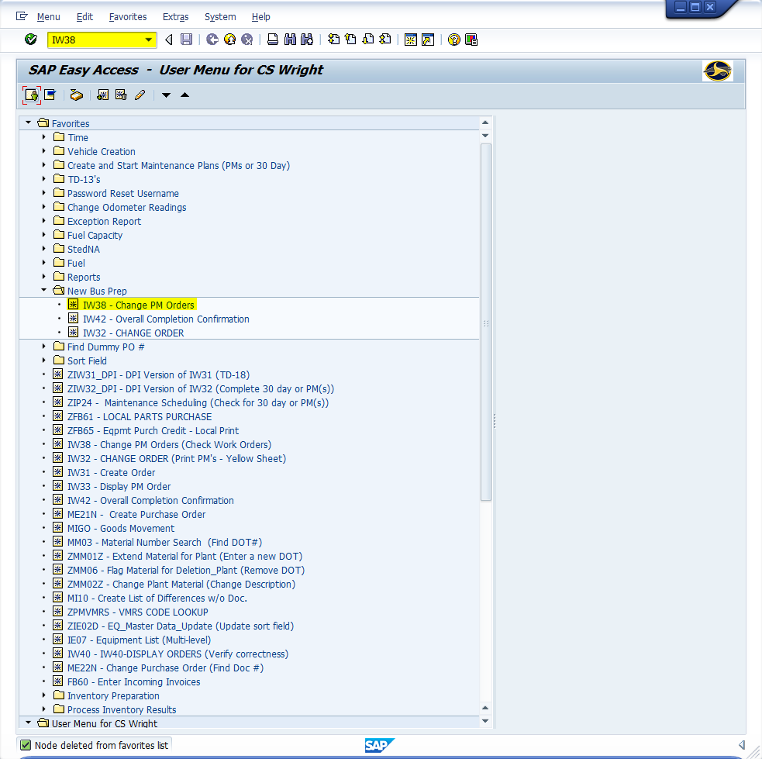
Window:
SAP R/3 Easy Access
Input IW38; or
Favorites menu, <Select> transaction IW38 – Change PM Orders

Slide 6
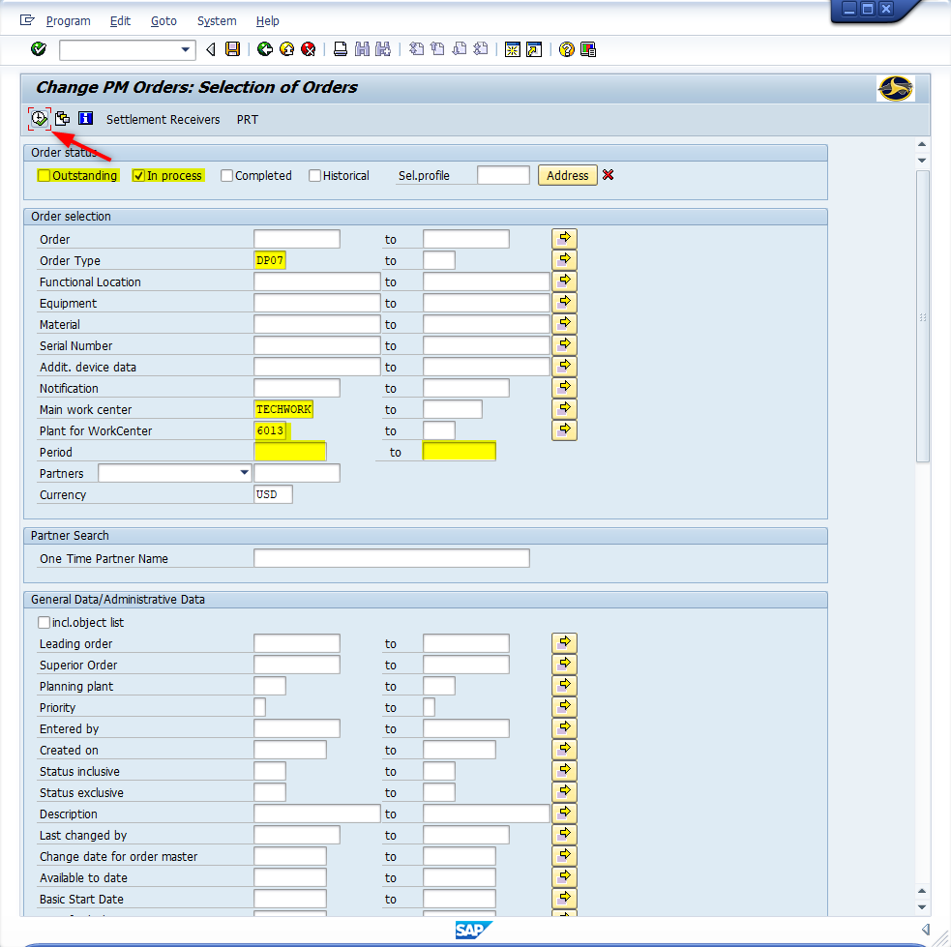
Window opens:
Change PM Orders: Selection of Orders
Outstanding Field - <Uncheck>
In process Field - <Check>
Order Type Field – Input DP07
Main work center Field – Input Techwork
Plant Field – Input four-digit code (i.e., Alamance = 6001)
Period Field(s) – Remove dates
<Click> Execute icon

Slide 7
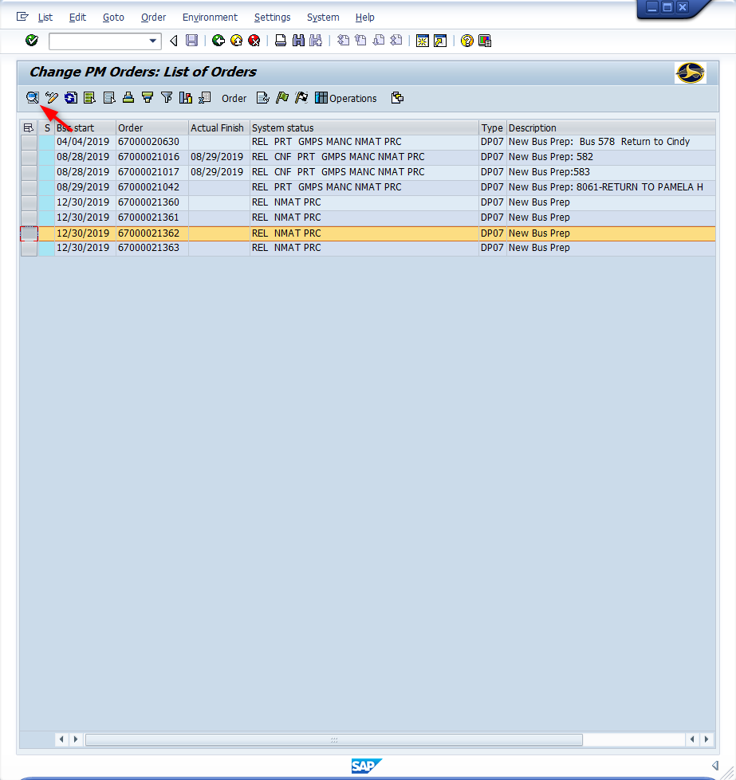
Window opens:
Change PM Orders: List of Orders
<Click> Select Block icon next to the New Bus Prep work order. If multiple lines are required to be selected hold down the <CTRL> key while clicking the additional lines.
<Click> Details icon
Tip: If there is only one New Bus Prep work order to process this screen will not display. The software will automatically open to the work order.

Slide 8
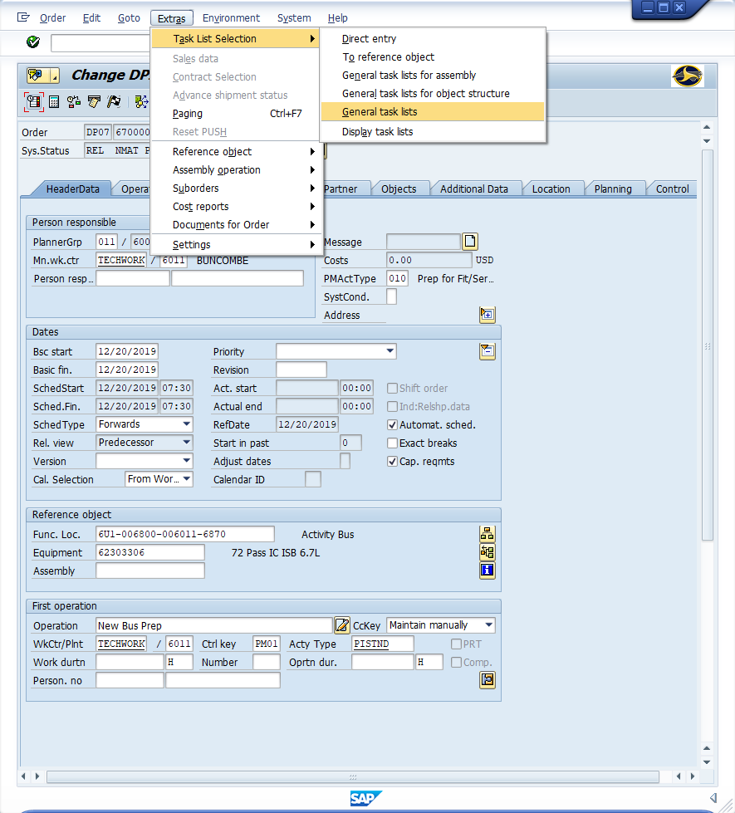
Window opens:
Change DPI New Vehicle Prep {Work Order}: Central Header
<Click> Extras (Top Menu)
<Click> Task List Selection
<Double-Click> General task lists

Slide 9
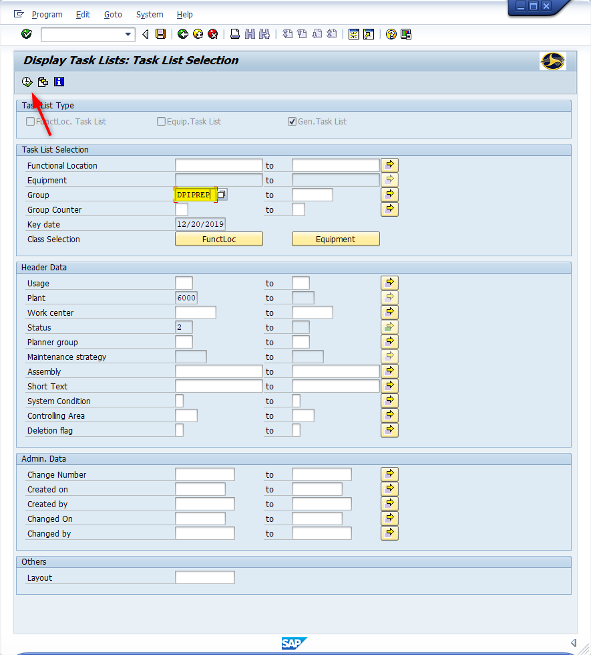
Window opens:
Display Task Lists: Task List Selection
Group Field – Input DPIPREP
<Click> Execute icon

Slide 10
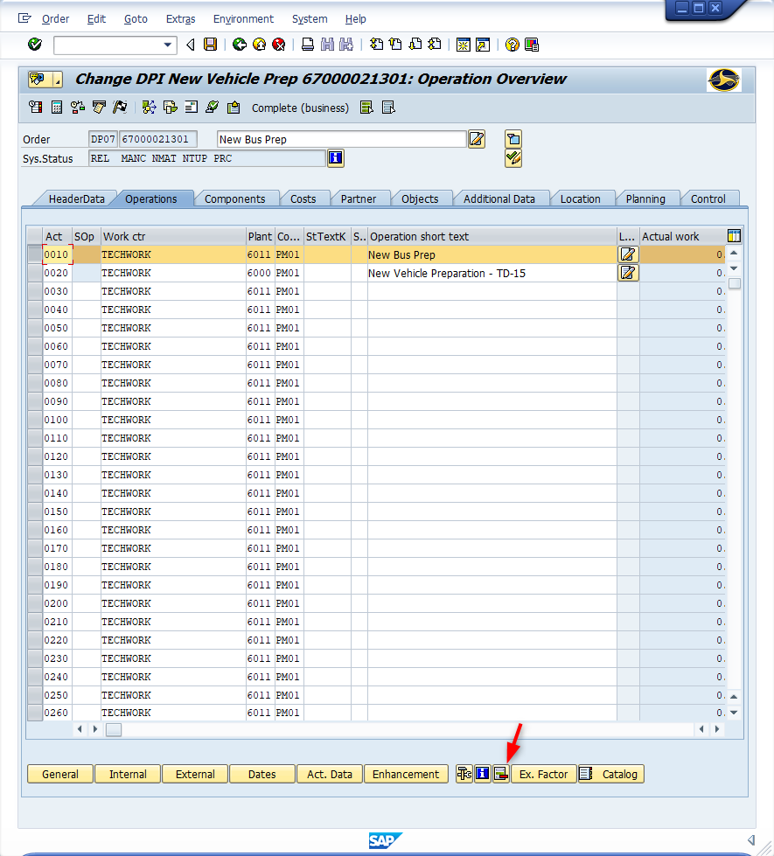
Window opens:
Change DPI New Vehicle Prep {Work Order}: Operation Overview
<Click> Operations Tab
<Click> Select Block icon (To the left of transaction 0010)
<Click> Delete row icon
Window opens:
Confirmation Prompt
<Click> Yes button

Slide 11
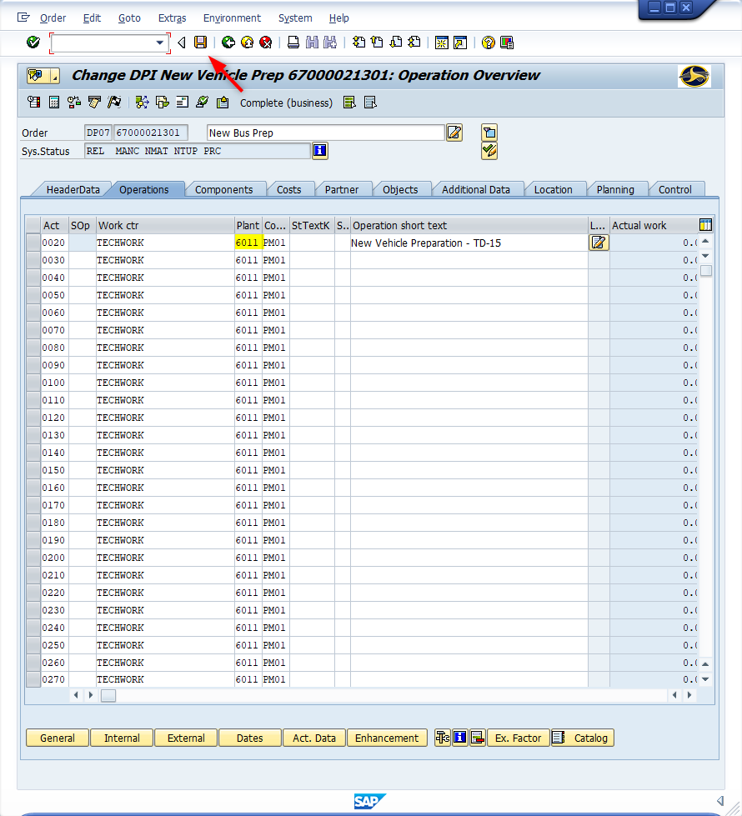
Window opens:
Change DPI New Vehicle Prep {Work Order}: Operation Overview
Transaction 0020 Plant Field (And any others) – Replace 6000 with the correct four-digit plant code.
<Click> Save icon

Slide 12
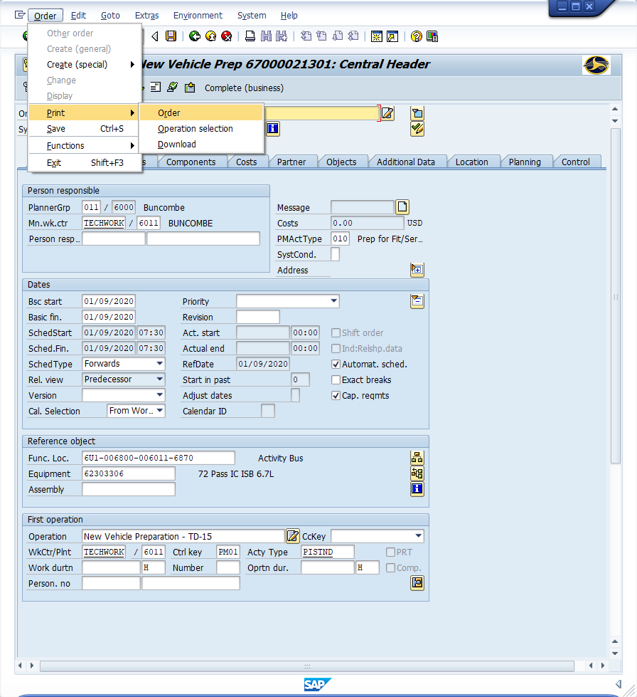
Window opens:
Change DPI New Vehicle Prep {Work Order}: Central Header
<Click> Order (Top Menu)
<Click> Print
<Click> Order

Slide 13
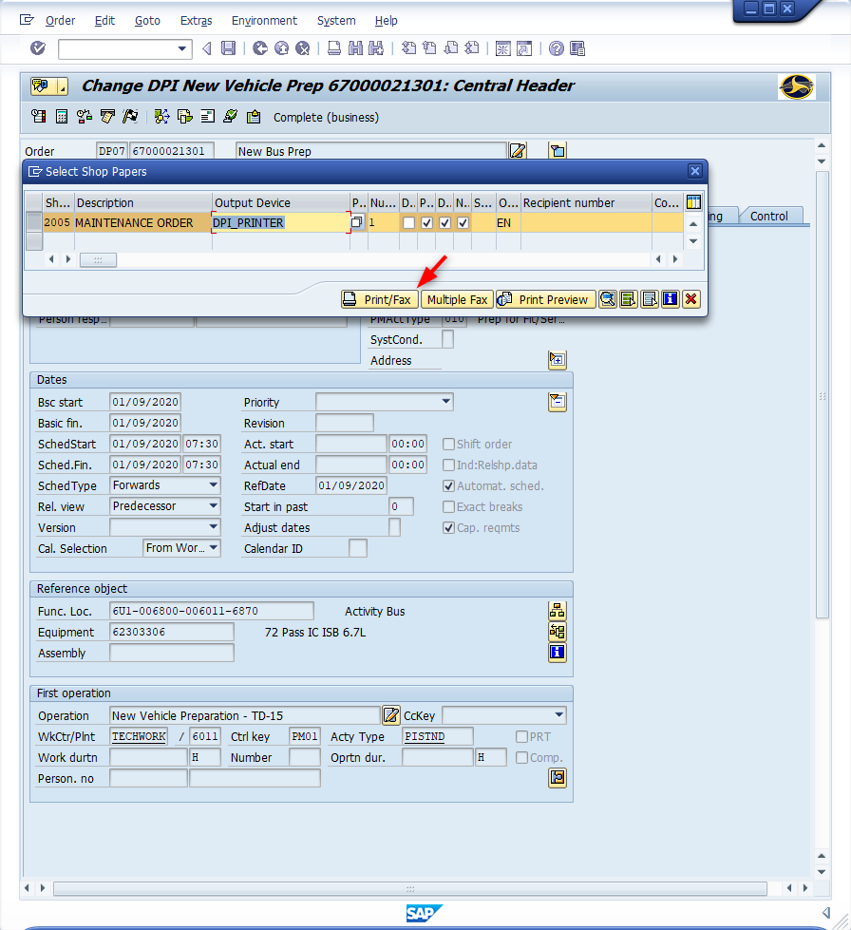
Window opens:
Change DPI New Vehicle Prep {Work Order}: Central Header
Select Shop Papers
<Click> Print/Fax button
<ESC> Twice

Slide 14
Questions
Email: Stephen.Wright@dpi.nc.gov

Slide 15
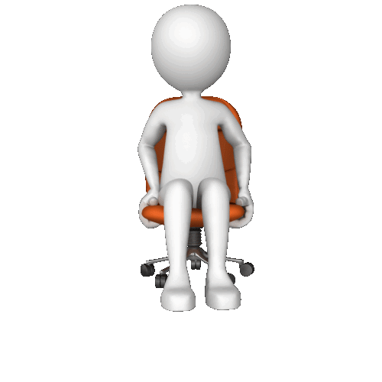
Thank You!
Stephen Wright
DPI Technical Consultant

