Slide 1
Two methods to observe tutorial
Standard Method
This method allows presentation to be resized to user preference.
Slide Show Method (Example below)
Presentation fills entire screen
Click on Slide Show tab at top of screen
Click icon <From Beginning>
Note: Either method; to advance click the progression arrow in the bottom right corner of each slide or press the down-arrow key.

Slide 2
Welcome to
BSIP 101
Transaction Procedures
Reopen a Teco’d
Work Order
Instructor: Stephen Wright DPI Technical Consultant

Slide 3
Purpose: Reopen a work order that was accidently or pre-maturely Teco’d

Slide 4
One transaction is required to complete this procedure:
IW32
Let’s get started -

Slide 5
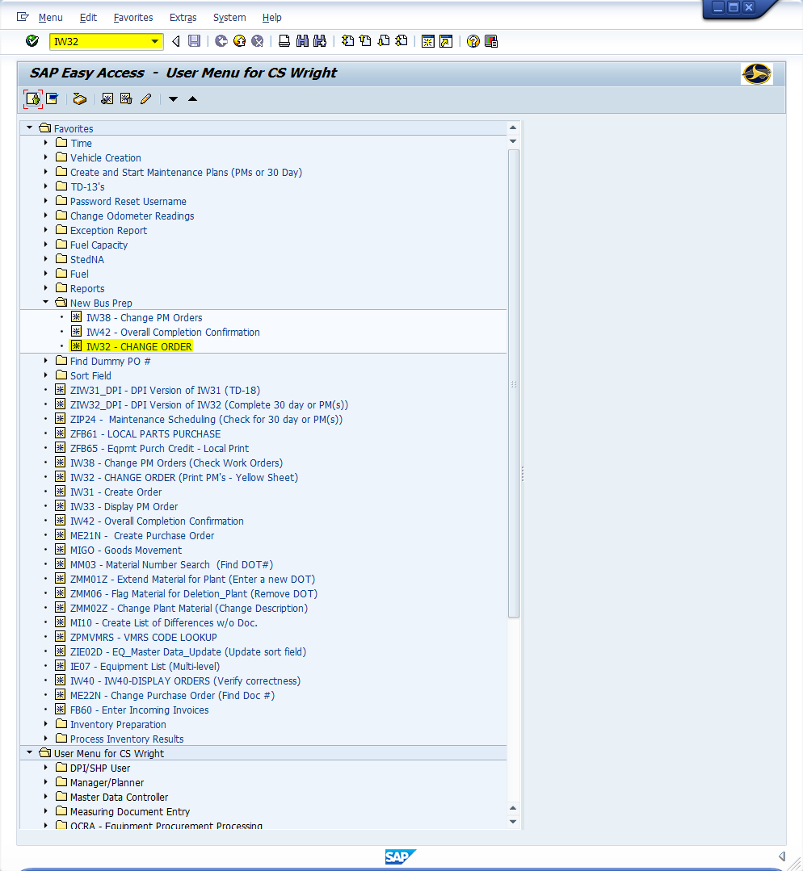
Window:
SAP R/3 Easy Access
Input IW32; or
Favorites menu, <Select> transaction IW32 – Change Order

Slide 6
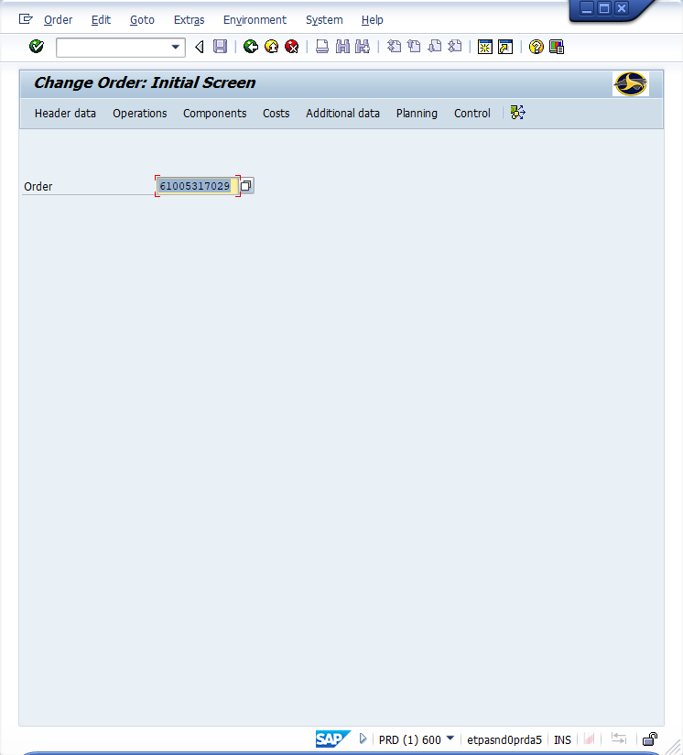
Window:
Change Order Initial Screen
Order Field – Input work order number
<Click> Continue icon

Slide 7
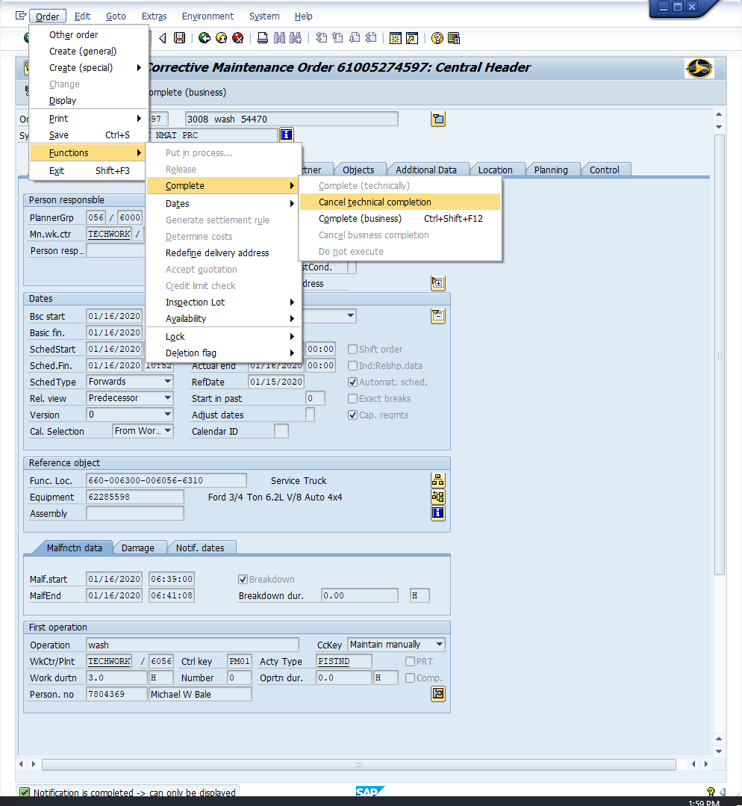
Window opens:
Change DPI Corrective Maintenance {Work Order}: Central Header
<Click> Order (Top Menu)
<Click> Functions
<Click> Complete
<Click> Cancel technical Completion

Slide 8
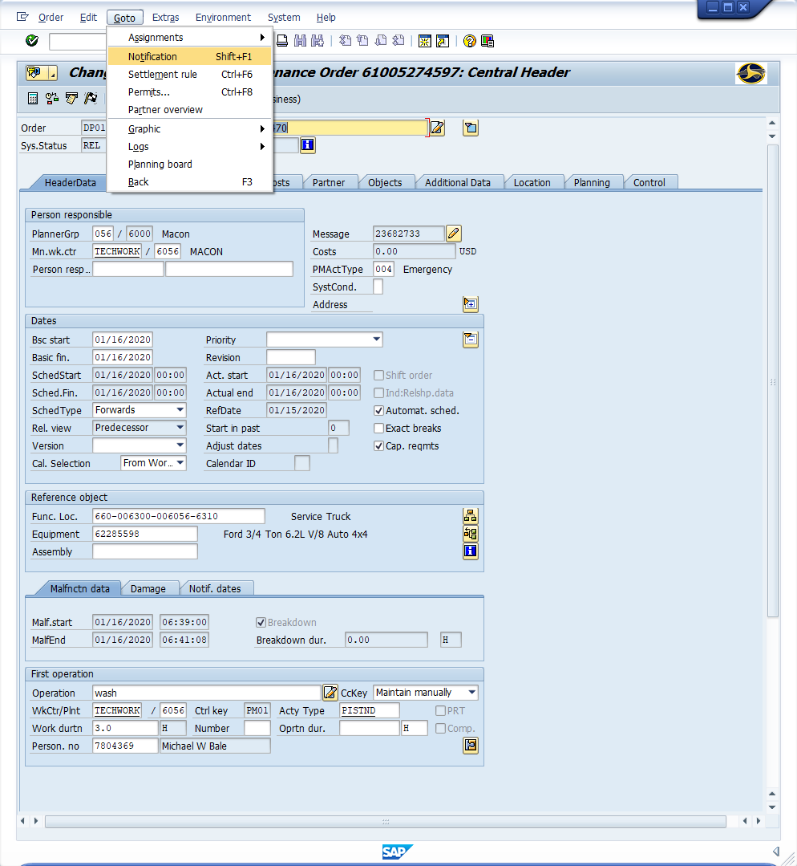
Window opens:
Change DPI Corrective Maintenance {Work Order}: Central Header
<Click> Goto (Top Menu)
<Click> Notification

Slide 9
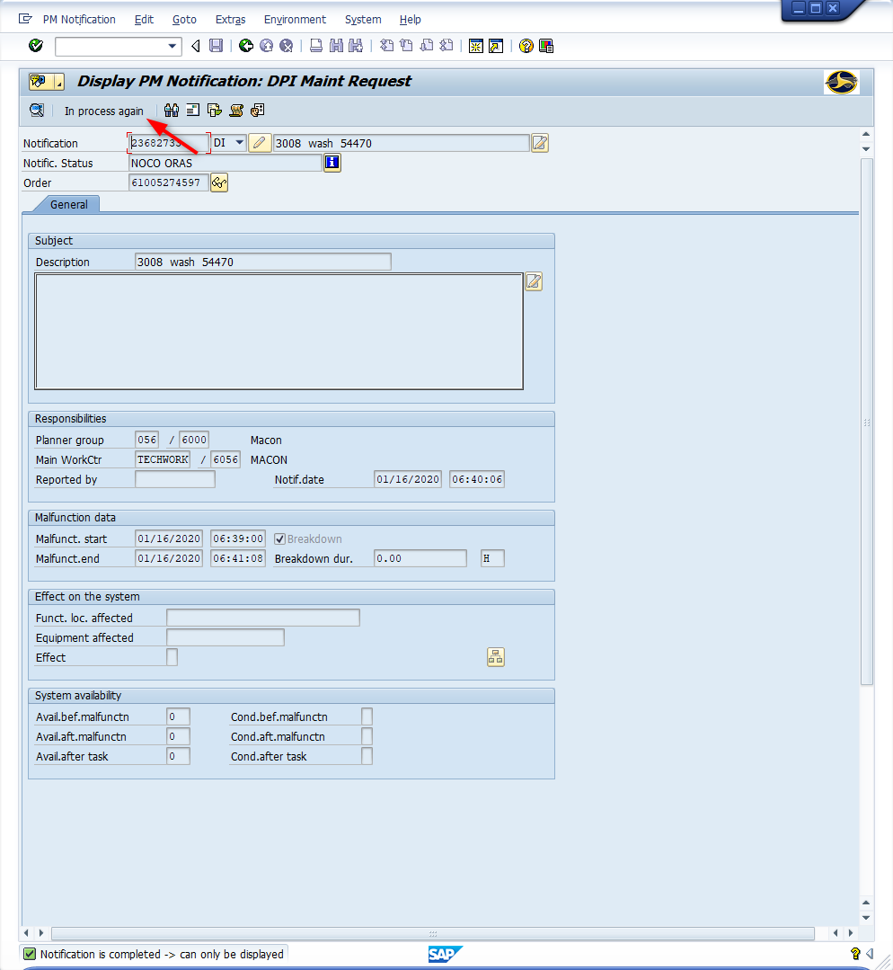
Window opens:
Display PM Notification: DPI Maint Request
<Click> In process again button
<Click> Back icon

Slide 10
Window opens:
Change DPI Corrective Maintenance {Work Order}: Central Header
<Click> Save icon
Tip: Use transaction ZIW32_DPI to make necessary changes.
Return to transaction IW32 to Teco workorder.
Order (Top Menu)
Functions
Complete
Complete (Technically))

Slide 11
Questions
Email: Stephen.Wright@dpi.nc.gov

Slide 12
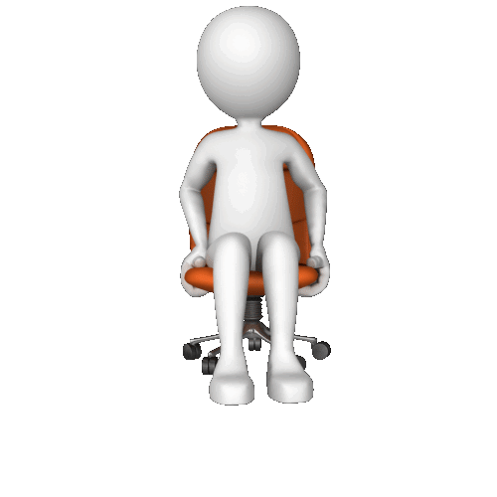
Thank You!
Stephen Wright
DPI Technical Consultant

