Slide 1
Two methods to observe tutorial
Standard Method
This method allows presentation to be resized to user preference.
Slide Show Method (Example below)
Presentation fills entire screen
Click on Slide Show tab at top of screen
Click icon <From Beginning>
Note: Either method; to advance click the progression arrow in the bottom right corner of each slide or press the down-arrow key.

Slide 2
Welcome to
BSIP 101
Transaction Procedures
VMRS
Non-Stock Material
(For Material Field)
Instructor: Stephen Wright DPI Technical Consultant

Slide 3
Purpose: Populate the VMRS field of the ZFB61/ZFB65 table

Slide 4
Two transactions are required to complete this procedure:
ZFB61
ZFB65
Let’s get started -

Slide 5
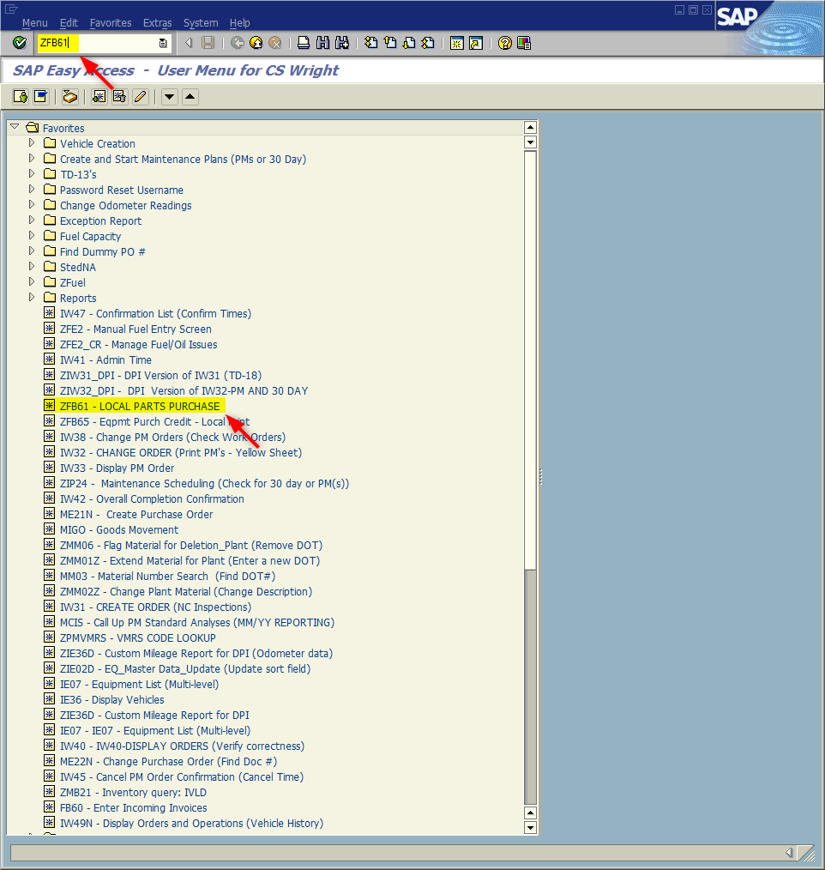
Window:
SAP R/3 Easy Access
Depending upon Transaction required open either ZFB61 or ZFB65
ZFB61 (Example displayed)
Input ZFB61; or
Favorites menu, <Select> transaction ZFB61 – Local Parts Purchase
OR
ZFB65
Input ZFB65; or
Favorites menu, <Select> transaction ZFB65 – Eqpmt Purch Credit

Slide 6
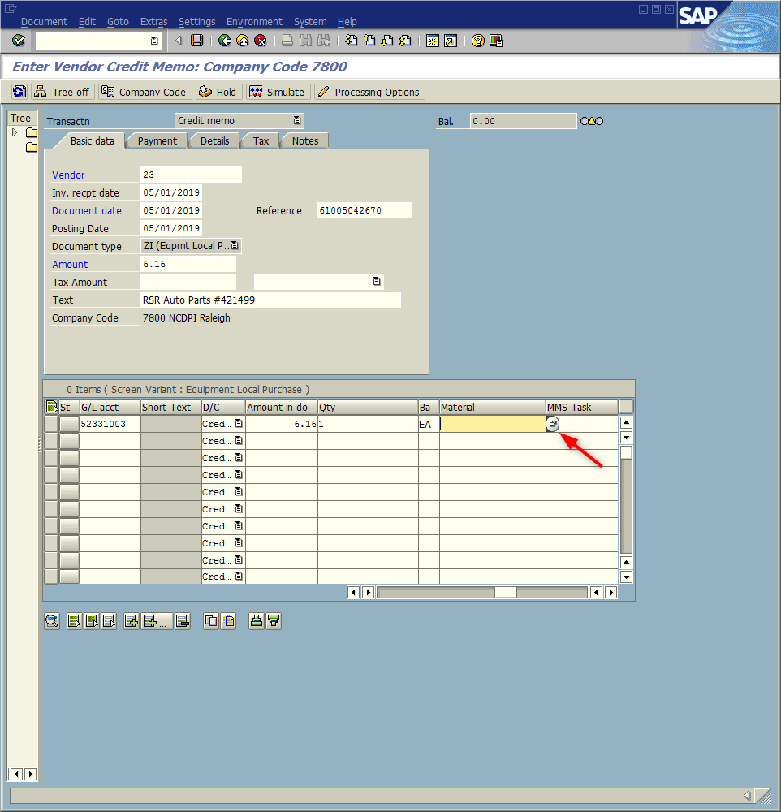
Window opens:
Enter Vendor Invoice: Company Code 7800
OR
Enter Credit Memo: Company Code 7800
Note: All steps of Transactions ZFB61/ZFB65 must be complete before performing this part of the transaction.
<Click> Material field; this will activate the field.
<Click> Match Code icon

Slide 7
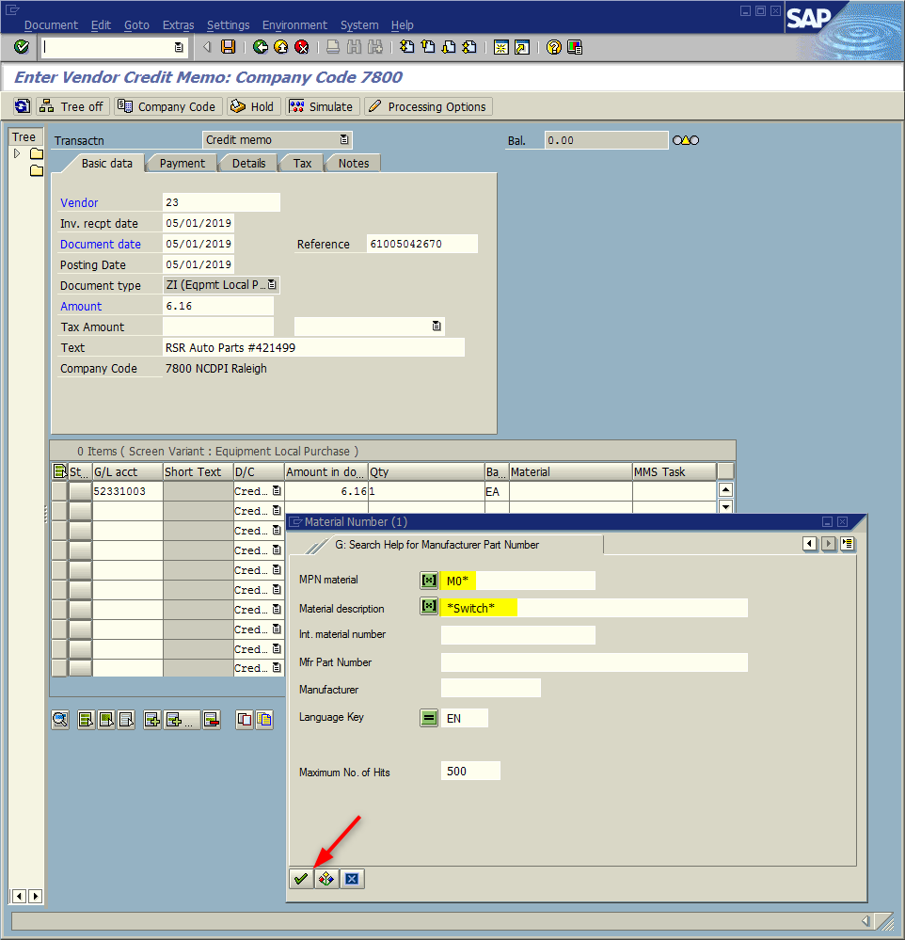
Window opens:
Material Number
G. Search Help for Manufacturer Part Number
MPN Material Field – Input M0* (Always)
Material description Field – Input search text. Use a word that is unique to the part. Surround the word surge with wild cards <Shift-8> * (i.e., *Switch*)
<Click> Start Search icon

Slide 8
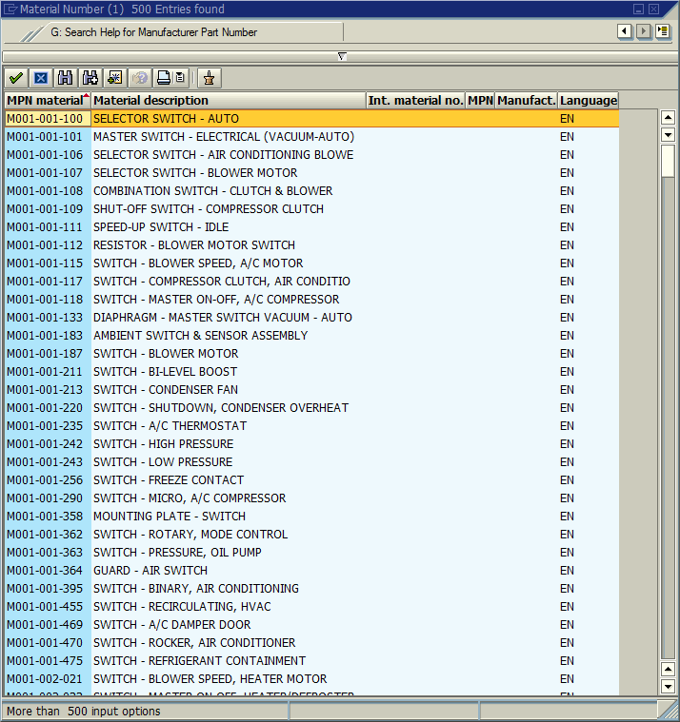
Window opens:
G. Search Help for Manufacturer Part Number
The new window appears; with the results of criteria searched.
In the example you will see all the occurrences of material numbers that have the word “switch” located in their description.

Slide 9
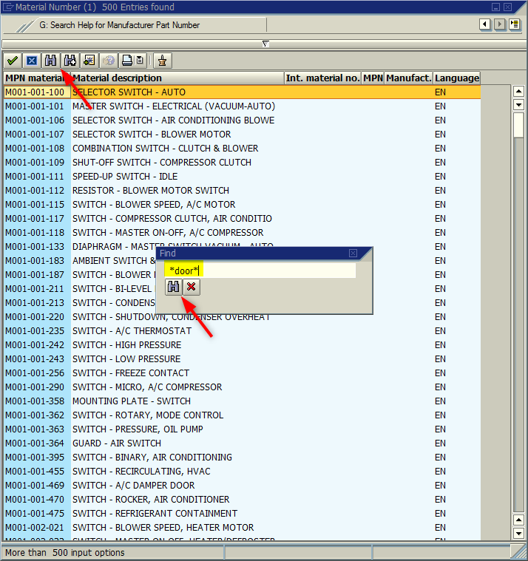
Window:
G. Search Help for Manufacturer Part Number
Our example produced a very extensive list; however, the search can be narrowed further.
Narrow search
<Click> Find icon
A Find window will appear
Input next tier to search (i.e., *door*) (Surround with wild cards (*))
<Click> Find icon

Slide 10
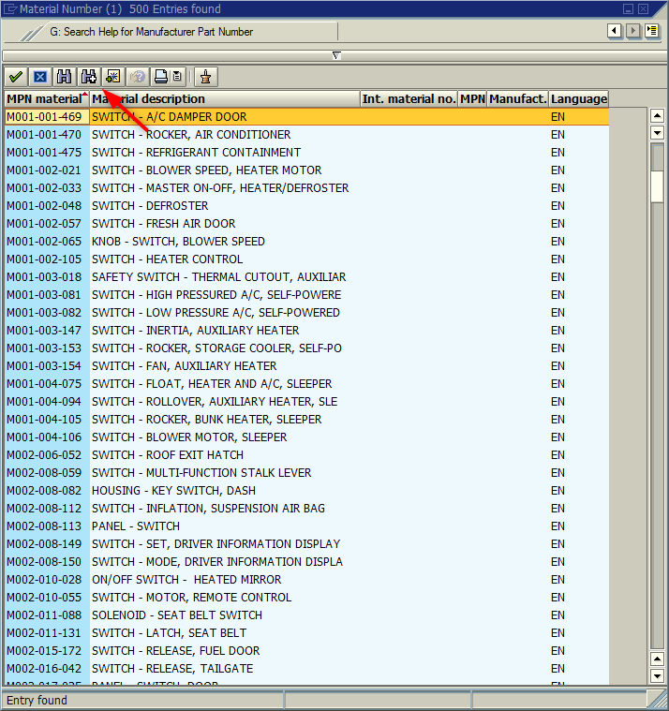
Window:
G. Search Help for Manufacturer Part Number
The software will find and highlight the first occurrence that contains “door” embedded within the description.
If this the item you are searching for
<Double-click> on the highlighted the line.
OR
<Click> Find Again icon to find the next occurrence. (Repeat as necessary)

Slide 11
Questions
Email: Stephen.Wright@dpi.nc.gov

Slide 12
Thank You!
Stephen Wright
DPI Technical Consultant

