Slide 1
Two methods to observe tutorial
Standard Method
This method allows presentation to be resized to user preference.
Slide Show Method (Example below)
Presentation fills entire screen
Click on Slide Show tab at top of screen
Click icon <From Beginning>
Note: Either method; to advance click the progression arrow in the bottom right corner of each slide or press the down-arrow key.

Slide 2
Welcome to
BSIP 101
Transaction Procedures
Transfer Materials LEA to LEA
Instructor: Stephen Wright DPI Technical Consultant

Slide 3
Purpose: Transfer materials from one LEA’s storage location to another LEA’s storage location

Slide 4
Note:
This is a twostep process it requires work to be completed by both LEAs (sending and receiving).
Transactions must be completed in order of: sending → receiving.
Also, the sending and receiving plants must have the same DOT number for the inventory item. If they do not, one or the other must correct their DOT number before the part is sent.

Slide 5
Before you proceed; verify that the inventory item is actually in stock at the Plant and Storage Location you are transferring from.
Just because you are holding an inventory item in your hand does not mean that it is recorded accurately within BSIP.
(You MUST have a count of at least 1 or greater to transfer)

Slide 6
Step One
Sending

Slide 7
One transaction is required to complete this procedure:
MIGO
Let’s get started -

Slide 8
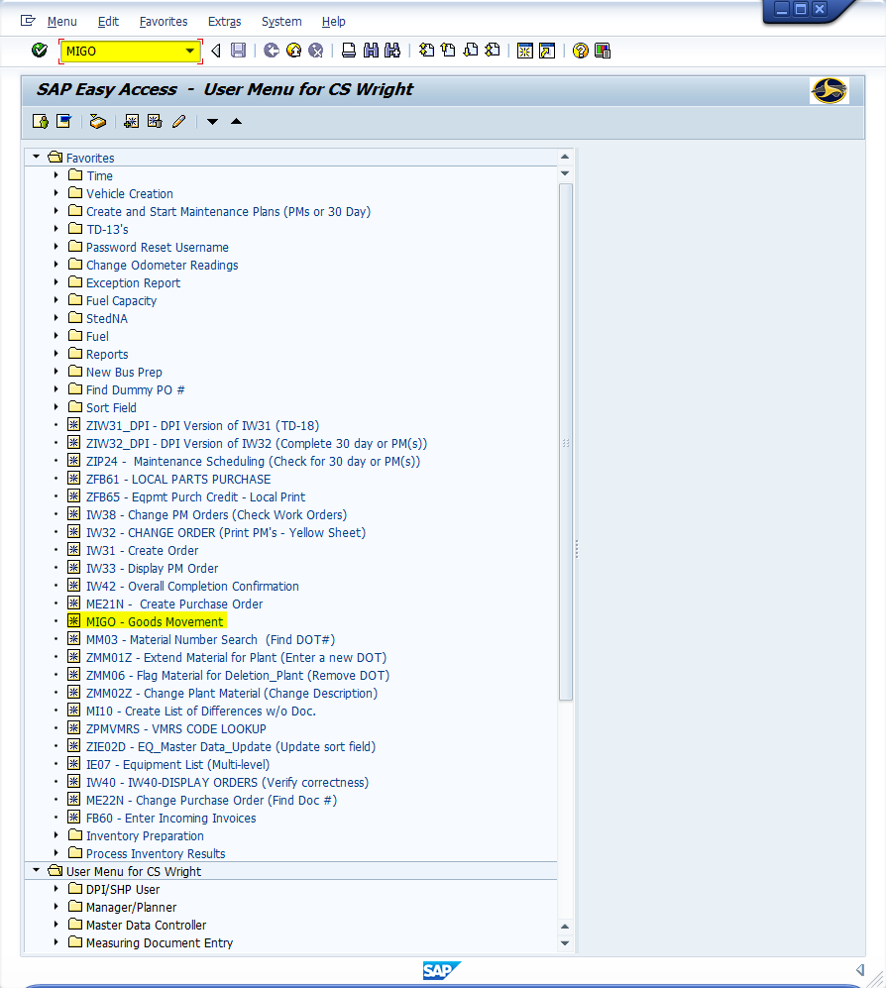
Window:
SAP R/3 Easy Access
Input MIGO; or
Favorites menu, <Select> transaction MIGO – Goods Movement

Slide 9
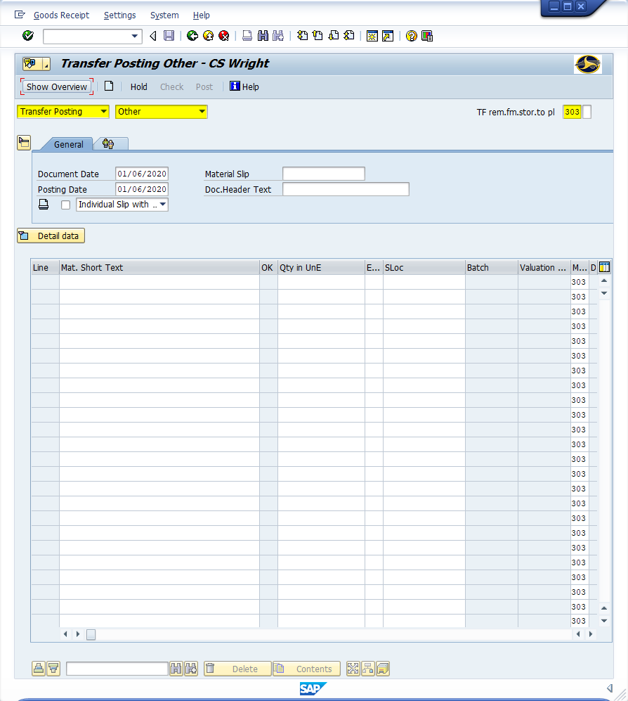
Window opens:
Transfer Posting Other – {Username}
Trans./Event Field - Transfer Posting
Reference Doc. Field - Other
Transfer Field – 303
<Click> Detail data button

Slide 10
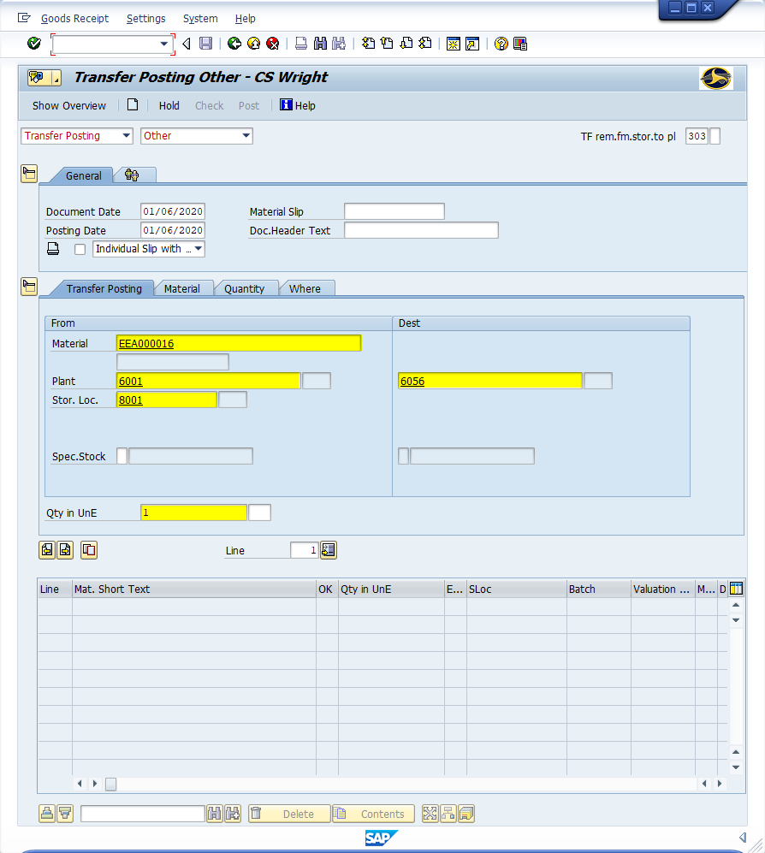
Window opens:
Transfer Posting Other – {Username}
Transfer Posting Tab
From Section
Material Field - Input nine-digit SAP material number
Plant Field – Input four-digit code (i.e., Alamance = 6001)
Storage Location Field – Input four-digit code (i.e., Alamance = 8001)
Destination Section
Storage Location Field – Input four-digit code (i.e., Macon = 8056)
Transfer Posting Section
Qty in UnE Field – Input the number of units to transfer
<Enter>

Slide 11
Window opens:
Transfer Posting Other – {Username}
Transfer Posting Tab
<Click> Next Item icon (If transferring multiple items; repeat the just completed starting with the material field )
OR
<Click> Save icon
<Click> Exit icon
Tip: Next Item icon is clicked; then the following occurs:
Information from the Transfer Posting tab is recorded in the table.
Line item reference is incremented for the next entry.
Transfer Posting tab fields are cleared for next entry.

Slide 12
Step Two
Receiving

Slide 13
One transaction is required to complete this procedure:
MIGO
Let’s get started -

Slide 14
Window:
SAP R/3 Easy Access
Input MIGO; or
Favorites menu, <Select> transaction MIGO – Goods Movement

Slide 15
Window opens:
Transfer Posting Other – {Username}
Trans./Event Field - Transfer Posting
Reference Doc. Field - Other
Transfer Field – 305
<Click> Detail data button

Slide 16
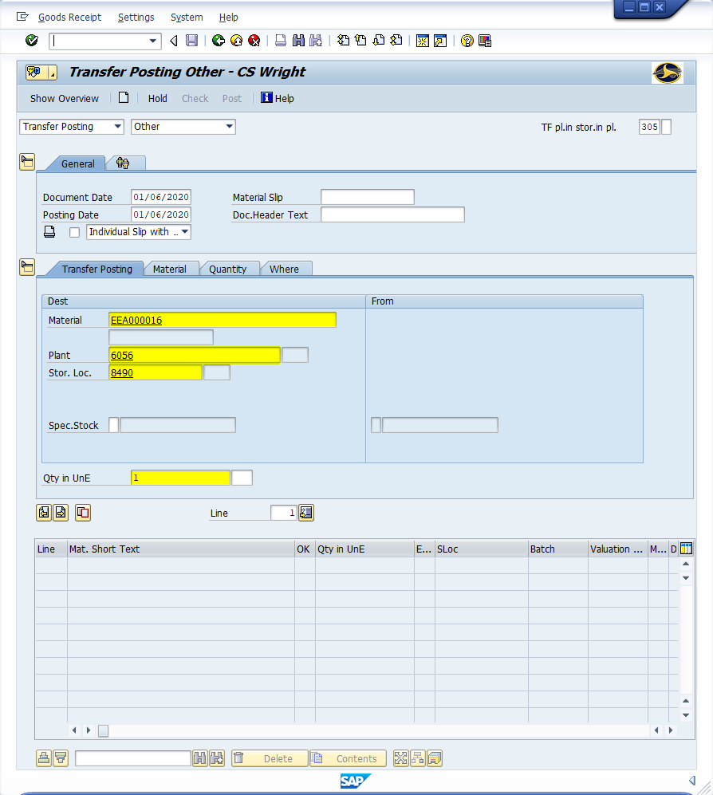
Window opens:
Transfer Posting Other – {Username}
Transfer Posting Tab
From Section
Material Field - Input nine-digit SAP material number
Plant Field – Input four-digit code (i.e., Macon = 6056)
Storage Location Field – Input four-digit code (i.e., Macon = 8490)
Transfer Posting Section
Qty in UnE Field – Input the number of units to transfer
<Enter>

Slide 17
Window opens:
Transfer Posting Other – {Username}
Transfer Posting Tab
<Click> Next Item icon (If transferring multiple items; repeat the just completed starting with the material field )
OR
<Click> Save icon
<Click> Exit icon
Tip: Next Item icon is clicked; then the following occurs:
Information from the Transfer Posting tab is recorded in the table.
Line item reference is incremented for the next entry.
Transfer Posting tab fields are cleared for next entry.

Slide 18
Questions
Email: Stephen.Wright@dpi.nc.gov

Slide 19
Thank You!
Stephen Wright
DPI Technical Consultant

