Slide 1
Two methods to observe tutorial
Standard Method
This method allows presentation to be resized to user preference.
Slide Show Method (Example below)
Presentation fills entire screen
Click on Slide Show tab at top of screen
Click icon <From Beginning>
Note: Either method; to advance click the progression arrow in the bottom right corner of each slide or press the down-arrow key.

Slide 2
Welcome to
BSIP 101
Transaction Procedures
Material Count
Adjustment
Instructor: Stephen Wright DPI Technical Consultant

Slide 3
This transaction should only be used for materials to correct for incorrect adjustments or are an acknowledgement that the source of the discrepancy could not be determined.

Slide 4
Purpose: Post a physical inventory count immediately

Slide 5
One transaction is required to complete this procedure:
MI10
Let’s get started -

Slide 6
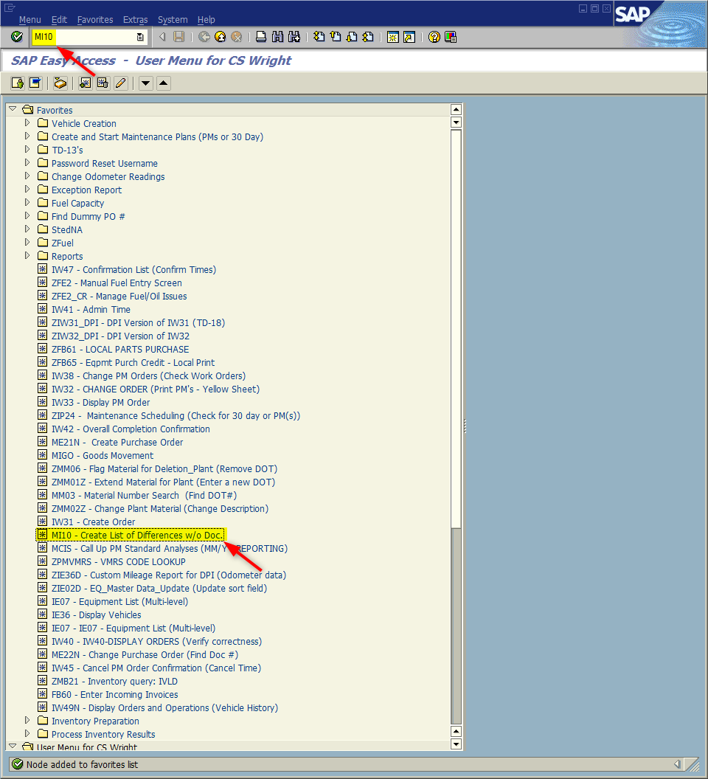
Window:
SAP R/3 Easy Access
Input MI10; or
Favorites menu, <Select> transaction MI10 – Create List of Difference w/o Doc.

Slide 7
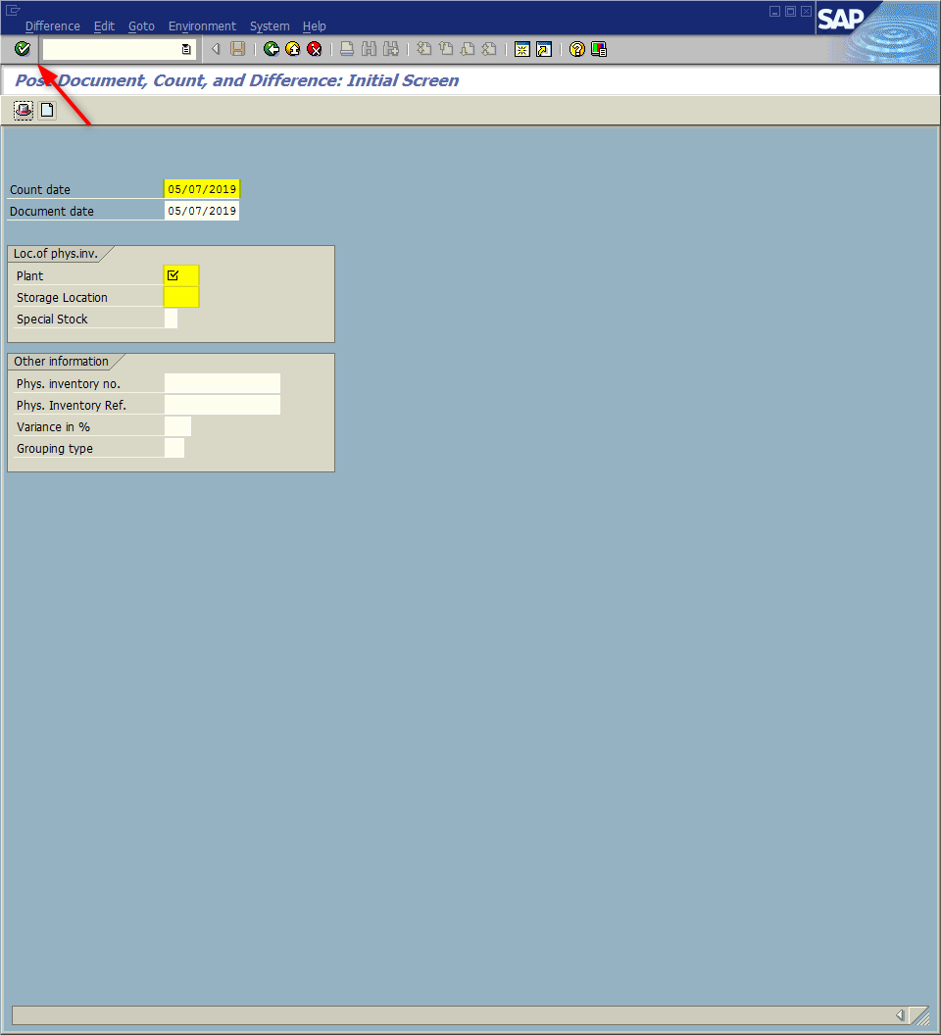
Window opens:
Post Document, Count, and Difference: Initial Screen
Count Date Field – Input date physical count taken.
Plant Field - Input four digit code (i.e., Alamance = 6001)
Storage Loc. Field – Input four digit code (i.e., Alamance = 8001)
<Enter>

Slide 8
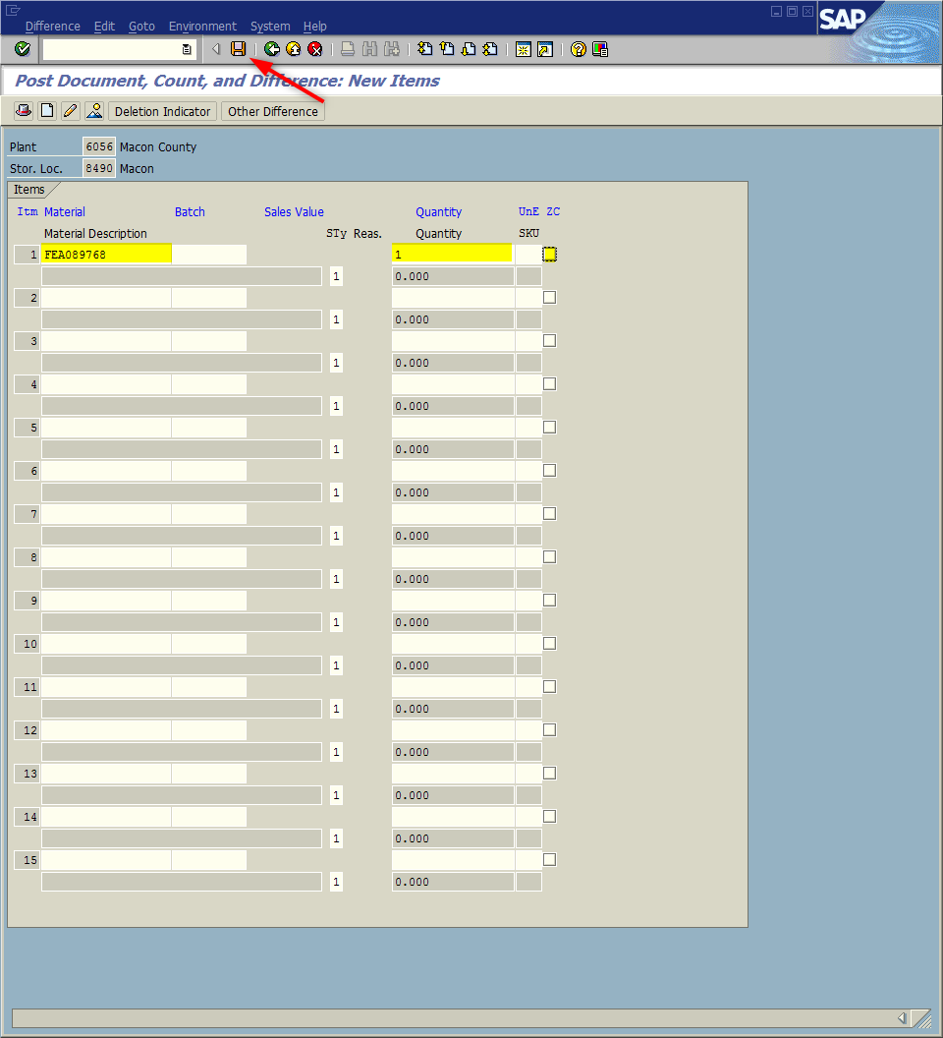
Window opens:
Post Document, Count, and Difference: New Items
Material Description Field – Input Nine-digit material number. (i.e., FEA089768)
Quantity Field - Input quantity on hand if greater than zero.
OR
ZC (Zero Count) Field - If count equals zero check the box.
<Click> Save icon

Slide 9
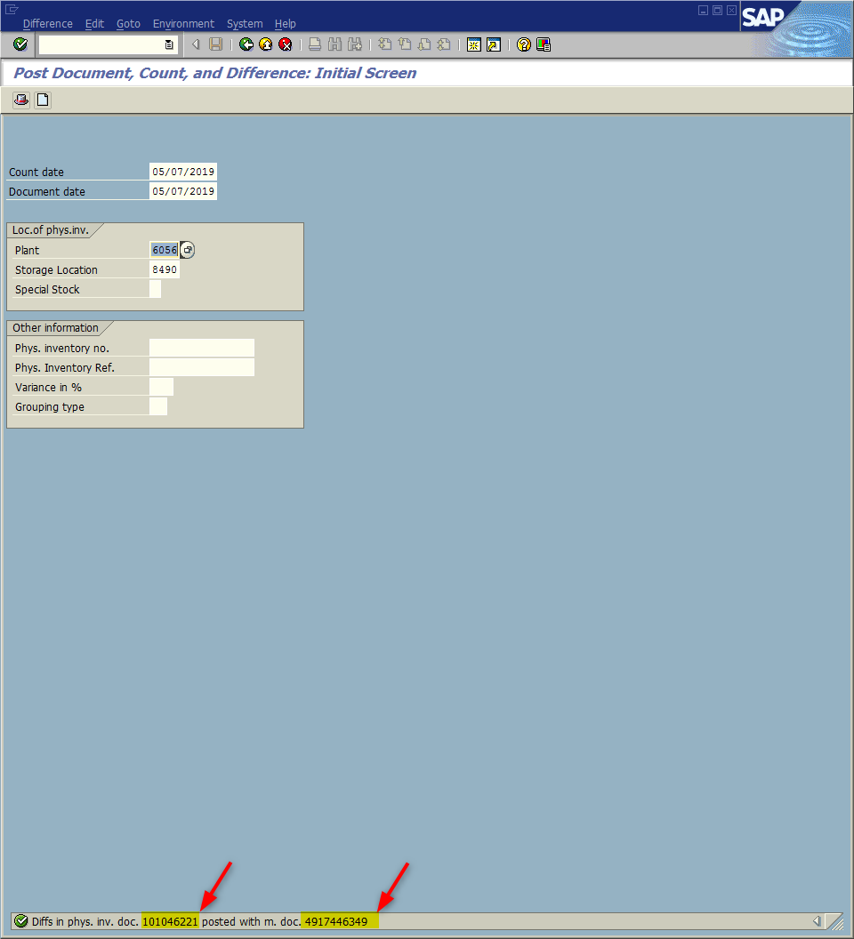
Window opens:
Post Document, Count, and Difference: Initial Screen
The system will generate a material document number and a physical inventory document number in the Status bar.
<ESC> or <Click> Back icon

Slide 10
Tip:
Posted changes can be seen using transaction ZMB20 with movement types 701 to 702.

Slide 11
Questions
Email: Stephen.Wright@dpi.nc.gov

Slide 12
Thank You!
Stephen Wright
Technical Consultant

