Slide 1
Two methods to observe tutorial
Standard Method
This method allows presentation to be resized to user preference.
Slide Show Method (Example below)
Presentation fills entire screen
Click on Slide Show tab at top of screen
Click icon <From Beginning>
Note: Either method; to advance click the progression arrow in the bottom right corner of each slide or press the down-arrow key.

Slide 2
Welcome to
BSIP 101
Transaction Procedures
Cancel Material
Movement
Instructor: Stephen Wright DPI Technical Consultant

Slide 3
Purpose: Credit or debit inventory items to and from stock.

Slide 4
One transaction is required to complete this procedure:
MIGO
Let’s get started -

Slide 5
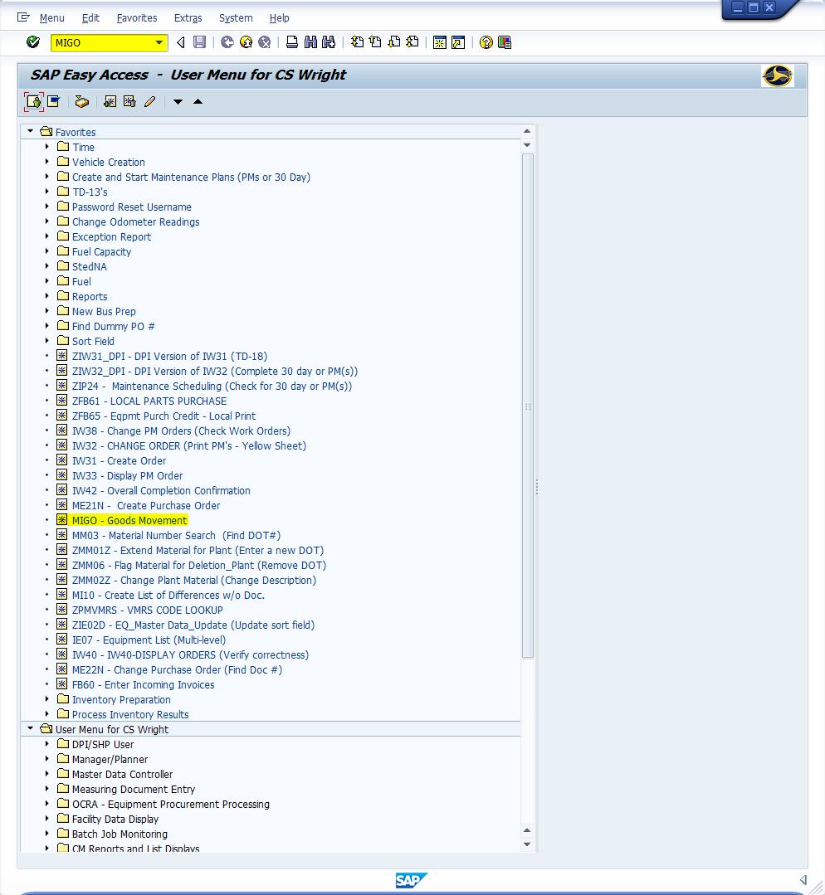
Window:
SAP R/3 Easy Access
Input MIGO; or
Favorites menu, <Select> transaction MIGO – Goods Movement

Slide 6
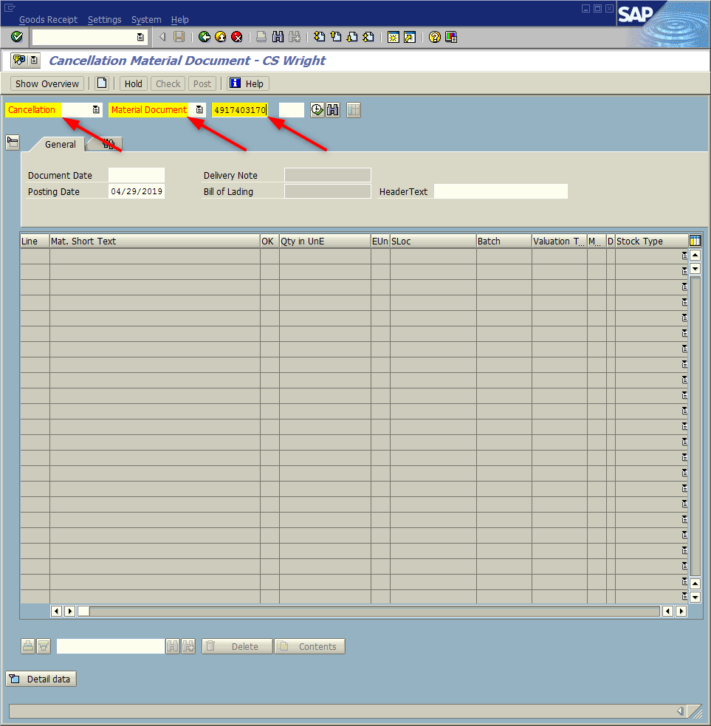
Window opens:
Cancellation Material Document– (User)
Trans./Event Field = Cancellation
Reference Doc. Field = Material Document (Software will often default automatically, based upon Trans./Event Field entry).
Material Document Field = Material Document Number form the work order (10 digits)
<Enter>
Tip: Material Document may be found by viewing the work order in Transaction ZIW32_DPI. If canceling a Purchase Order the number would be recorded on the invoice.

Slide 7
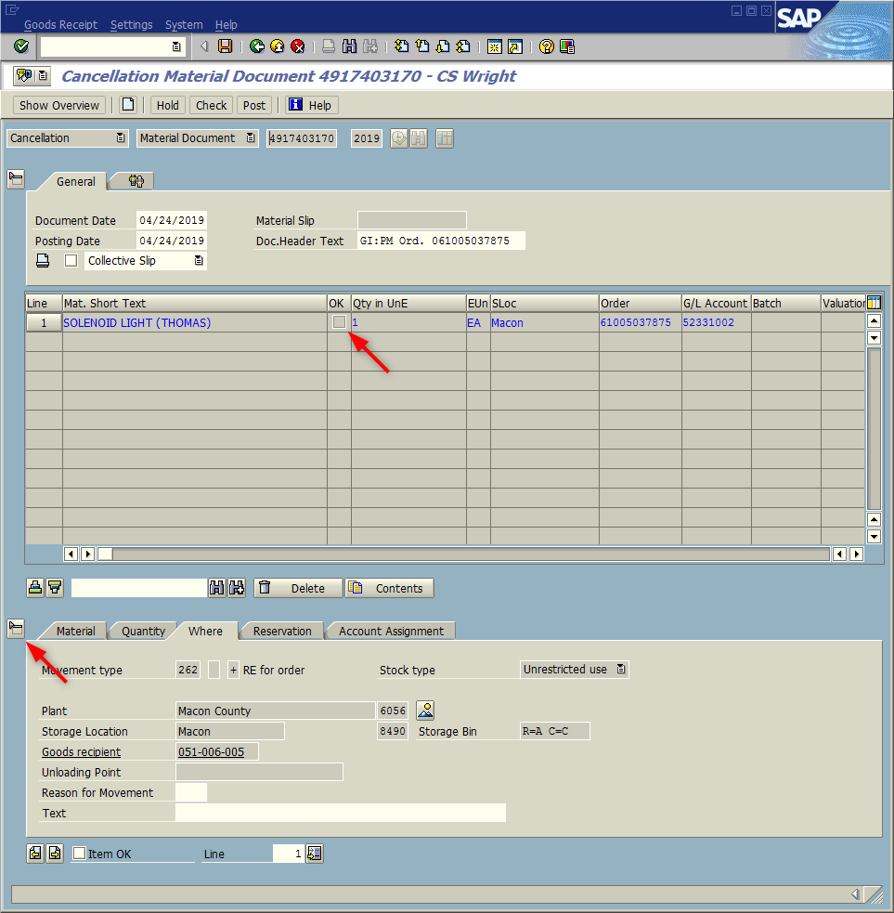
Window:
Cancellation Material Document– (User)
The window updates displaying the inventory item(s) associated with the material document number entered.
OK column Field - <Check> the box next to the items to be cancelled.
Tip: If the top line in your table has the OK column box grayed out and is unavailable to be checked; it is not an error it simply means the detail data is active. Click Close Detail Data icon to deactivate.

Slide 8
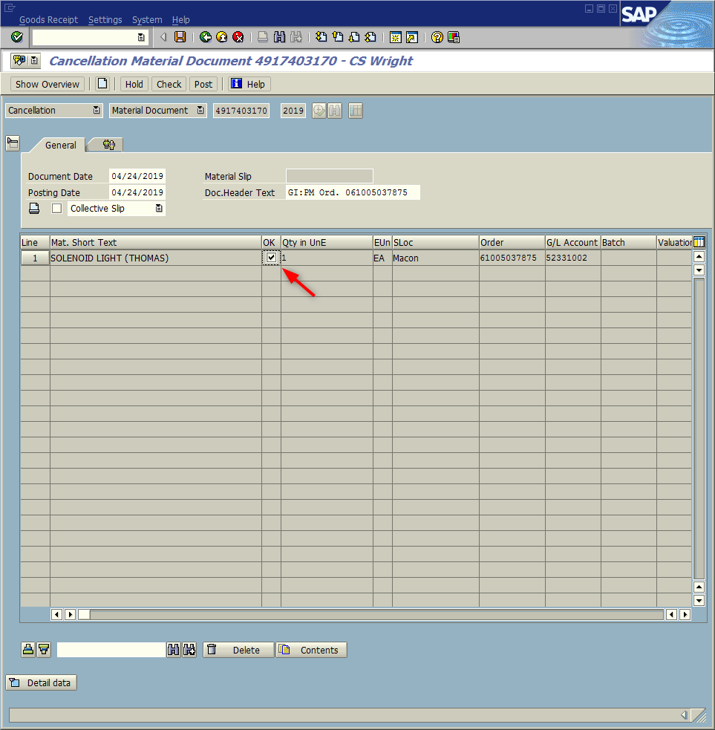
Window:
Cancellation Material Document– (User)
The window updates: With the Detail Data Table minimized your screen should look very similar to the screen displayed to the right. The OK column fields should now display with white back-grounds and be available to receive a check.
Tip: The Detail data table can be relaunched if needed; by clicking in the bottom left corner of the screen on the Detail data icon

Slide 9
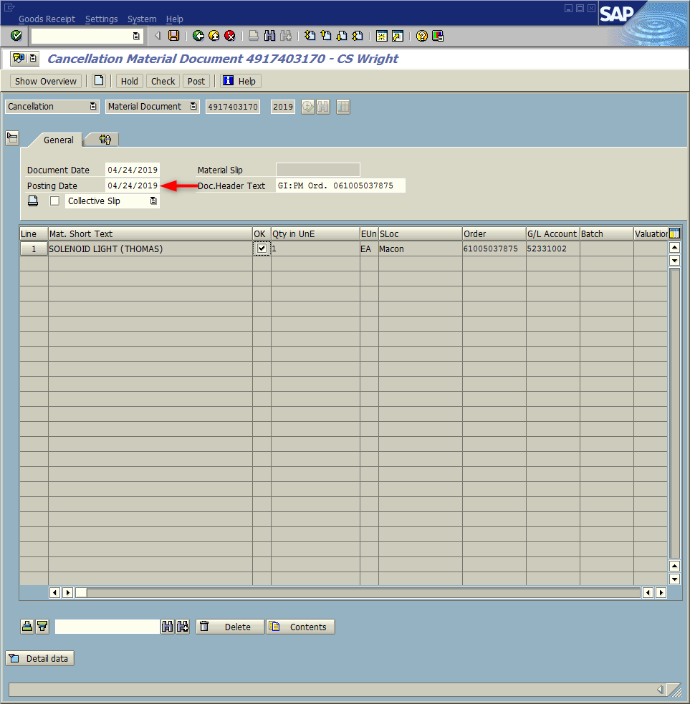
Window:
Cancellation Material Document– (User)
Tip: If the material document was created in a prior (closed) financial period, the posting date must be changed to the current date.
<Click> Execute icon

Slide 10
Window opens:
Display logs
Tip: If canceling a receipt of materials (Purchase Order) you will be prompted to enter a reason for the cancellation (Shown to the right)
<Click> Continue icon

Slide 11
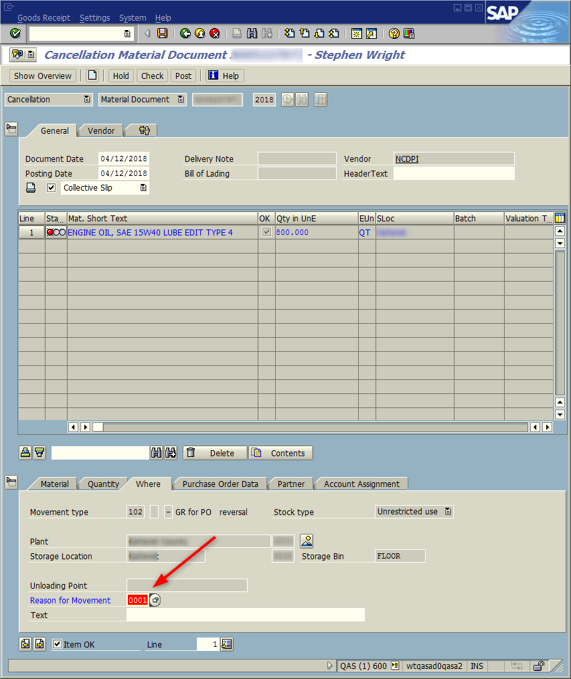
Window:
Cancellation Material Document– (User)
<Click> Detail data button
<Click> Where tab
Reason for Movement = Input 0001
<Click> Save icon
Record “Material document XXXXXXXXXX posted” that is displayed in the status bar.
<Click> Exit icon

Slide 12
Questions
Email: Stephen.Wright@dpi.nc.gov

Slide 13
Thank You!
Stephen Wright
DPI Technical Consultant

