Slide 1
Two methods to observe tutorial
Standard Method
This method allows presentation to be resized to user preference.
Slide Show Method (Example below)
Presentation fills entire screen
Click on Slide Show tab at top of screen
Click icon <From Beginning>
Note: Either method; to advance click the progression arrow in the bottom right corner of each slide or press the down-arrow key.

Slide 2
Welcome to
BSIP 101
Transaction Procedures
Charge Non-Stock
Materials &
Sublet Repairs
Instructor: Stephen Wright DPI Technical Consultant

Slide 3
Purpose: Charge a non-inventory part or a sublet to a work order

Slide 4
One transaction is required to complete this procedure:
ZFB61
Let’s get started -

Slide 5
Transaction may be accessed from two entry points:
SAP Easy Access Screen
Type ZFB61; or
Click on the transaction from favorites menu
Imprest Cash
ZIW31_DPI screen (TD-18 entry screen)

Slide 6
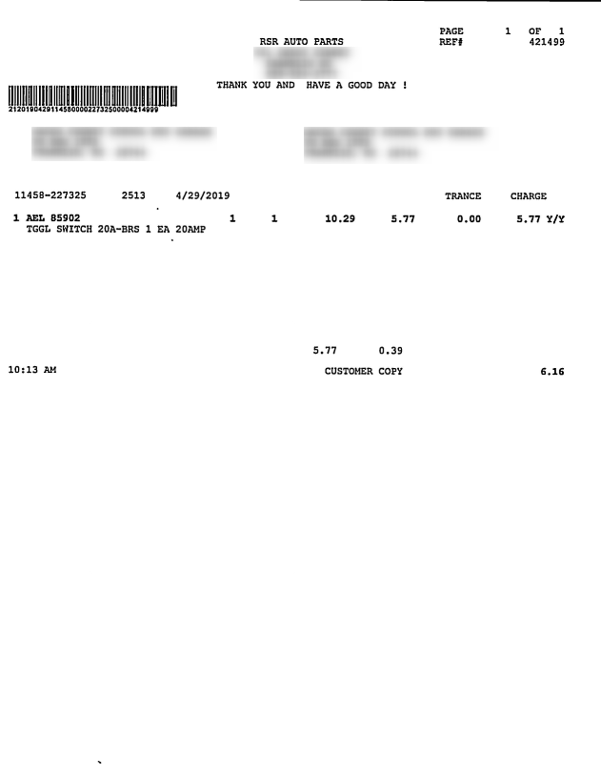
Invoice to Charge

Slide 7
Option 1

Slide 8
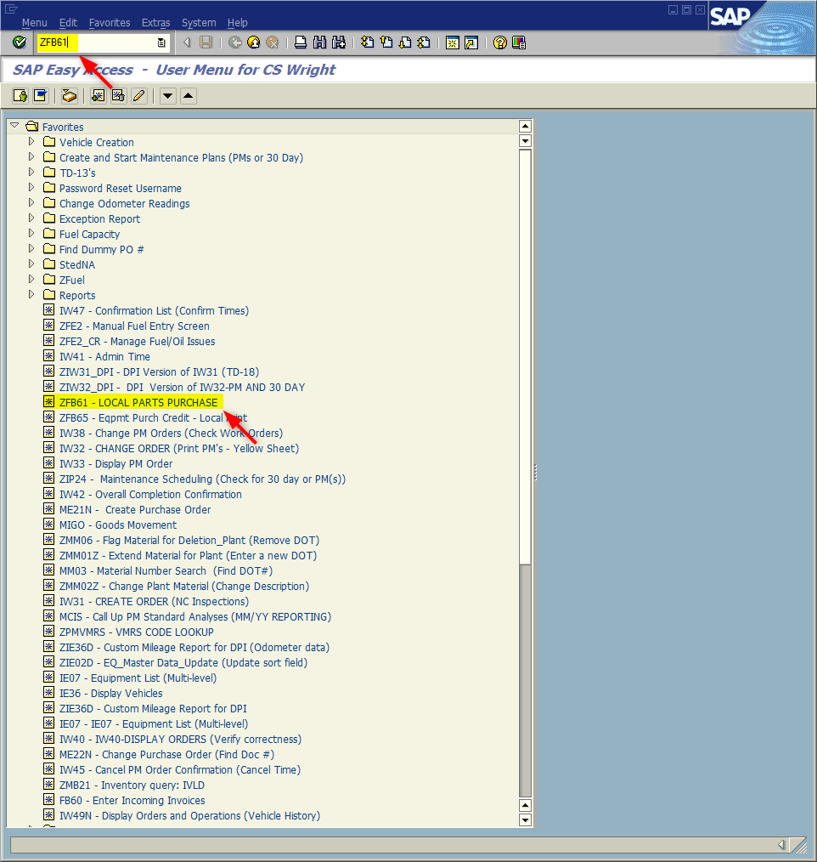
Window:
SAP R/3 Easy Access
Input ZFB61; or
Favorites menu, <Select> transaction ZFB61 – Local Parts Purchase

Slide 9
Option 2

Slide 10
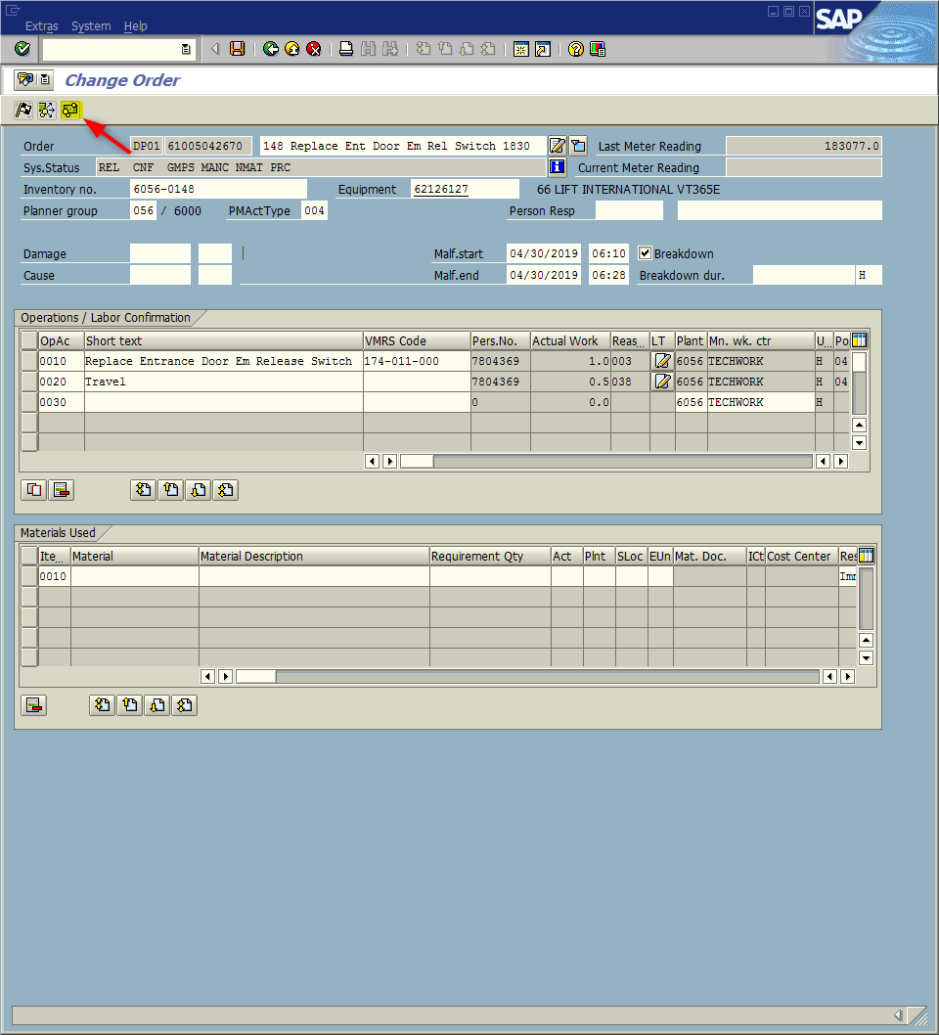
Window:
Change Order
Access to Transaction ZFB61 can occur when completing Transaction ZIW31_DPI (TD-18 Work Order).
Complete the work order as normal
<Click> Save icon
<Click> Imprest Cash icon

Slide 11
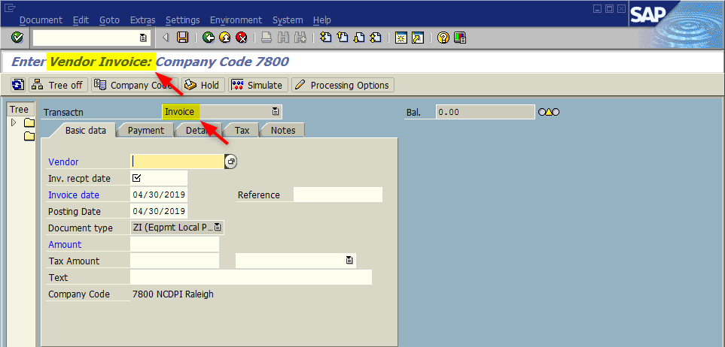
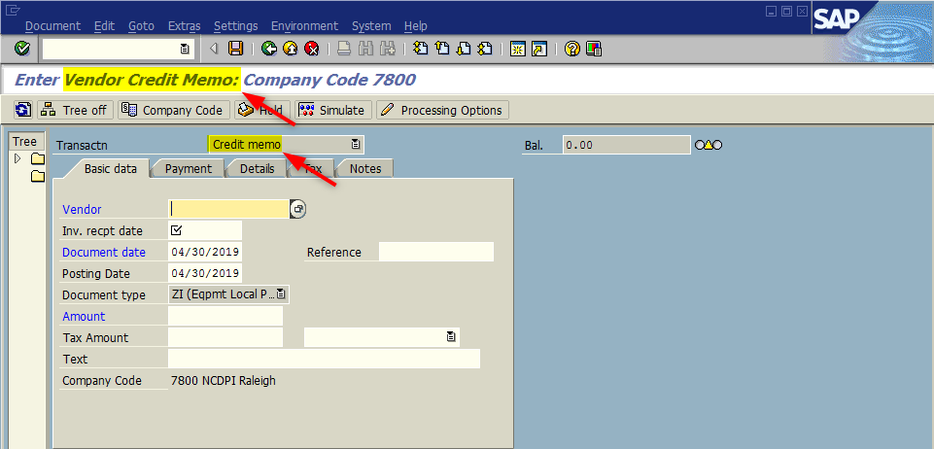
Window opens:
Enter Vendor Invoice: Company Code 7800
TIP: Transactions ZFB61 and ZFB65 screens are nearly identical.
Variances:
Screen Title
Vendor Invoice
Vendor Credit Memo
Transactn field
Invoice
Credit memo
Verify you are utilizing the correct transaction before continuing
ZFB61 Screen
ZFB65 Screen

Slide 12
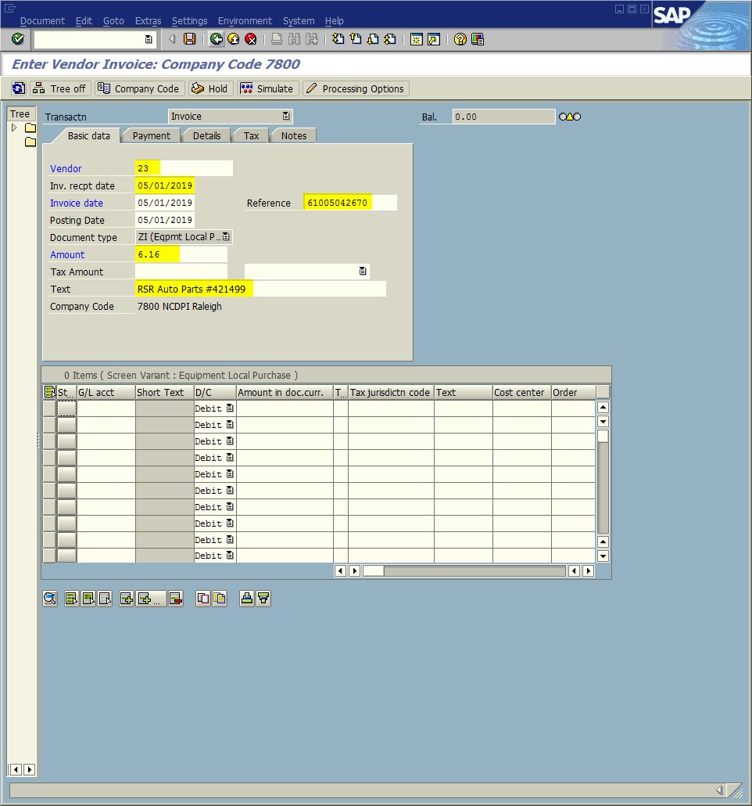
Window opens:
Enter Vendor Invoice: Company Code 7800
Vendor field – Input 23 (Always)
Inv. recpt date field – Input date invoice received.
Reference Field – Input work order number (TD-18 or PM number)
Amount Field – Input Total (Include tax, shipping, & additional fees) of non-stock materials and sublet repairs
Text Field – Input Vendor & invoice number (i.e., RSR Auto Parts #421499)

Slide 13
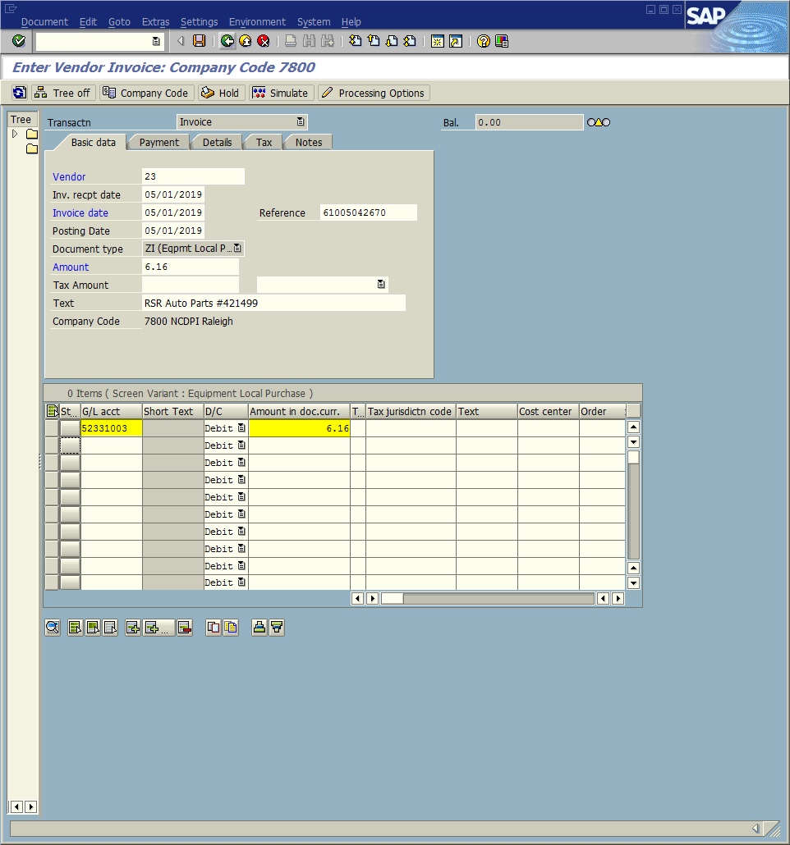
Window:
Enter Vendor Invoice: Company Code 7800
G/L acct Field - Input
52331003 (Material); or
52333002 (Services)
Amount in doc. curr. Field – Input price for material; plus prorated tax; plus prorated shipping

Slide 14
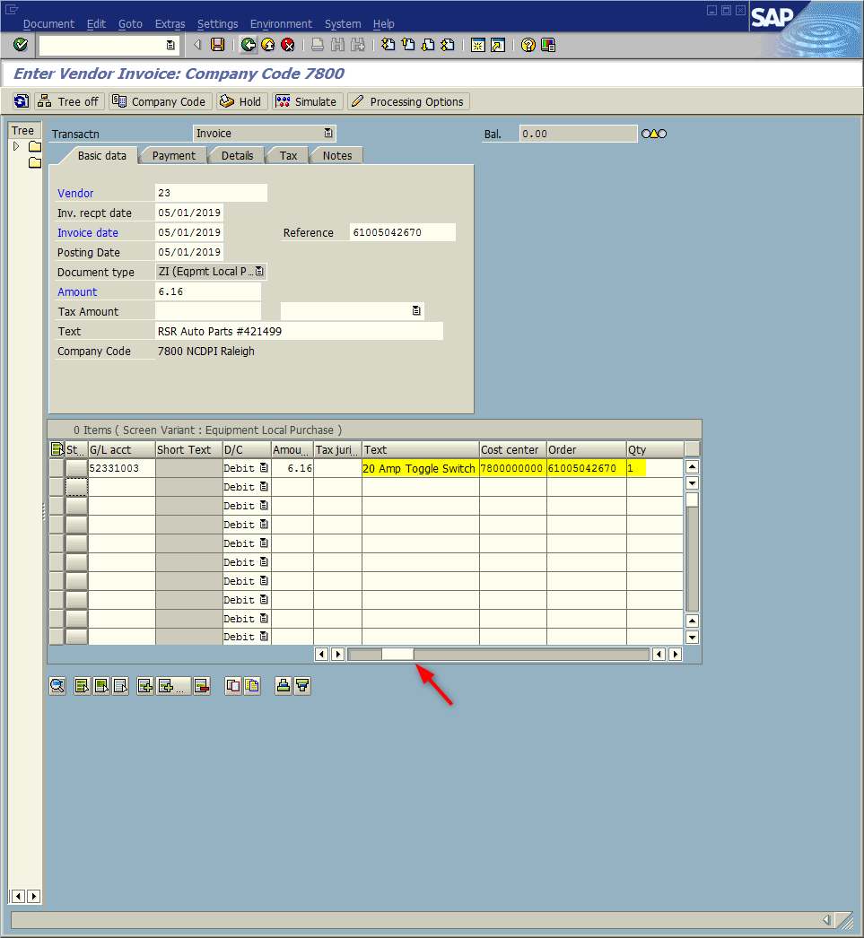
Window:
Enter Vendor Invoice: Company Code 7800
Text Field – Input Description of Material/Service
Cost center Field – Input 7800000000 (Always)
Order Field – Input work order to be charged
Qty Field – Input Quantity
Tip: Use the scroll bar to view columns not displayed on the table.

Slide 15
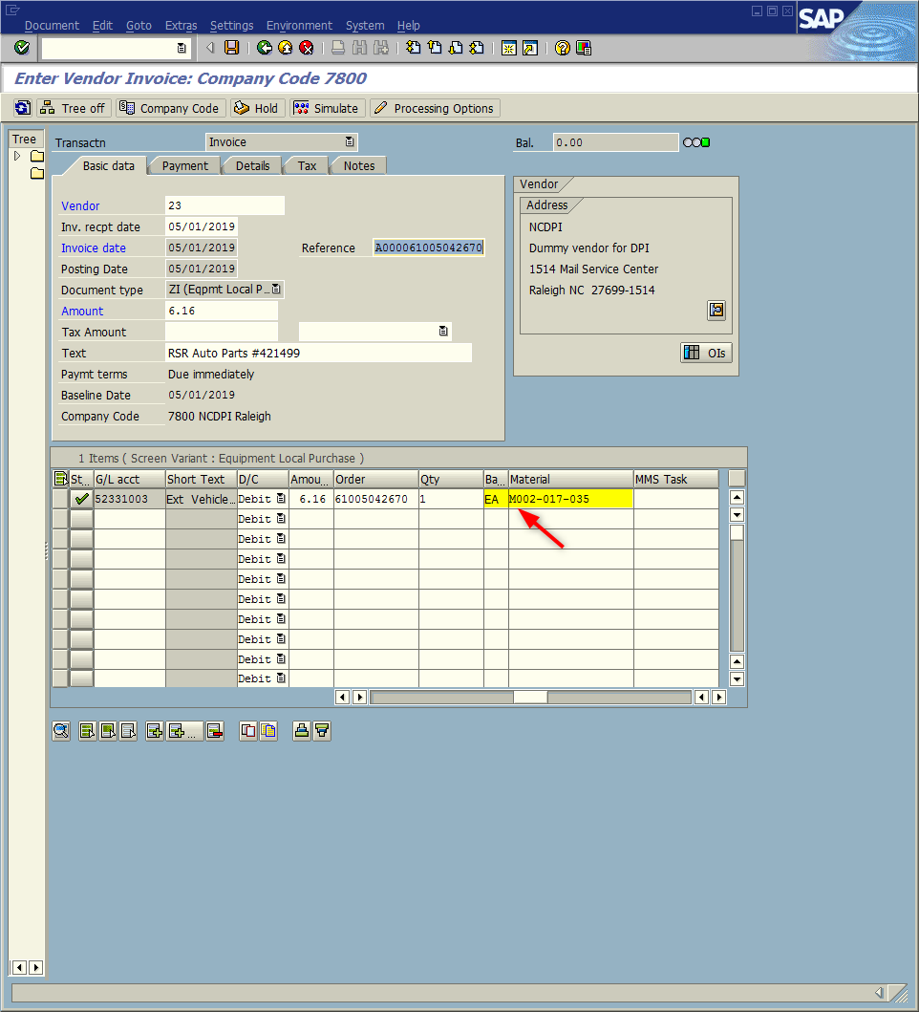
Window:
Enter Vendor Invoice: Company Code 7800
Base Unit of Measure Field – Input EA, QT, etc.
Material Field – Input VMRS code
Retrieved from TD-18 or PM - should correspond to the line the mechanic did the work; or
Perform search (See tutorial VMRS (For Material Field))
Tip: Material number here will always begin with a “M” and then follow with VMRS code.

Slide 16
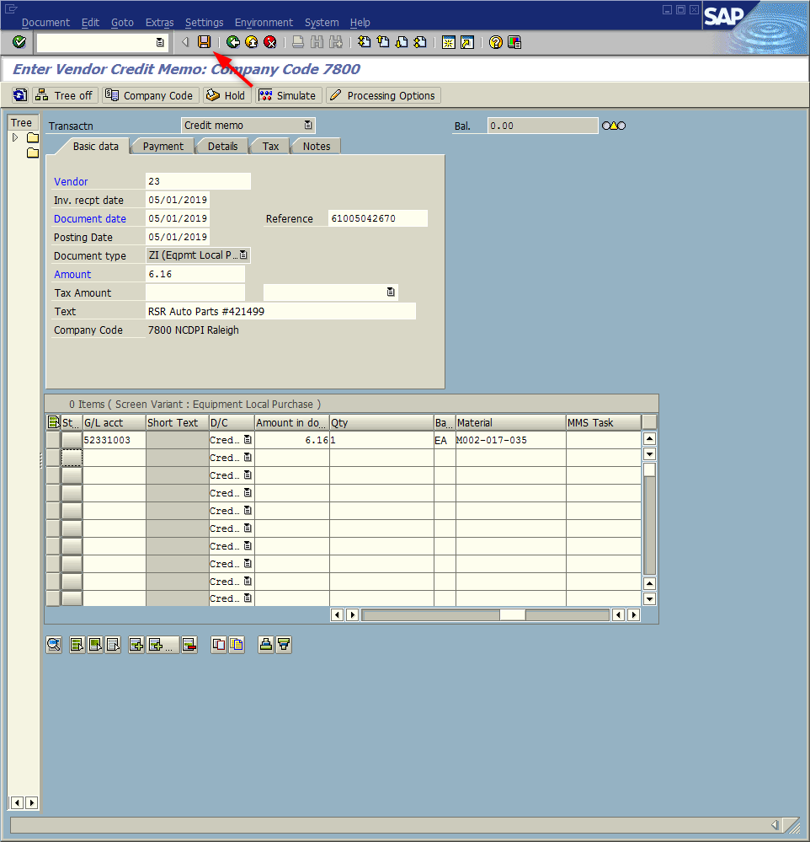
Window:
Enter Vendor Invoice: Company Code 7800
<Click> Save icon (This will also launch validity check for the data input)
System will place the Material Document Number in the bottom Status Bar.
Record this number on the invoice
<ESC>

Slide 17
Validity Check Messages:
(These appear on the bottom status bar)
Posting is only possible with a zero balance; correct document
The value entered on the Basic data tab in the amount field MUST equal the table’s sum of the values entered in Amount in doc. curr.
Quantity and unit of measurement are not consistent
Either the Qty is blank or Base Unit of Measure is input incorrectly in the table.
Enter M###-###-### (# = numeric) does not exist in MARA (check entry)
VMRS code entered in the Material column of the table is incorrect (check format and code).
Make necessary changes; then <Click>the Save icon to record update. Repeat as necessary.

Slide 18
Questions
Email: Stephen.Wright@dpi.nc.gov

Slide 19
Thank You!
Stephen Wright
DPI Technical Consultant

