Slide 1
Two methods to observe tutorial
Standard Method
This method allows presentation to be resized to user preference.
Slide Show Method (Example below)
Presentation fills entire screen
Click on Slide Show tab at top of screen
Click icon <From Beginning>
Note: Either method; to advance click the progression arrow in the bottom right corner of each slide or press the down-arrow key.

Slide 2
Welcome to
BSIP 101
Transaction Procedures
Fuel
Post-Receipt
Instructor: Stephen Wright DPI Technical Consultant

Slide 3
Purpose: Confirm fuel received correctly

Slide 4
One transaction is required to complete this procedure:
ZMB20
Let’s get started -

Slide 5
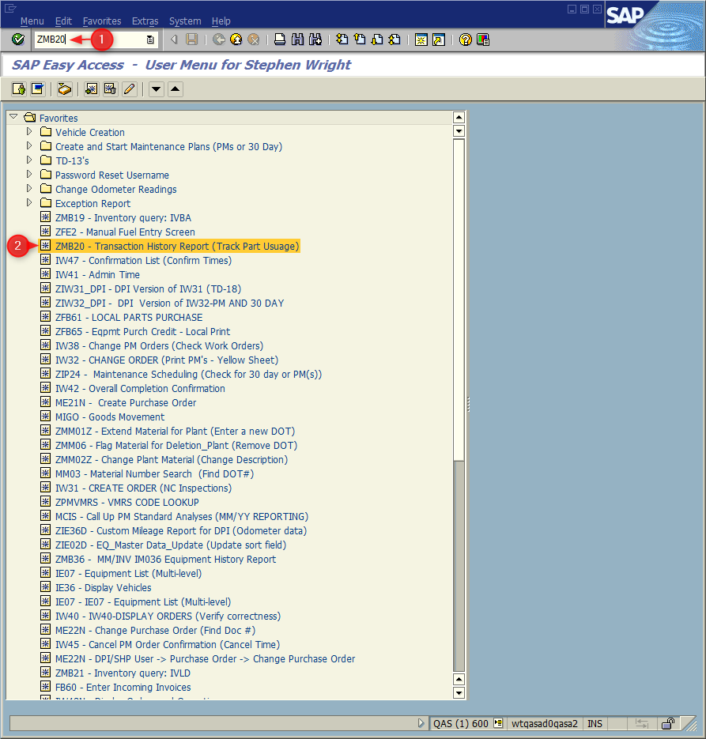
Window:
SAP R/3 Easy Access
Input ZMB20; or
Favorites menu, <Select> transaction ZMB20 – Transaction History Report.

Slide 6
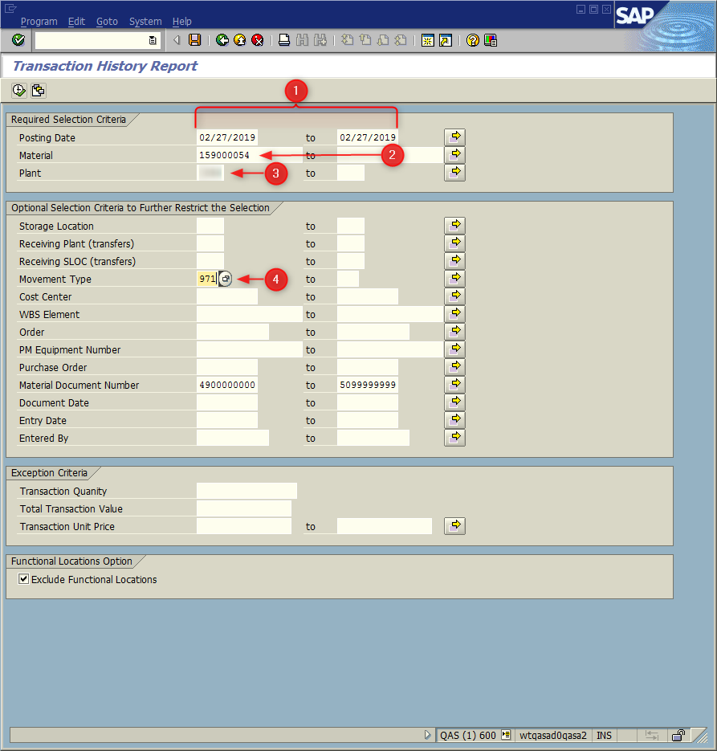
Window opens:
Transaction History Report
Posting Date Field = Input date fuel received using MIGO
Material Field
159000054 = Diesel
159000055 = Unleaded
Plant Field = Input four-digit plant code (i.e., Alamance =6001)
Movement Type Field = 971 (Receipt of bulk Fuel)
<Click> Execute Icon (Based upon LEA size this may take a few seconds)

Slide 7
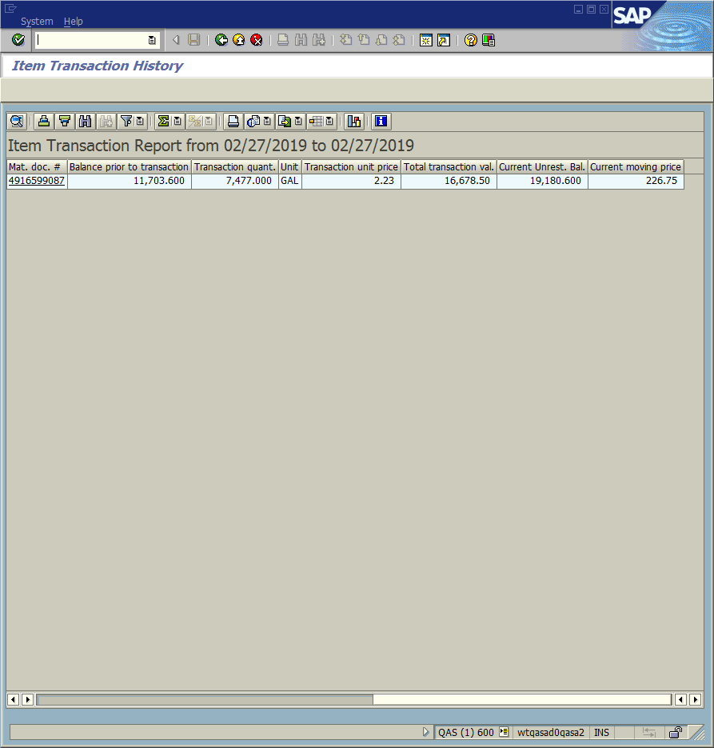
Window opens:
Item History Report
Verify: (Scroll to the right)
Balance Prior to Transaction
Transaction Quantity
Transaction unit Price
Total Transaction Value
<Click> Exit icon (Twice)

Slide 8
If an error was discovered Correct Immediately!
Do not issue any product before correction made; otherwise more corrections will have to be made.

Slide 9
Questions
Email: Stephen.Wright@dpi.nc.gov

Slide 10
Thank You!
Stephen Wright
Technical Consultant

