Slide 1
Two methods to observe tutorial
Standard Method
This method allows presentation to be resized to user preference.
Slide Show Method (Example below)
Presentation fills entire screen
Click on Slide Show tab at top of screen
Click icon <From Beginning>
Note: Either method; to advance click the progression arrow in the bottom right corner of each slide or press the down-arrow key.

Slide 2
Welcome to
BSIP 101
Transaction Procedures
Zfuel Upload
Instructor: Stephen Wright DPI Technical Consultant

Slide 3
Purpose: Upload Fuel data to PC

Slide 4
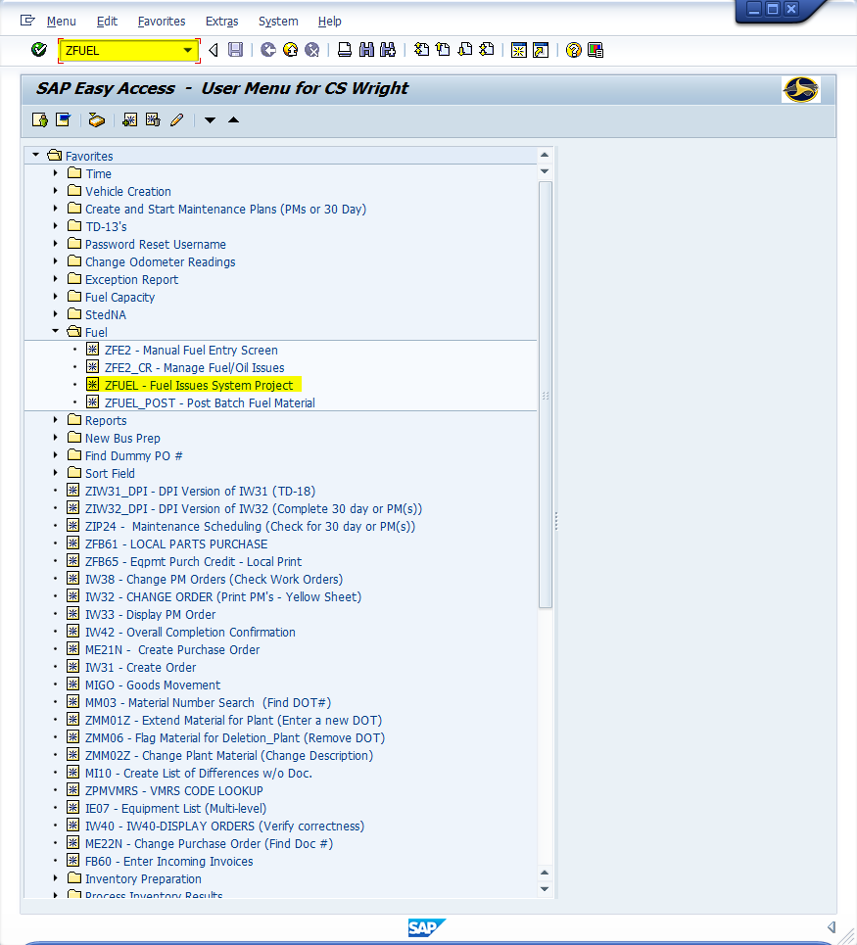
Window:
SAP R/3 Easy Access
Input ZFUEL; or
Favorites menu, <Select> transaction ZFUEL – Fuel Issues System Project

Slide 5
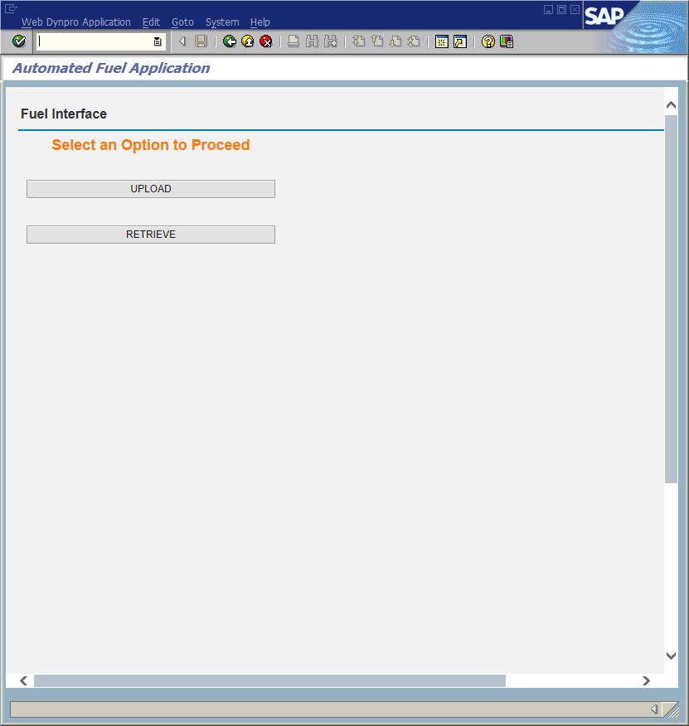
Window opens:
Automated Fuel Application
<Click> Upload button

Slide 6
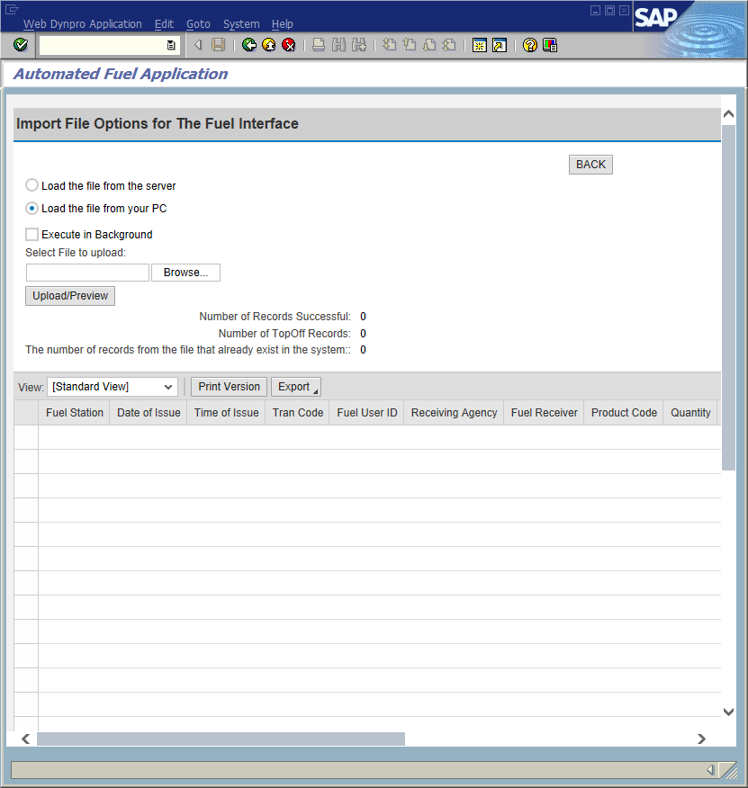
Window opens:
Automated Fuel Application
Import File Options for the Fuel Interface
<Select> Load the file from your PC
Select File to upload input box appears
<Click> Browse button
<Double-Click> on the desired “.txt” file located on the Client C (Generally V: drive)
<Click>
<Click>

Slide 7
Window:
Automated Fuel Application
Review the following data:
Number of Records Successful – the number of fuel records placed in the table for processing (THE FUEL IS NOT YET POSTED).
Number of Top-Off Records – the number of top-off fuel records that were consolidated and set in the schedule for processing.
The number of records from the file that already exists in the system – the amount of fuel records that have already been posted successfully and did not need to be placed in the table for processing because they would be duplicates.
<Click> Exit icon

Slide 8
Questions
Email: Stephen.Wright@dpi.nc.gov

Slide 9
Thank You!
Stephen Wright
DPI Technical Consultant

