Slide 1
Two methods to observe tutorial
Standard Method
This method allows presentation to be resized to user preference.
Slide Show Method (Example below)
Presentation fills entire screen
Click on Slide Show tab at top of screen
Click icon <From Beginning>
Note: Either method; to advance click the progression arrow in the bottom right corner of each slide or press the down-arrow key.

Slide 2
Welcome to
BSIP 101
Transaction Procedures
Annual Inventory
Step 2
Print Phys Inv Docs
Instructor: Stephen Wright DPI Technical Consultant

Slide 3
Purpose: Print the Phys Inv doc(s) that are used to record the actual Phys Inv quantities & to key the data into BSIP

Slide 4
To print the inventory documents, you must know the inventory document numbers generated by Transaction MI31.
Refer to Transaction MI24 if you do not know the inventory document numbers.

Slide 5
One transaction is required to complete this procedure:
MI21
Let’s get started -

Slide 6
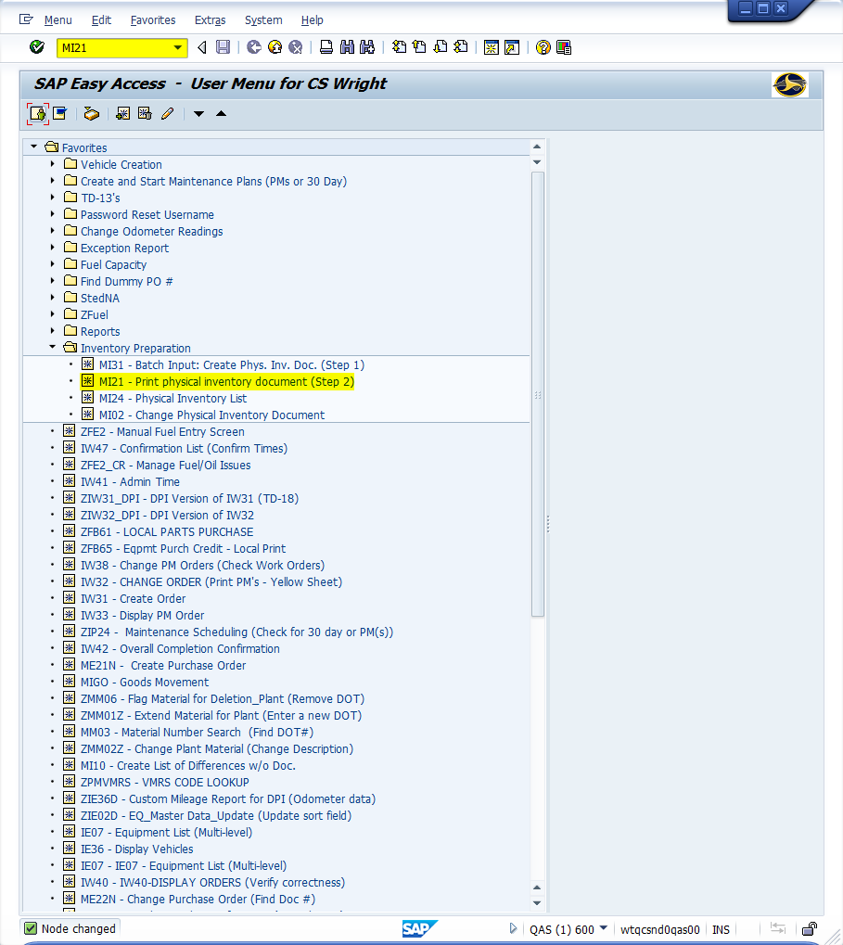
Window:
SAP R/3 Easy Access
Input MI21; or
Favorites menu, <Select> transaction MI21 – Print Physical Inventory Document

Slide 7
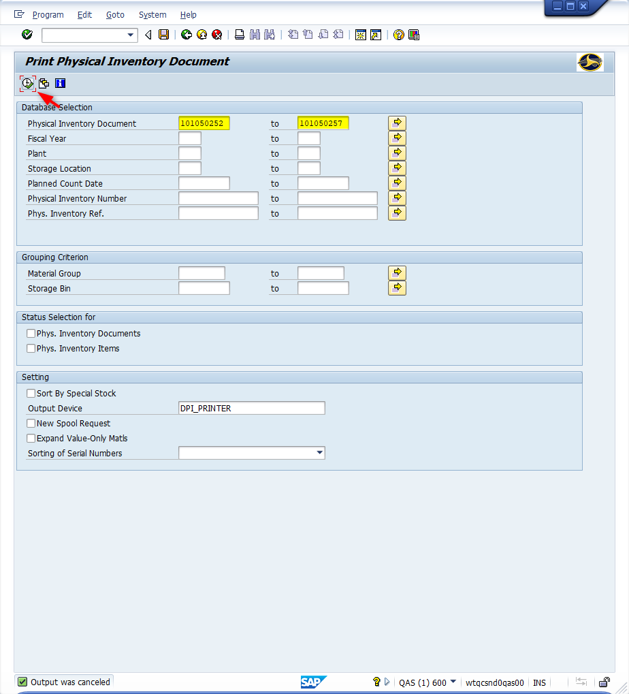
Window opens:
Print Physical Inventory Document
Database Selections Section
Physical Inventory Document Field - Input the physical inventory document numbers produced in Step 1 with Transaction MI31. Users have option to process one document or the entire range.
<Click> Execute icon

Slide 8
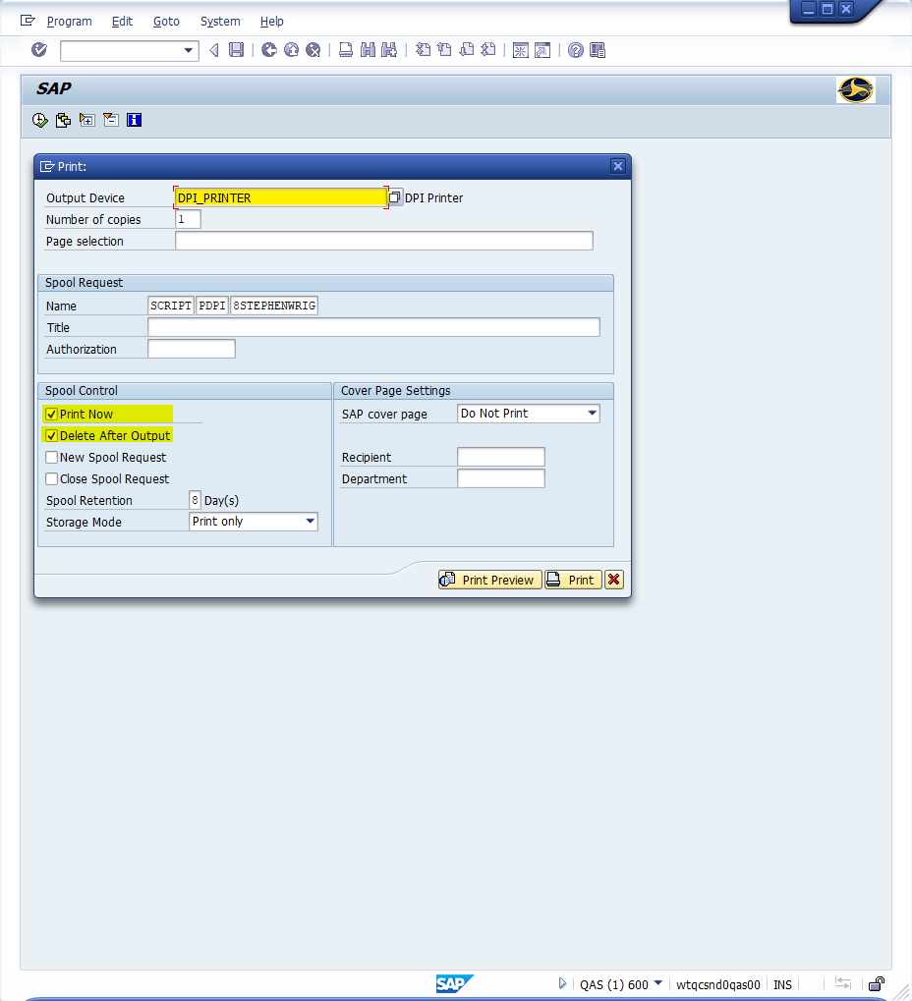
Window Opens:
SAP
Print
Output Device Field – Input DPI_PRINTER (Should default)
Print Now Field – <Check> (Should default)
Delete After Output - <Check> (Should default)
<Click> Print button

Slide 9
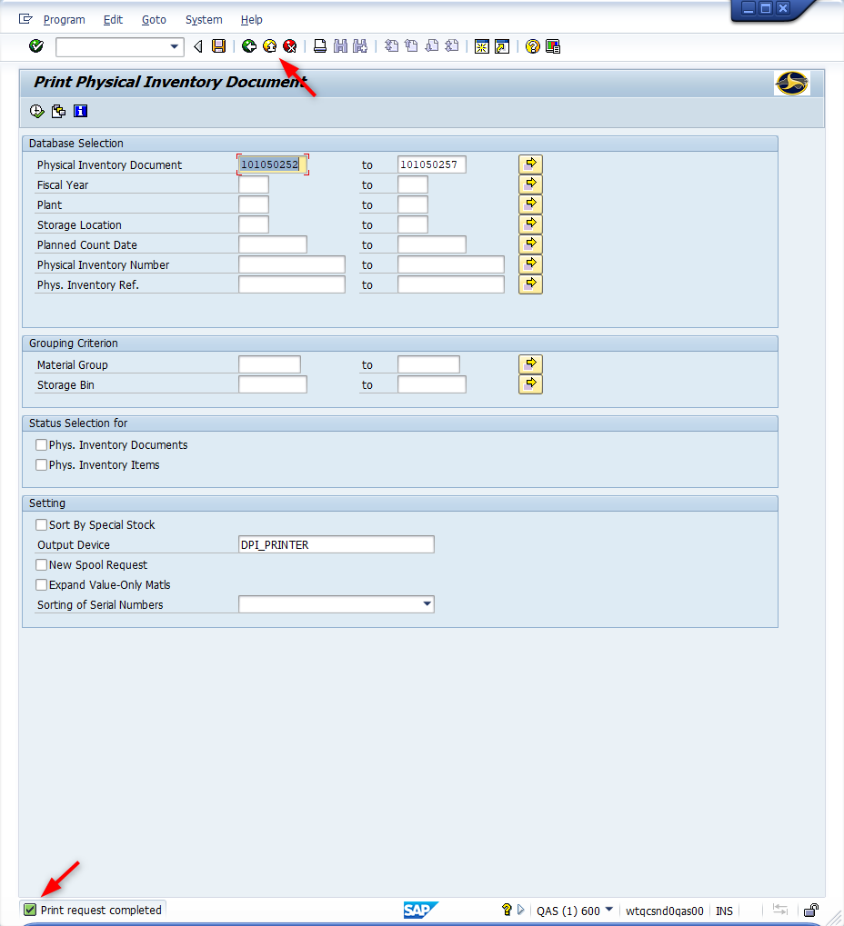
Window Opens:
Print Physical Inventory Document
Tip: “Print request completed” message will display at the bottom status bar.
<Click> Exit button

Slide 10
Questions
Email: Stephen.Wright@dpi.nc.gov

Slide 11
Thank You!
Stephen Wright
Technical Consultant

