Slide 1
Two methods to observe tutorial
Standard Method
This method allows presentation to be resized to user preference.
Slide Show Method (Example below)
Presentation fills entire screen
Click on Slide Show tab at top of screen
Click icon <From Beginning>
Note: Either method; to advance click the progression arrow in the bottom right corner of each slide or press the down-arrow key.

Slide 2
Welcome to
BSIP 101
Transaction Procedures
Annual Inventory
Physical Inventory List
Instructor: Stephen Wright DPI Technical Consultant

Slide 3
Purpose: Use this transaction if you forget to record your inv doc numbers or if your SAP session times out or you get logged off the system while MI31 is processing.

Slide 4
One transaction is required to complete this procedure:
MI24
Let’s get started -

Slide 5
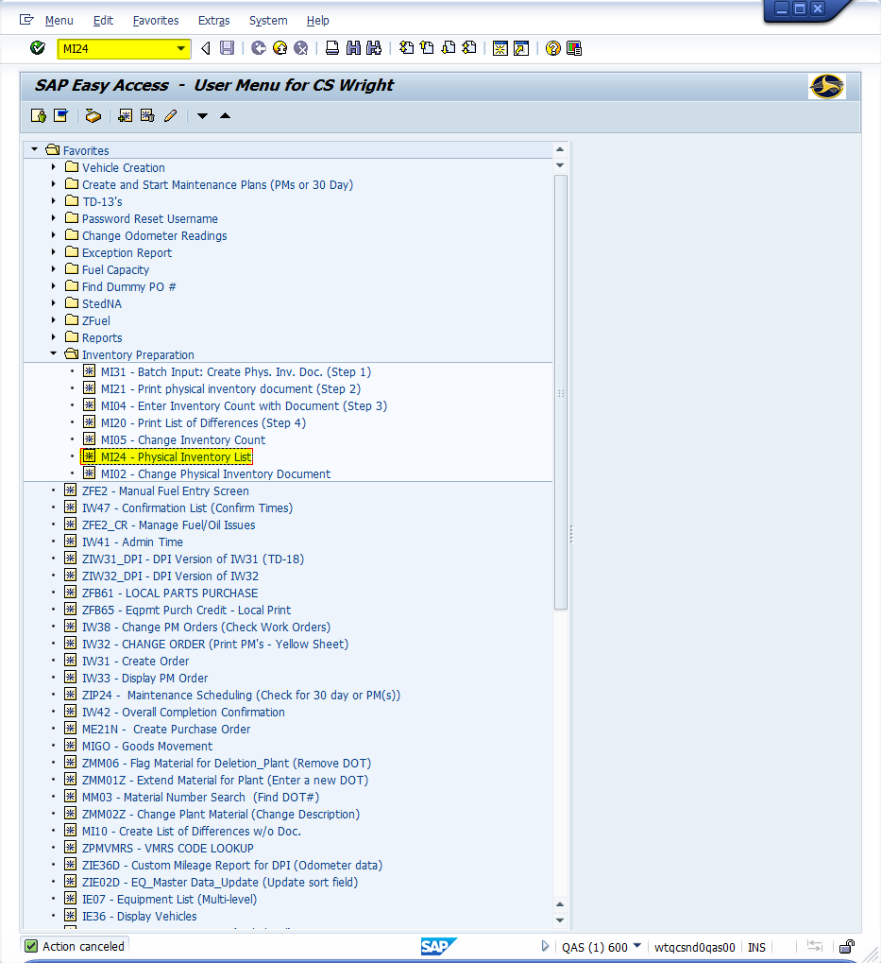
Window:
SAP R/3 Easy Access
Input MI24; or
Favorites menu, <Select> transaction MI24 – Physical Inventory List

Slide 6
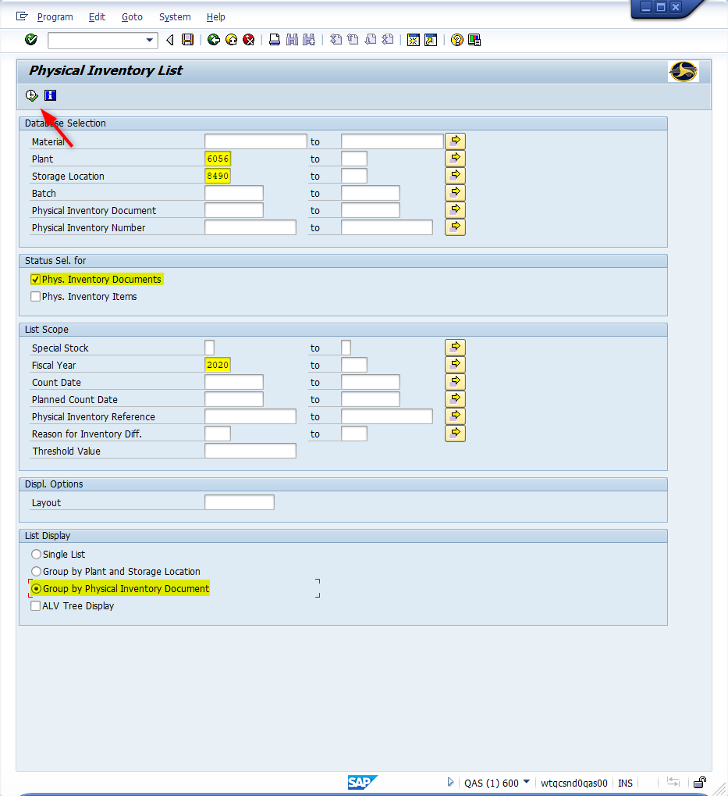
Window opens:
Physical Inventory List
Database Selection Section
Plant Field - Input four-digit number (i.e., Alamance = 6001)
Storage Location Field - Input four-digit number (i.e., Alamance = 8001)
Status Sel. for Section
Phys. Inventory Documents - <Check>
List Scope Section
Fiscal Year – Input year
List Display Section
Group by Physical Inventory Document - <Check>
<Click> Execute icon

Slide 7
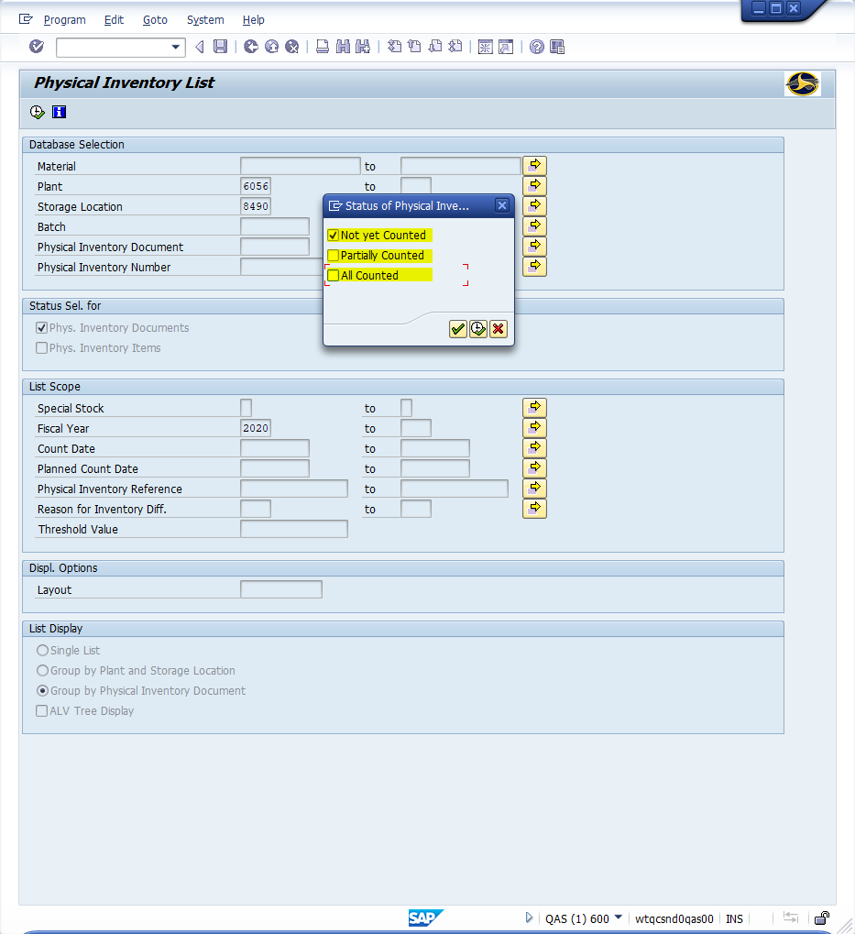
Window opens:
Physical Inventory List Status of Physical Inventory
Not yet Counted Field – <Check>
Partially Counted Field – <Uncheck>
All Counted Field – <Uncheck>
<Click> Execute icon

Slide 8
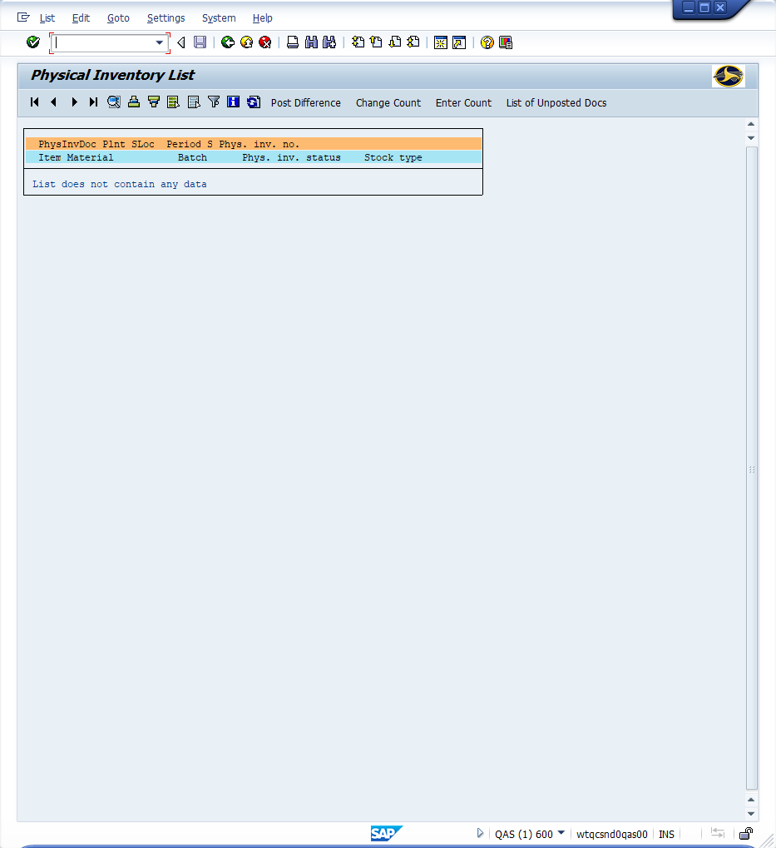
Window opens:
Physical Inventory List
Tip: The screen displays showing all the physical inventory documents that meet the criteria “Not yet counted.” The first data column contains the physical inventory document number and shows all the materials associated with that document.
Record the inventory document numbers
<Click> Exit icon

Slide 9
Questions
Email: Stephen.Wright@dpi.nc.gov

Slide 10
Thank You!
Stephen Wright
Technical Consultant

