Slide 1
Two methods to observe tutorial
Standard Method
This method allows presentation to be resized to user preference.
Slide Show Method (Example below)
Presentation fills entire screen
Click on Slide Show tab at top of screen
Click icon <From Beginning>
Note: Either method; to advance click the progression arrow in the bottom right corner of each slide or press the down-arrow key.

Slide 2
Welcome to
BSIP 101
Transaction Procedures
Issue Material to Teco’d
Work Order
Instructor: Stephen Wright DPI Technical Consultant

Slide 3
Purpose: Issue materials to a work order after the work order has been technically complete

Slide 4
One transaction is required to complete this procedure:
MIGO
Let’s get started -

Slide 5
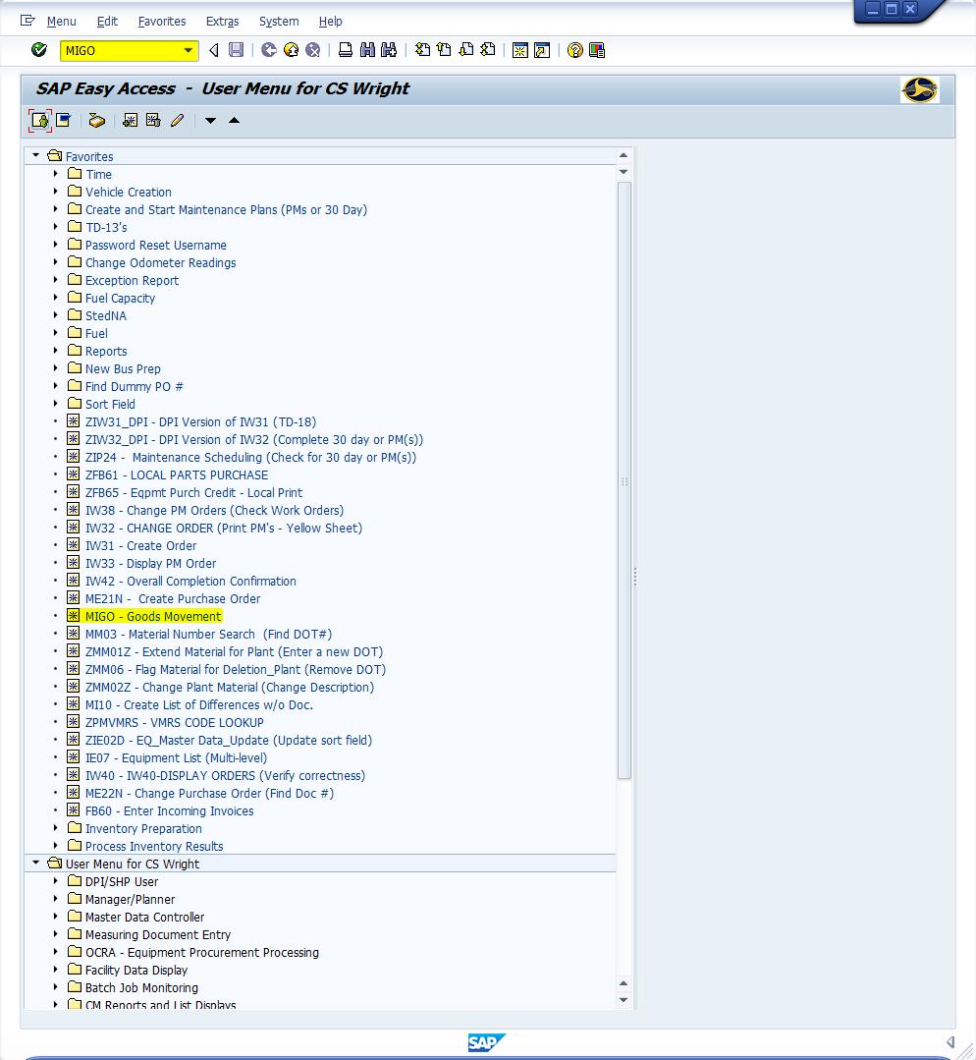
Window:
SAP R/3 Easy Access
Input MIGO; or
Favorites menu, <Select> transaction MIGO – Goods Movement

Slide 6
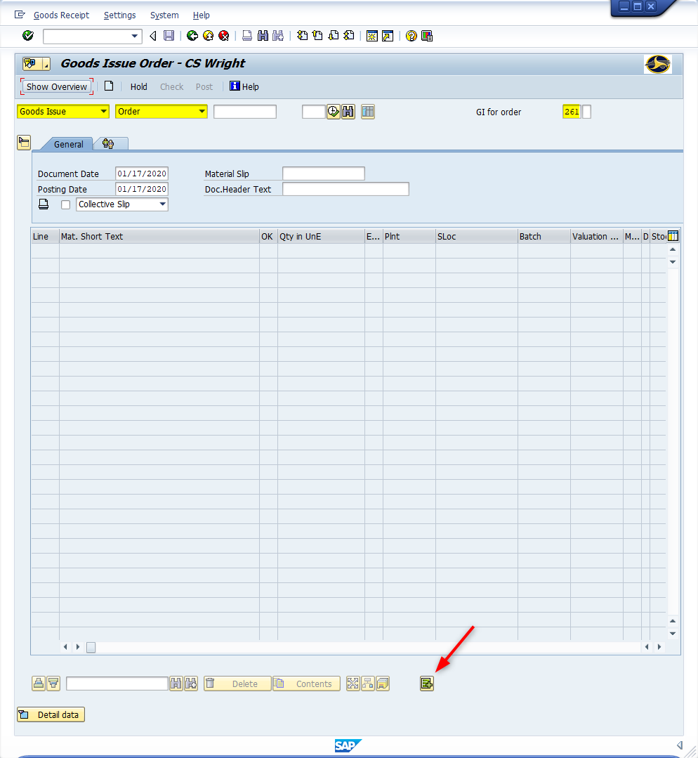
Window opens:
Cancellation Material Document– {Username}
Trans./Event Field = Cancellation
Reference Doc. Field = Order (Software will often default automatically, based upon Trans./Event Field entry)
GI for Order Field – 261 (Always)
<Click> New Item icon
Tip: This will open the data table to allow data input (Fields will turn from gray to white). If the detail data section is maximized click on the Detail Data icon to minimize the section.

Slide 7
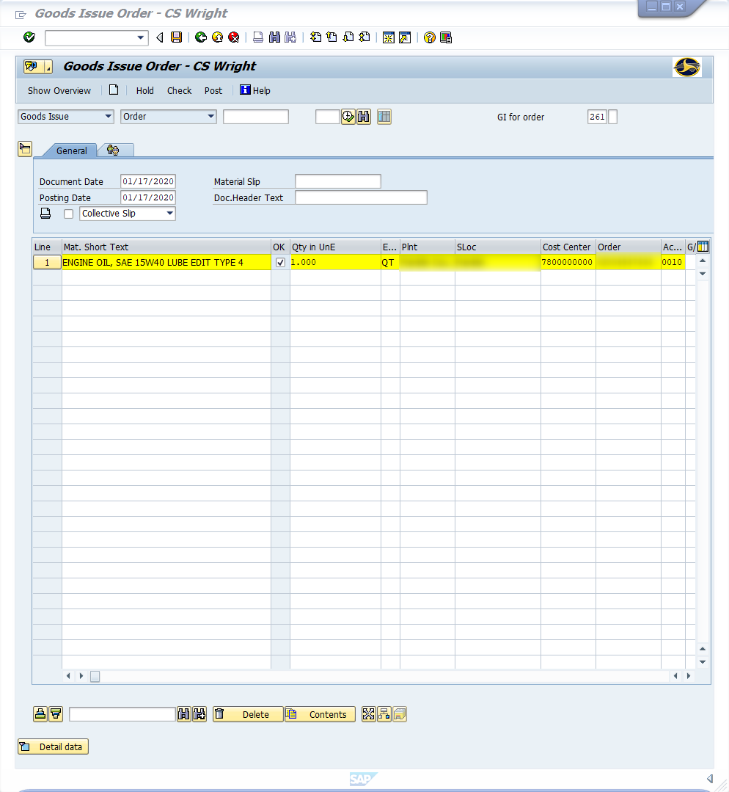
Window:
Cancellation Material Document– {Username}
Material Field – Input nine-digit DOT number (i.e., Oil = 159000049)
Requirement Quantity Field – Input quantity of item used
Unit of Measure Field – Select measurement
Plant Field – Defaults to four-digit code (i.e., Alamance = 6001)
Storage Local Field – Defaults to four-digit code (i.e., Alamance = 8001)
Cost Center Field - 7800000000
Order Field –Input Work order assigning material to
Activity Field – Input transaction assigning material to
Repeat as necessary

Slide 8
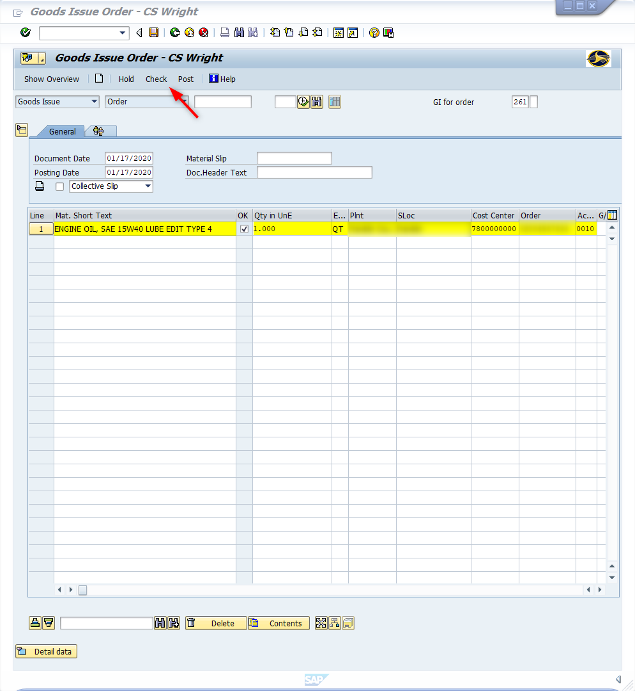
Window:
Cancellation Material Document– {Username}
<Click> Check button
<Click> Save icon
<Click> Exit icon

Slide 9
Questions
Email: Stephen.Wright@dpi.nc.gov

Slide 10
Thank You!
Stephen Wright
DPI Technical Consultant

