Slide 1
Two methods to observe tutorial
Standard Method
This method allows presentation to be resized to user preference.
Slide Show Method (Example below)
Presentation fills entire screen
Click on Slide Show tab at top of screen
Click icon <From Beginning>
Note: Either method; to advance click the progression arrow in the bottom right corner of each slide or press the down-arrow key.

Slide 2
Welcome to
BSIP 101
Transaction Procedures
30 Day Inspection Review & Print
Instructor: Stephen Wright DPI Technical Consultant

Slide 3
Purpose: Review and print DP02 Monthly Inspection work orders

Slide 4
One transaction is required to complete this procedure:
ZIP24
Let’s get started -

Slide 5
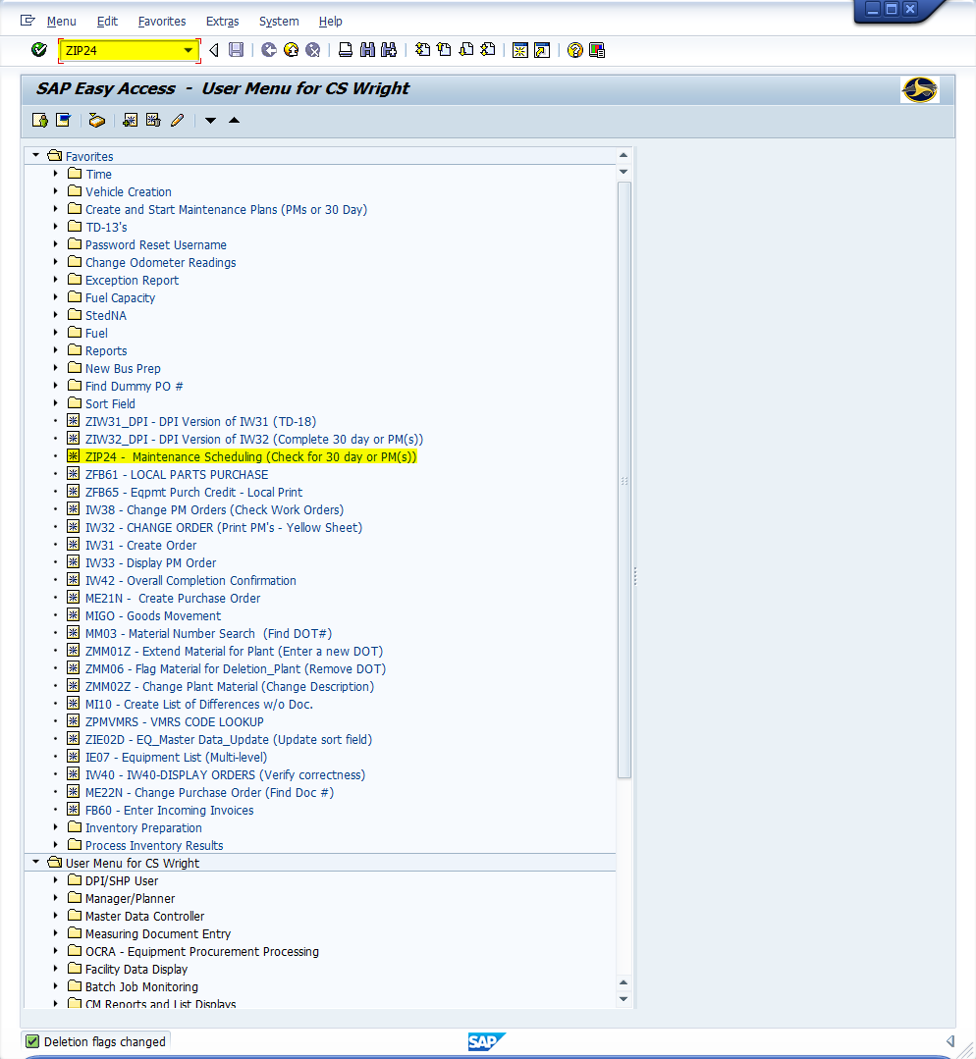
Window:
SAP R/3 Easy Access
Input ZIP24; or
Favorites menu, <Select> transaction ZIP24 – Maintenance Scheduling

Slide 6
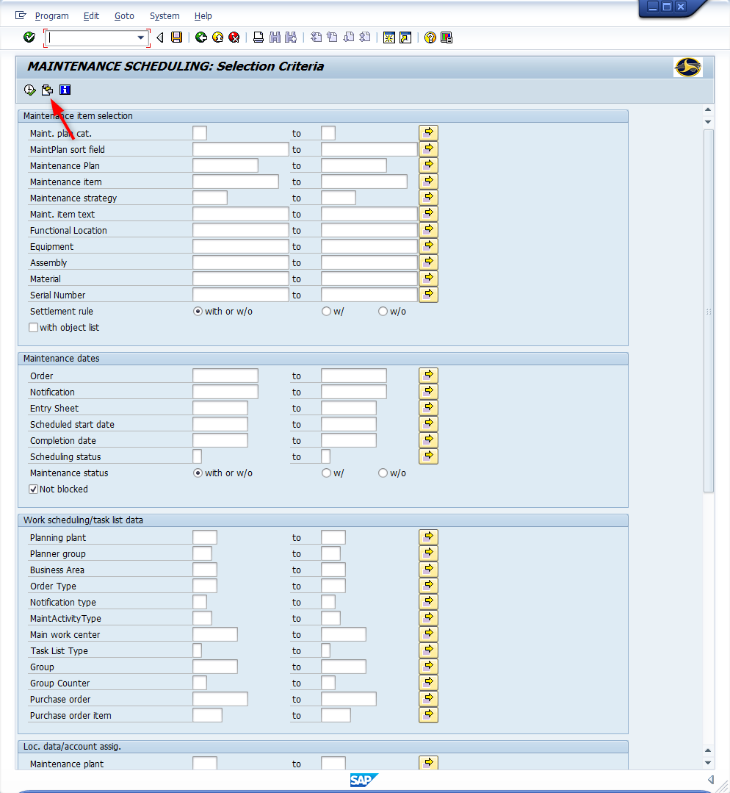
Window opens:
Maintenance Scheduling: Selection Criteria
<Click> Get Variant icon

Slide 7
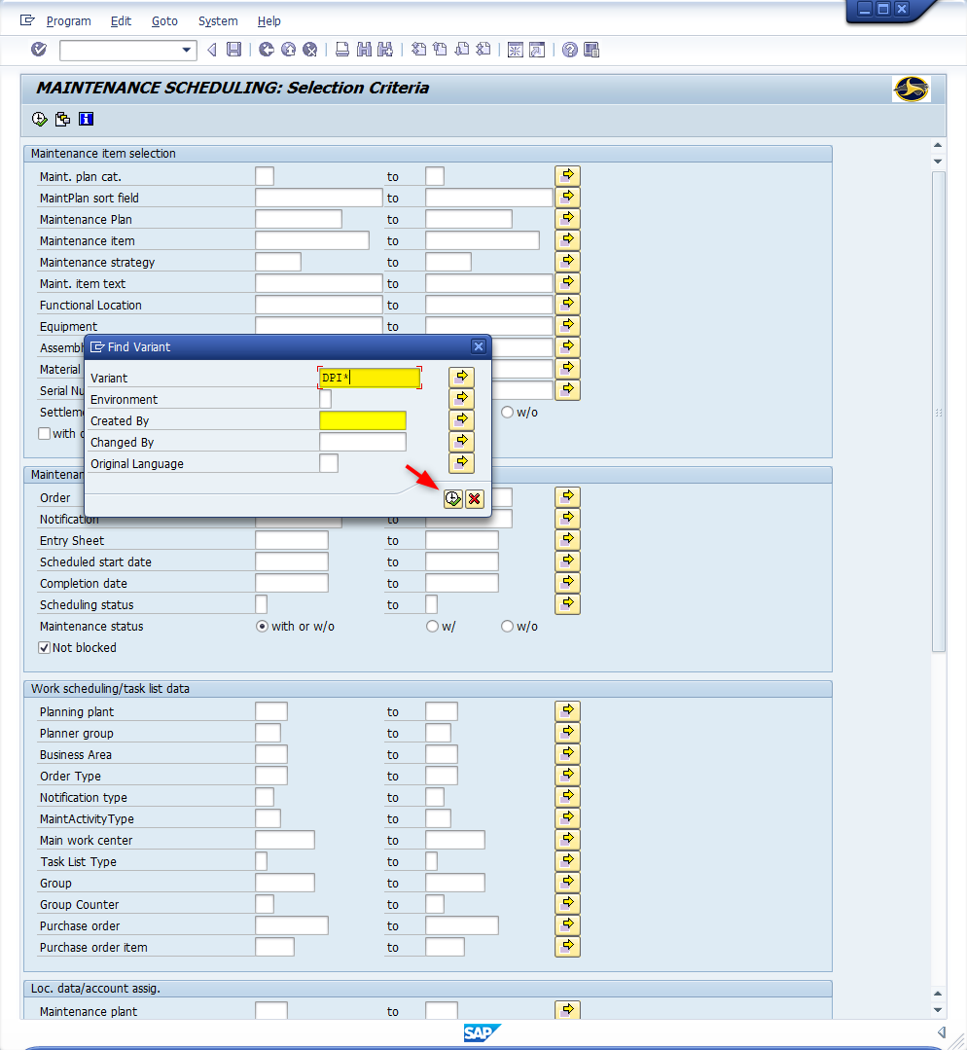
Window opens:
Maintenance Scheduling: Selection Criteria
Find Variant
Variant Field – Input DPI*
Created By Field – Remove username
<Click> Execute icon

Slide 8
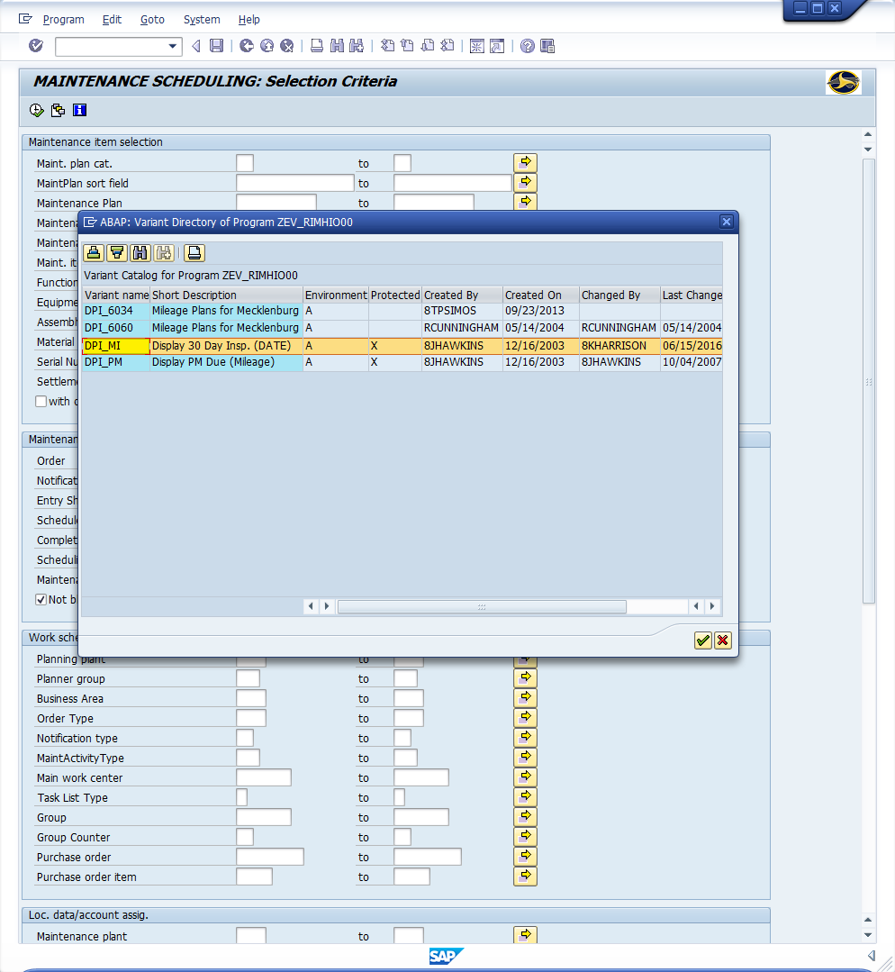
Window opens:
Maintenance Scheduling: Selection Criteria
ABAP: Variant Directory of Program ZEV_RIMHI000
<Double-Click> DPI_MI

Slide 9
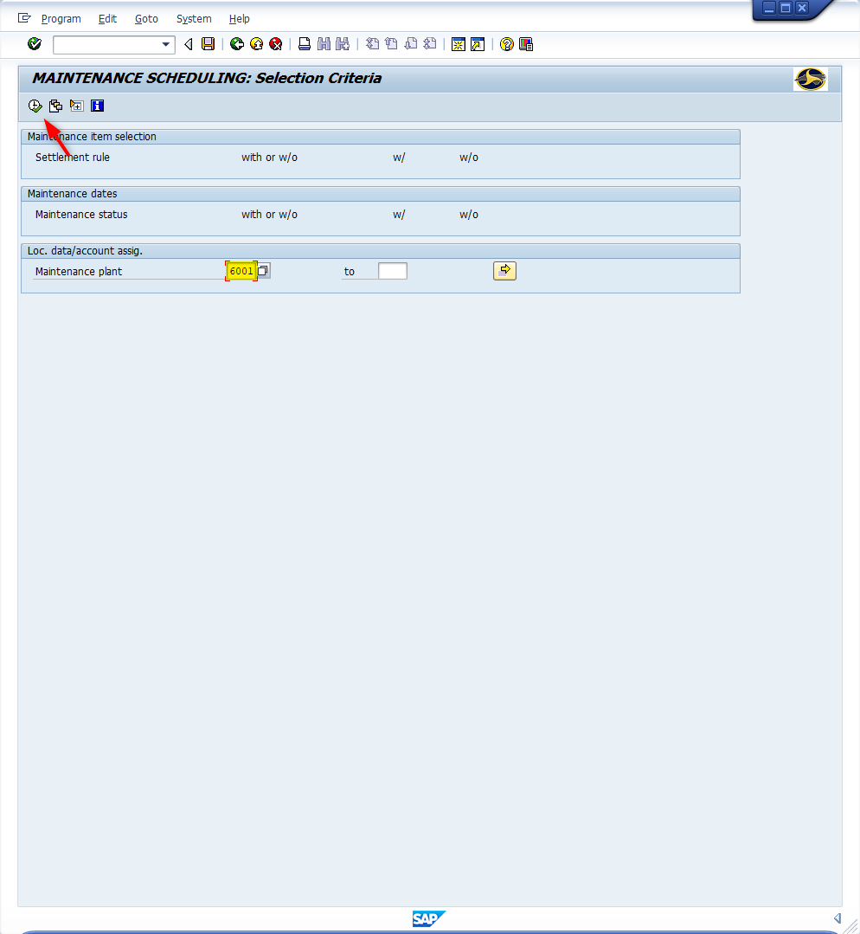
Window opens:
Maintenance Scheduling: Selection Criteria
Maintenance Plant Field – Input four-digit code (i.e., Alamance = 6001)
<Click> Execute icon

Slide 10
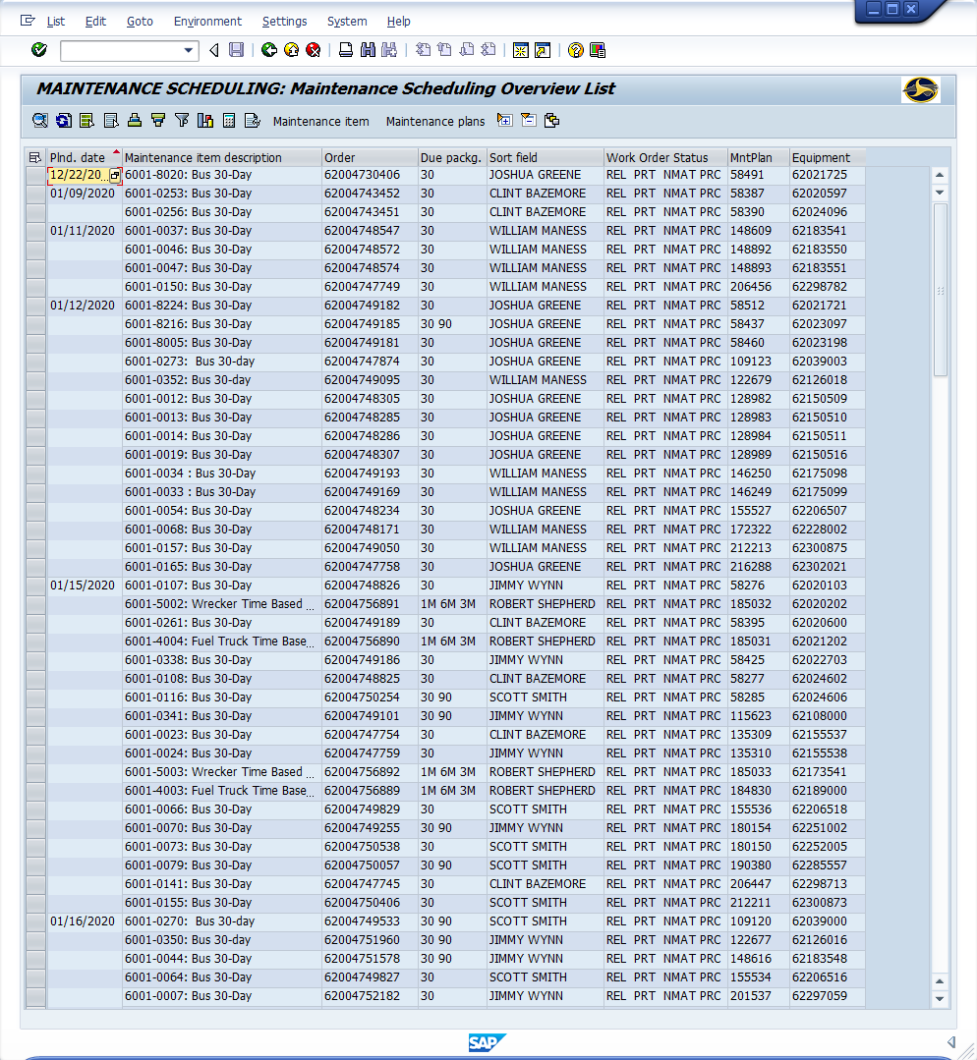
Window opens:
Maintenance Scheduling: Maintenance Scheduling Overview List
Column Descriptions
Planned date (Important) - Due date for inspection to be completed
Maintenance item description – Bus inventory number & maintenance schedule
Order – Work order
Due Packages – Type of Inspection
Sort Field (Optional) – Mechanics name, School, etc.

Slide 11
Window opens:
Maintenance Scheduling: Maintenance Scheduling Overview List
Column Descriptions (Continued)
Work Order Status – (Important)
CRTD = Created
REL = Released
TECO = Technically Completed
CNF = Confirmed
PRT = Printed
NMAT = No material components
MANC = Material availability not checked
PRC = Pre-costed
Maintenance Plan – SAP maintenance plan number for each vehicle (The schedule for when PM’s are due)
Equipment – SAP generated equipment number of vehicle

Slide 12
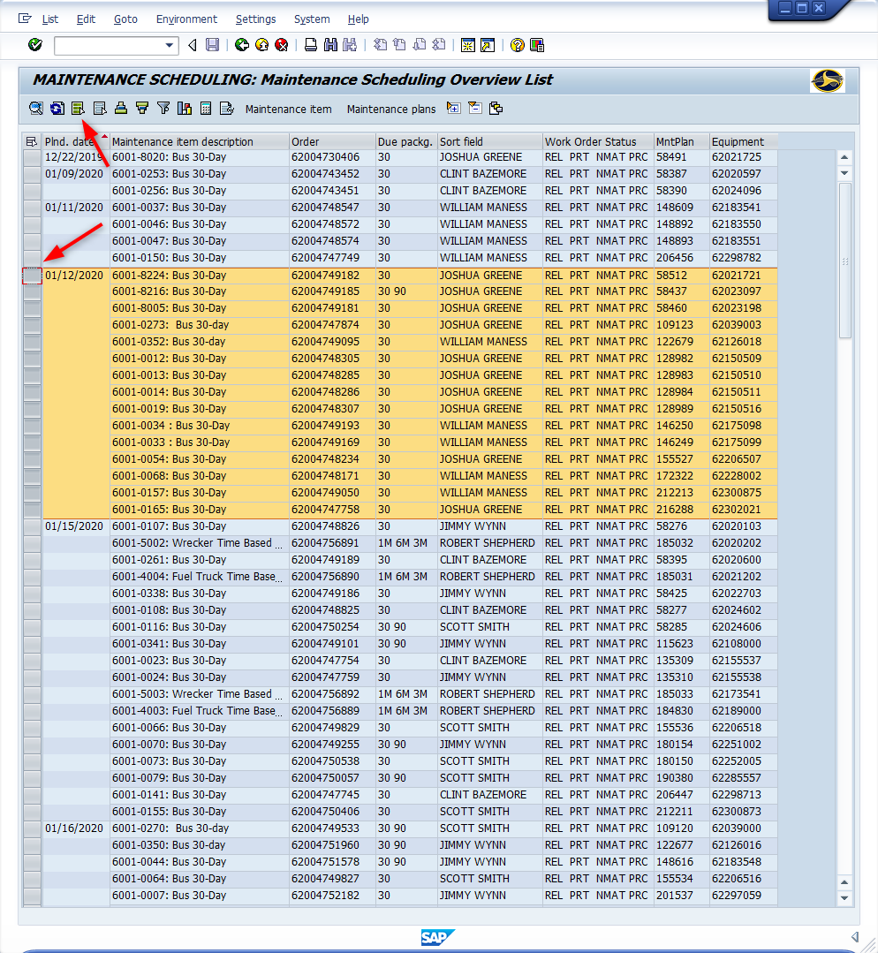
Window opens:
Maintenance Scheduling: Maintenance Scheduling Overview List
Make Selection (Three Methods)
Select Individually
<Click> Select icon to the left of the row. Select multiple rows by holding <Ctrl> key and clicking; or
Select Group
<Click> Select icon of the top-left of the group
Hold <Shift> key
<Click> Select icon of the bottom-left of the group ; or
Select All
<Click> Select All icon

Slide 13
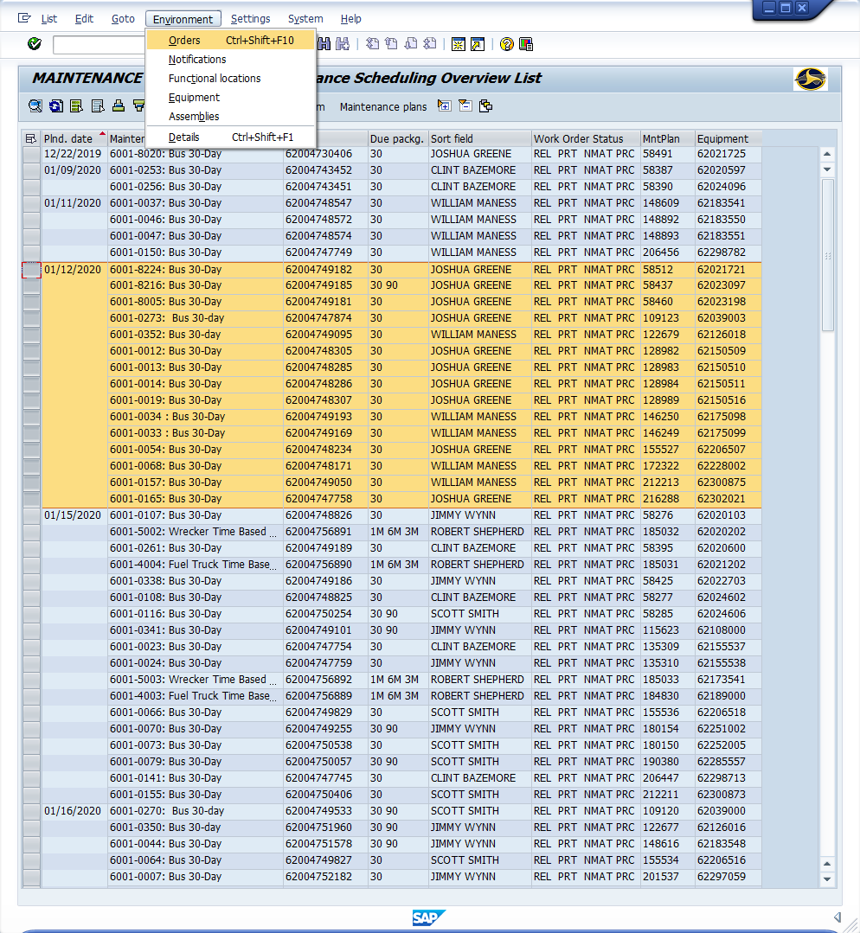
Window opens:
Maintenance Scheduling: Maintenance Scheduling Overview List
<Click> Environment (Top Menu)
<Click> Orders

Slide 14
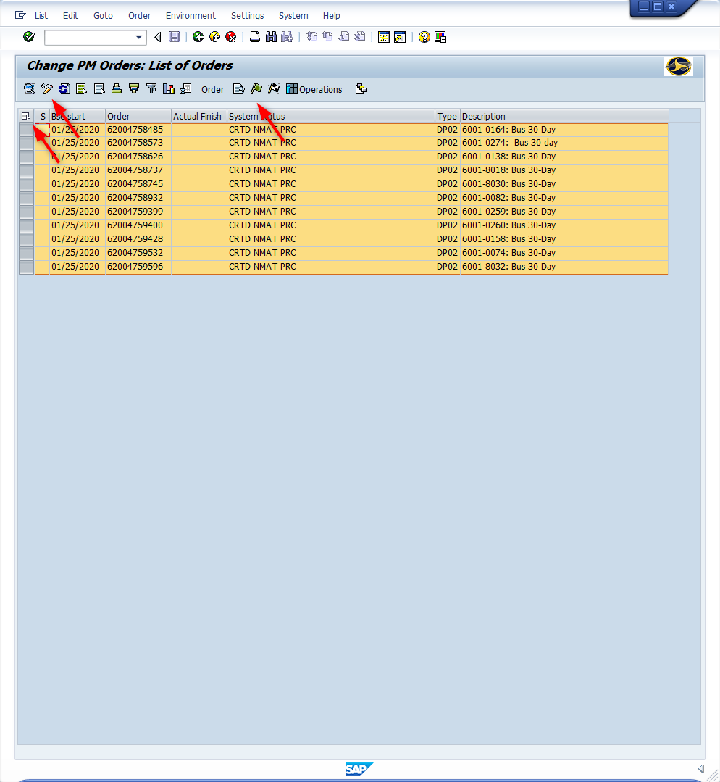
Window opens:
Change PM Orders: List of Orders
<Click> Select All icon
<Click> Change Display icon
<Click> Release order icon

Slide 15
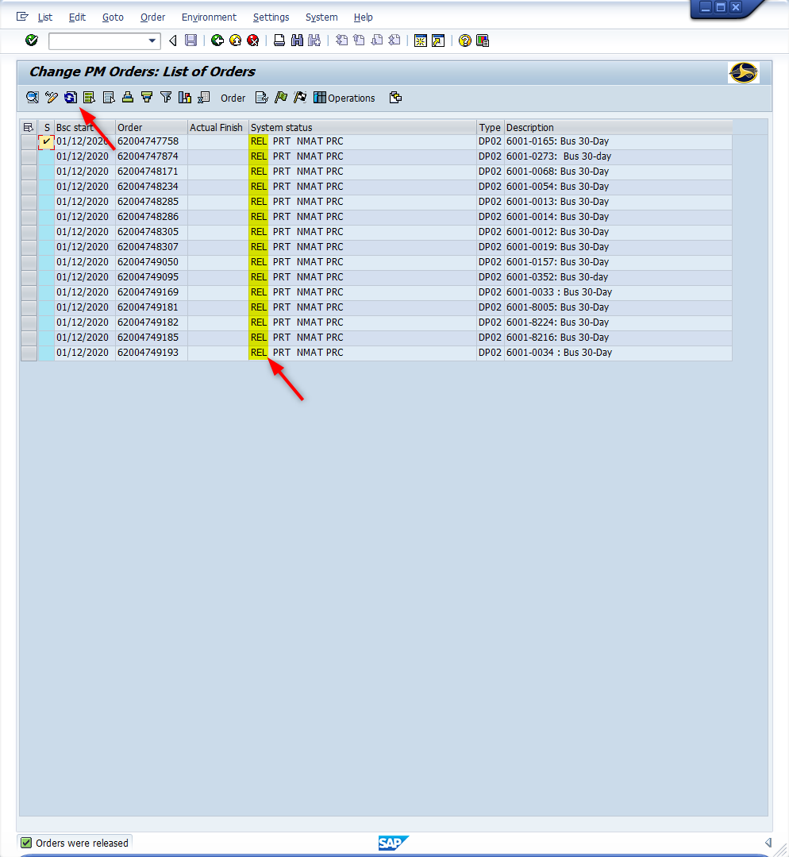
Window opens:
Change PM orders: List of Orders
<Click> Update icon
Tip: “REL” will automatically display in the System Status column for each work order released

Slide 16
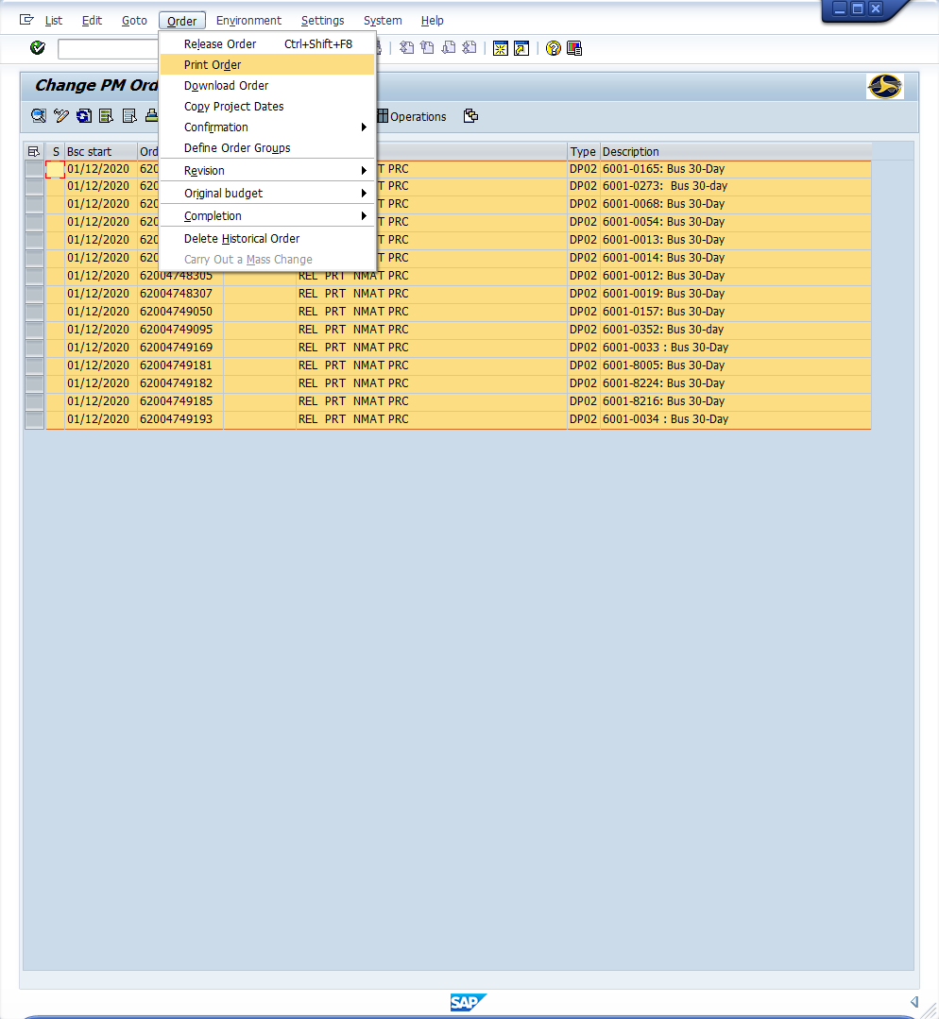
Window opens:
Change PM orders: List of Orders
<Click> Select All icon
<Click> Order (Top Menu)
<Click> Print Order

Slide 17
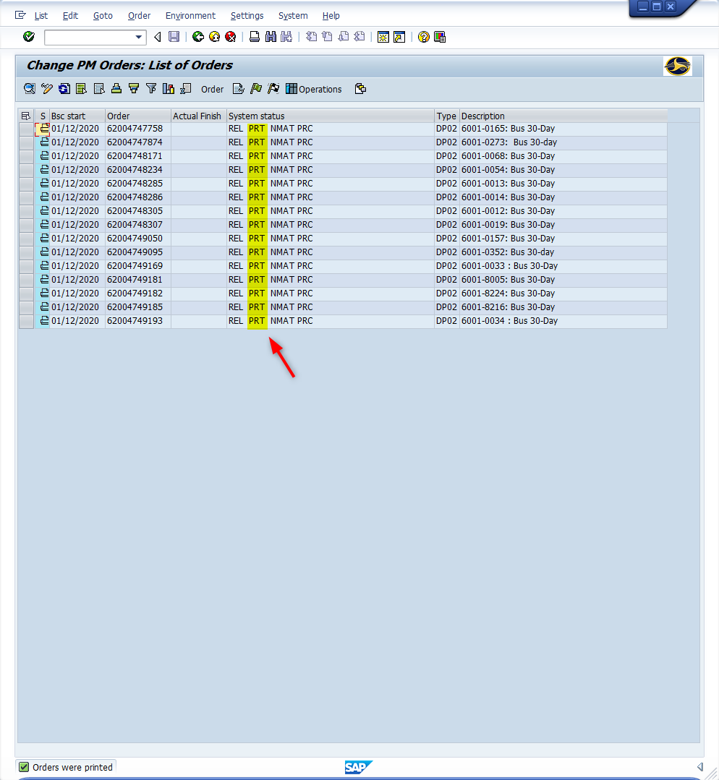
Window opens:
Change PM orders: List of Orders
<Click> Update icon
Tip: “PRT” will automatically display in the System Status column for each work order printed
<Click> Back icon
<Click> Exit icon (Twice)

Slide 18
Questions
Email: Stephen.Wright@dpi.nc.gov

Slide 19
Thank You!
Stephen Wright
DPI Technical Consultant

