Slide 1
Two methods to observe tutorial
Standard Method
This method allows presentation to be resized to user preference.
Slide Show Method (Example below)
Presentation fills entire screen
Click on Slide Show tab at top of screen
Click icon <From Beginning>
Note: Either method; to advance click the progression arrow in the bottom right corner of each slide or press the down-arrow key.

Slide 2
Welcome to
BSIP 101
Transaction Procedures
Administrative Time
Instructor: Stephen Wright DPI Technical Consultant

Slide 3
Purpose: Charge time not attributed to a vehicle

Slide 4
One transaction is required to complete this procedure:
IW41
Let’s get started -

Slide 5
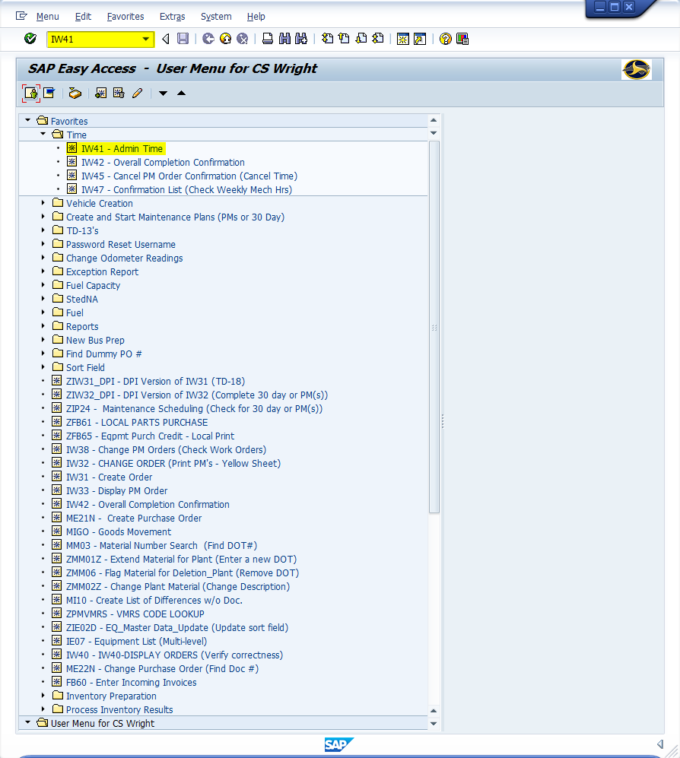
Window:
SAP R/3 Easy Access
Input IW41; or
Favorites menu, <Select> transaction IW41 – Enter PM Order Confirmation (Admin Time)

Slide 6
Administrative Work Number Facts:
11 digits (Always)
Last five digits change (Based upon Plant) (i.e., 680000#####)
Plant | 680000#####
6001 | 64291
6002 | 64292
6003 | 64293
6004 | 64294
6005 | 64295
6006 | 64296
6007 | 64297
6008 | 64298
6009 | 64299
6010 | 64300
6011 | 64301
6012 | 64302
6013 | 64303
6014 | 64304
6015 | 64305
6016 | 64306
6017 | 64307
6018 | 64308
6019 | 64309
6020 | 64310
6021 | 64311
6022 | 64312
6023 | 64313
6024 | 64314
6025 | 64315
Plant | 680000#####
6026 | 64316
6027 | 64317
6028 | 64318
6029 | 64319
6030 | 64320
6031 | 64321
6032 | 64322
6033 | 64323
6034 | 64324
6035 | 64325
6036 | 64326
6037 | 64327
6038 | 64328
6039 | 64329
6040 | 64330
6041 | 64331
6042 | 64332
6043 | 64333
6044 | 64334
6045 | 64335
6046 | 64336
6047 | 64337
6048 | 64338
6049 | 64339
6050 | 64340
Plant | 680000#####
6051 | 64341
6052 | 64342
6053 | 64343
6054 | 64344
6055 | 64345
6056 | 64346
6057 | 64347
6058 | 64349
6059 | 64350
6060 | 64351
6061 | 64666
6062 | 64667
6063 | 64669
6064 | 64670
6065 | 64671
6066 | 64672
6067 | 64673
6068 | 64674
6069 | 64675
6070 | 64676
6071 | 64677
6072 | 64678
6073 | 64679
6074 | 64680
6075 | 64681
Plant | 680000#####
6076 | 64682
6077 | 64683
6078 | 64684
6079 | 64685
6080 | 64686
6081 | 64687
6082 | 64688
6083 | 64689
6084 | 64690
6085 | 64691
6086 | 64692
6087 | 64693
6088 | 64694
6089 | 64695
6090 | 64696
6091 | 64697
6092 | 64698
6093 | 64699
6094 | 64700
6095 | 64701
6096 | 64702
6097 | 64703
6098 | 64704
6099 | 64705
6100 | 64706

Slide 7
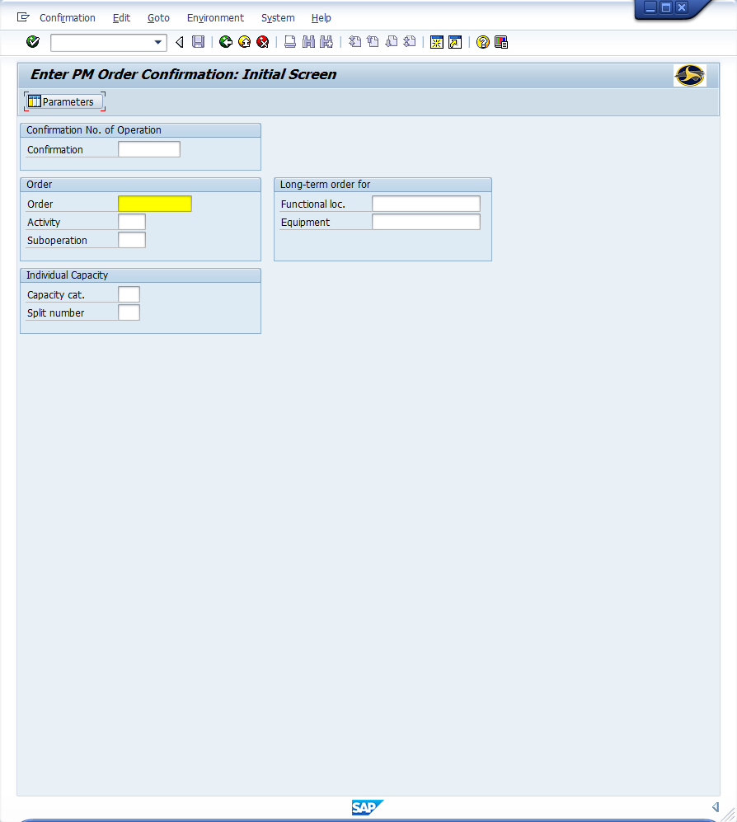
Window opens:
Enter PM Order Confirmation: Initial Screen
Order Field – Input 11-digit administrative work order
Activity Field – Input four-digit code (See below)
<Enter>
Act Description
0010 Vacation/Sick Leave
0020 Workshops/Training
0030 BSIP Work
0040 Fuel Route
0050 Shop
0060 Stock Room Work
0070 Travel not for repair/inspection
0080 Charter Bus Examination

Slide 8
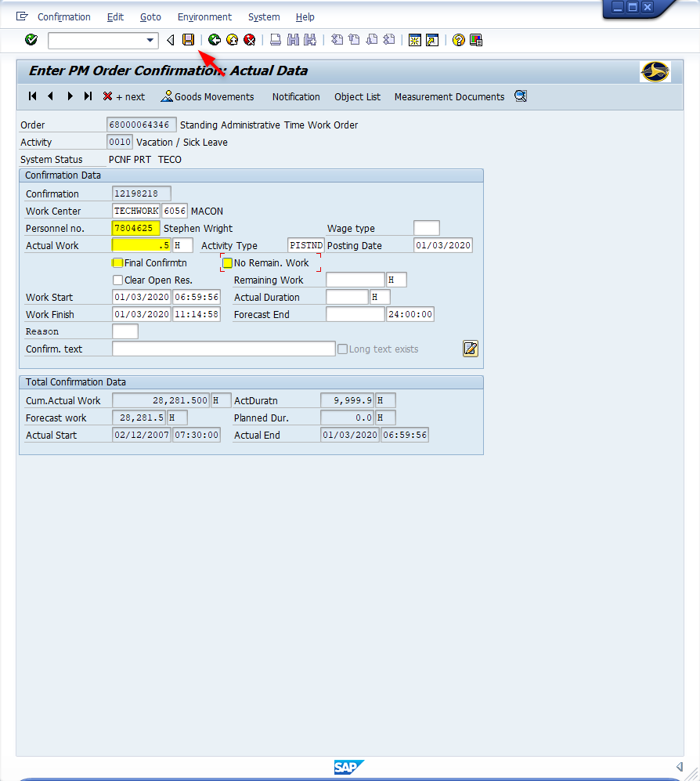
Window opens:
Enter PM Order Confirmation: Actual Data
Personnel Number Field – Input seven-digit employee identification number
Actual Work Field - Input time to complete transaction
<Uncheck> Final Confirmation Field
<Uncheck> No Remaining Work
<Click> Save icon

Slide 9
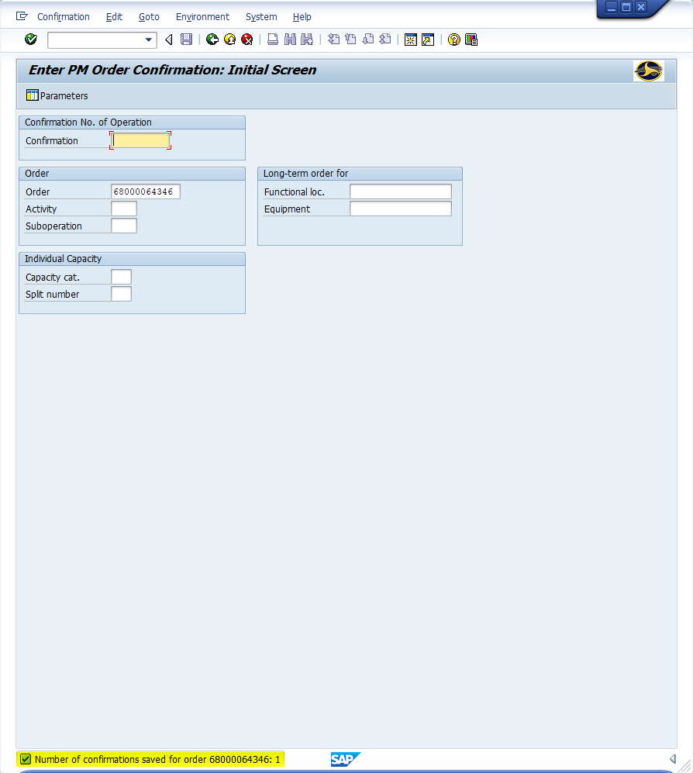
Window opens:
Enter PM Order confirmation: Initial Screen
Tip: Confirmation appears in the status bar
<Click> Continue icon if more confirmations to be input
OR
<Click> Exit icon

Slide 10
Questions
Email: Stephen.Wright@dpi.nc.gov

Slide 11
Thank You!
Stephen Wright
DPI Technical Consultant

