Slide 1
Two methods to observe tutorial
Standard Method
This method allows presentation to be resized to user preference.
Slide Show Method (Example below)
Presentation fills entire screen
Click on Slide Show tab at top of screen
Click icon <From Beginning>
Note: Either method; to advance click the progression arrow in the bottom right corner of each slide or press the down-arrow key.

Slide 2
Welcome to
BSIP 101
Transaction Procedures
Report
Work Orders
Outstanding & In Process
Instructor: Stephen Wright DPI Technical Consultant

Slide 3
Purpose: Identify all work orders that are outstanding and/or in process

Slide 4
One transaction is required to complete this procedure:
IW38
Let’s get started -

Slide 5
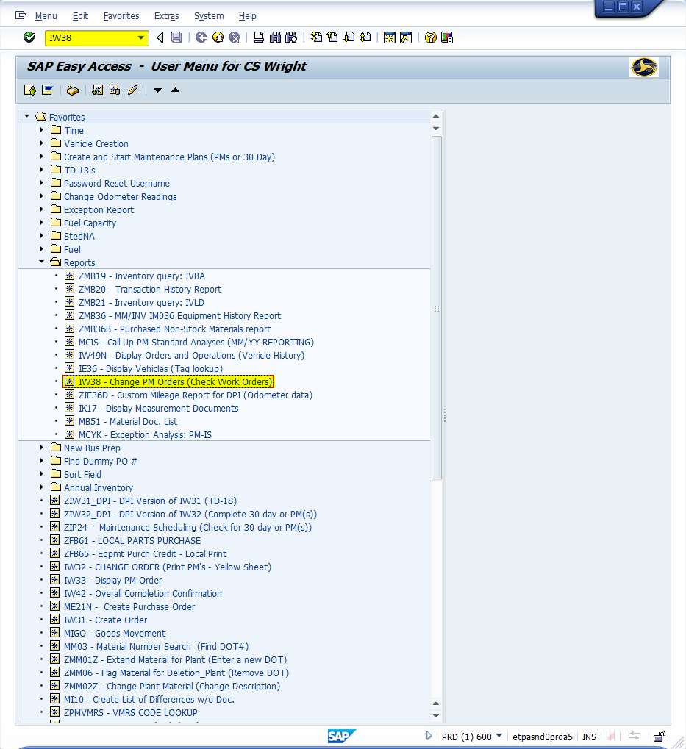
Window:
SAP R/3 Easy Access
Input IW38; or
Favorites menu, <Select> transaction IW38 – Change PM Orders

Slide 6
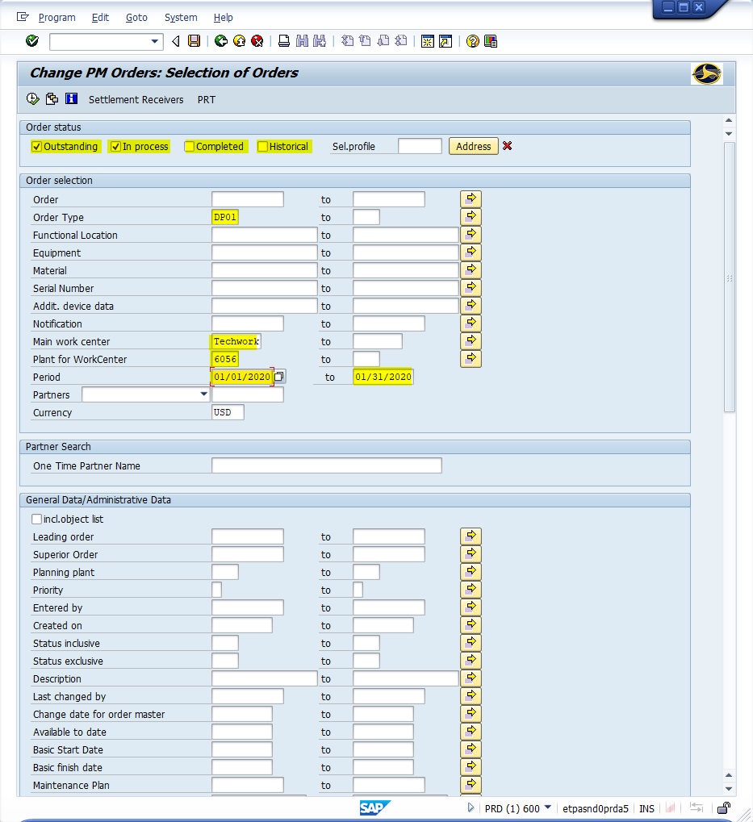
Window opens:
Change PM Orders: Selection of Orders
Order Status
<Check> one and/or both
Outstanding Field
In Process
<Uncheck> both
Completed
Historical

Slide 7
Window opens:
Change PM Orders: Selection of Orders
Order Selection
Order Type Field – Input four-digit code; leave blank to see all order types.
Common Order Types
DP01 = Corrective Maintenance
DP02 = Preventive Maintenance
Main work center field – TECHWORK (Always)
Plant Field – Input four-digit code (i.e., Alamance = 6001)
Date/Range Field – Input a single date or date range (i.e., 01/01/2020, 01/31/2020)
<Click> Execute icon

Slide 8
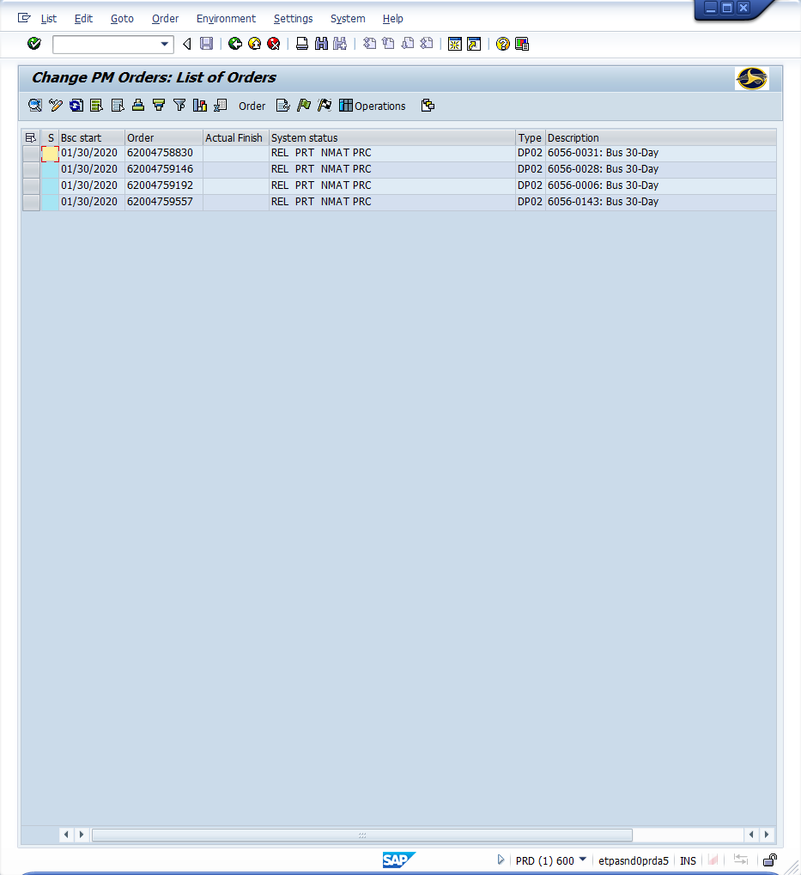
Window opens:
Change PM Orders: List of Orders
<Double-Click> Work order number to open the Change DPI Corrective/Preventive Maintenance Order {Work order number}: Central Header screen
<Click> Back icon (Returns to table)
<Click> Exit icon (Returns to main menu)

Slide 9
Questions
Email: Stephen.Wright@dpi.nc.gov

Slide 10
Thank You!
Stephen Wright
DPI Technical Consultant

