Slide 1
Two methods to observe tutorial
Standard Method
This method allows presentation to be resized to user preference.
Slide Show Method (Example below)
Presentation fills entire screen
Click on Slide Show tab at top of screen
Click icon <From Beginning>
Note: Either method; to advance click the progression arrow in the bottom right corner of each slide or press the down-arrow key.

Slide 2
Welcome to
BSIP 101
Transaction Procedures
Report
Work Orders
Display Operations
Instructor: Stephen Wright DPI Technical Consultant

Slide 3
Purpose: Display information relevant to the operations of a work order

Slide 4
One transaction is required to complete this procedure:
IW49
Let’s get started -

Slide 5
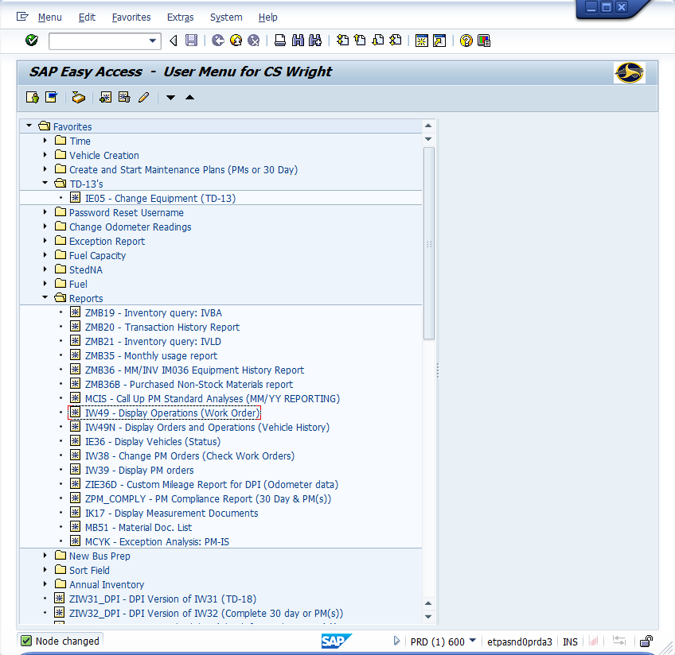
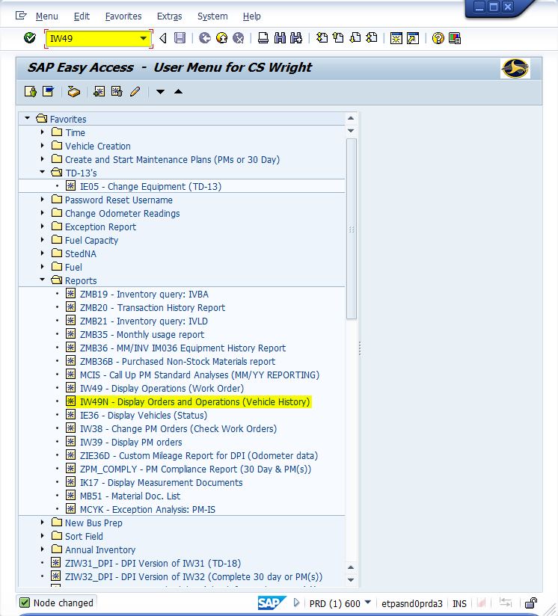
Window:
SAP R/3 Easy Access
Input IW49; or
Favorites menu, <Select> transaction IW49 – Display Operations

Slide 6
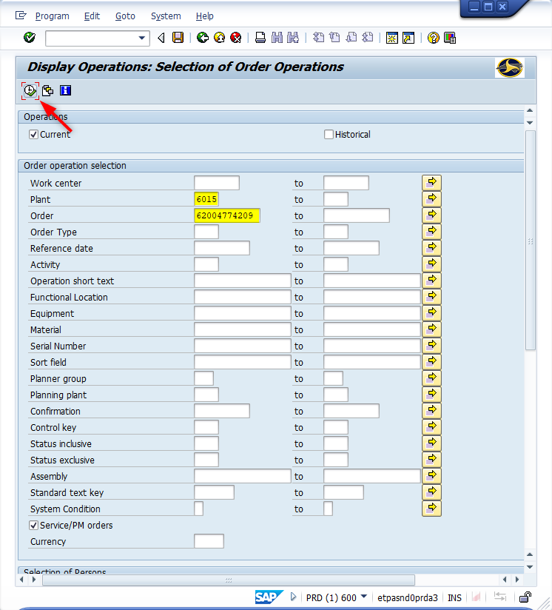
Window opens:
Display Operations: Selection of Order Operations
Plant Field – Input four-digit code (i.e., Alamance = 6001)
Order Field – Input eleven-digit work order number.
<Click> Execute icon

Slide 7
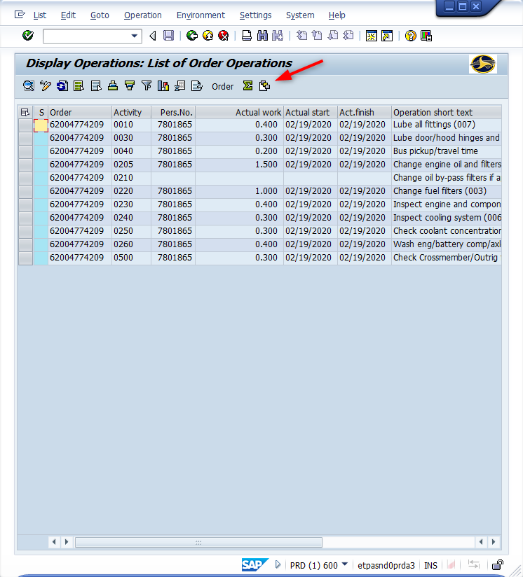
Window opens:
Display Operations: List of Order Operations
Setup Table (Required only once)
<Click> Current icon

Slide 8
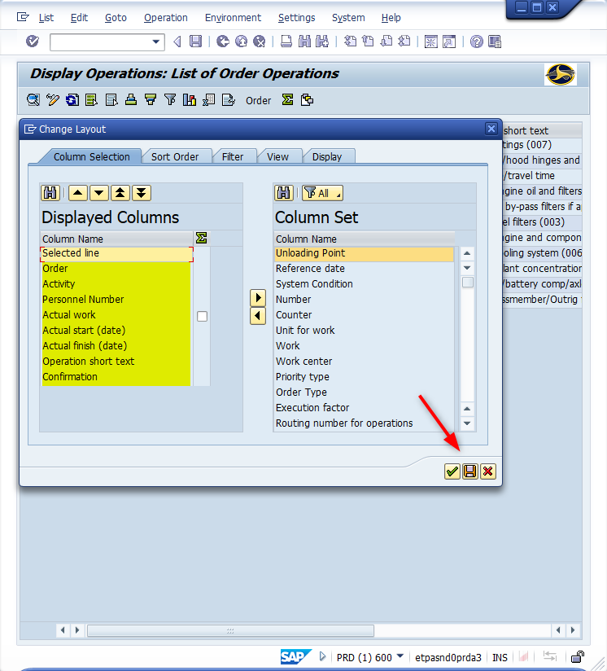
Window opens:
Change Layout
<Double-Click> On the following list of items to move them from right column to the left column. Also, if a different item is in the left column - <Double-Click> on it to move it back to the right column. Highlighted are a list of useful items to review.
<Click> Save icon

Slide 9
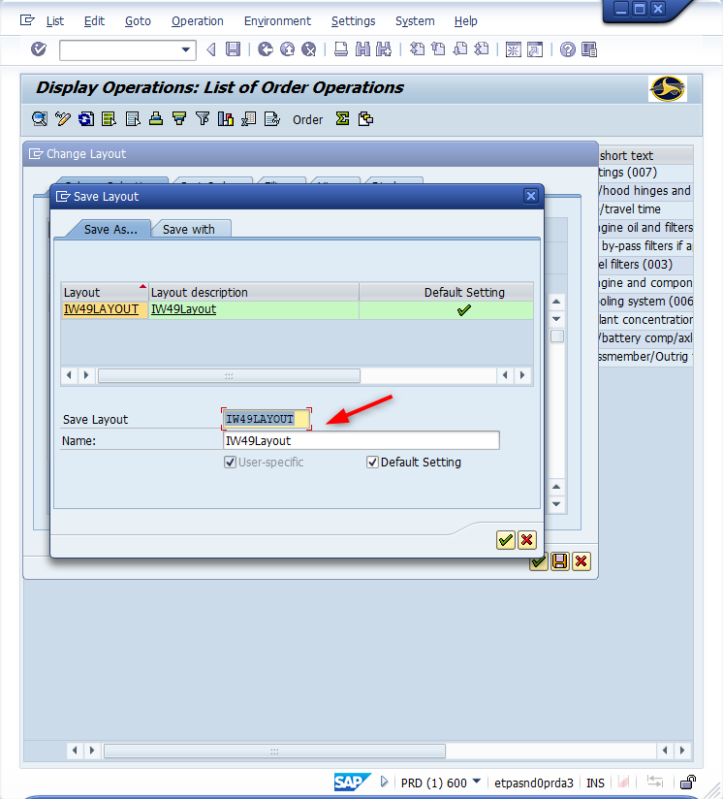
Window opens:
Save Layout
Save Layout Field – Input a layout description (i.e., IW49Layout)
Name Field – Input a name for layout (i.e., Suggest using the same name as the save layout field)
<Click> Continue icon (Twice)

Slide 10
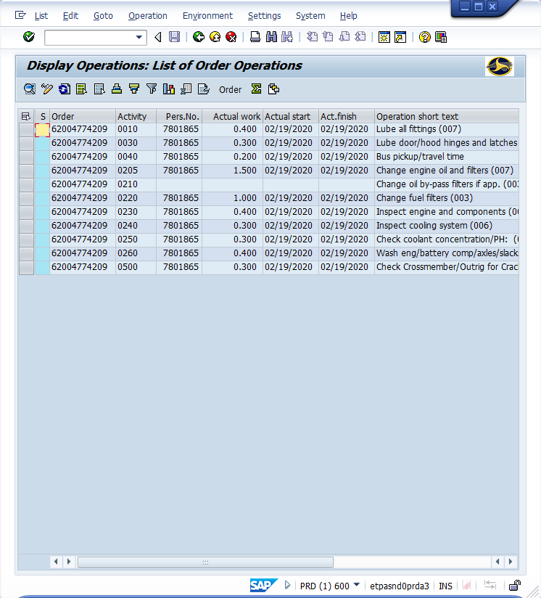
Window opens:
Display Operations: List of Order Operations
Tip: The screen will display all of the information requested.
<Click> Exit icon (Twice)

Slide 11
Questions
Email: Stephen.Wright@dpi.nc.gov

Slide 12
Thank You!
Stephen Wright
DPI Technical Consultant

