Slide 1
Two methods to observe tutorial
Standard Method
This method allows presentation to be resized to user preference.
Slide Show Method (Example below)
Presentation fills entire screen
Click on Slide Show tab at top of screen
Click icon <From Beginning>
Note: Either method; to advance click the progression arrow in the bottom right corner of each slide or press the down-arrow key.

Slide 2
Welcome to
BSIP 101
Transaction Procedures
Report Compliance PM(s)
Instructor: Stephen Wright DPI Technical Consultant

Slide 3
Purpose: Produce a report that displays compliance of PM’s (Preventative Maintenance) work orders

Slide 4
One transaction is required to complete this procedure:
ZPM_COMPLY
Let’s get started -

Slide 5
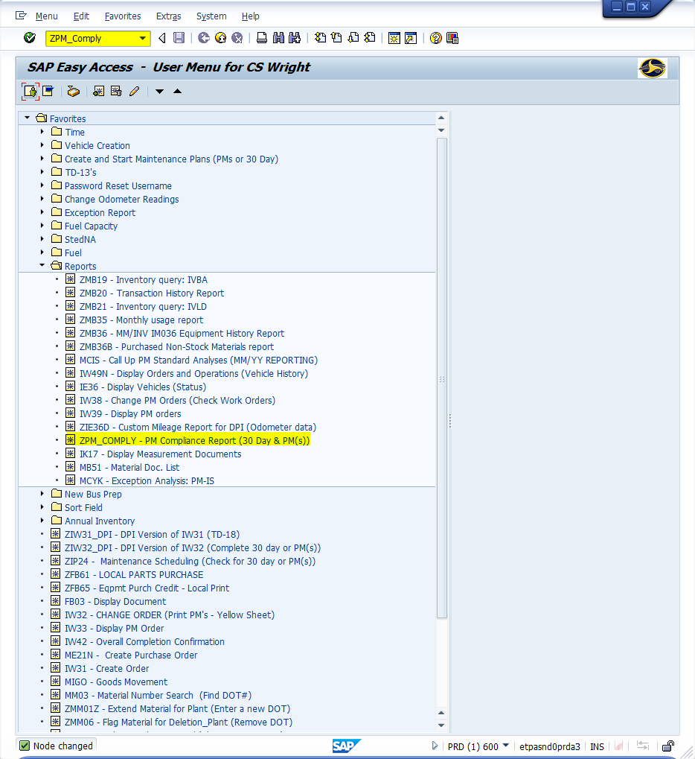
Window:
SAP R/3 Easy Access
Input ZPM_COMPLY; or
Favorites menu, <Select> transaction ZPM_COMPLY – PM Compliance Report

Slide 6
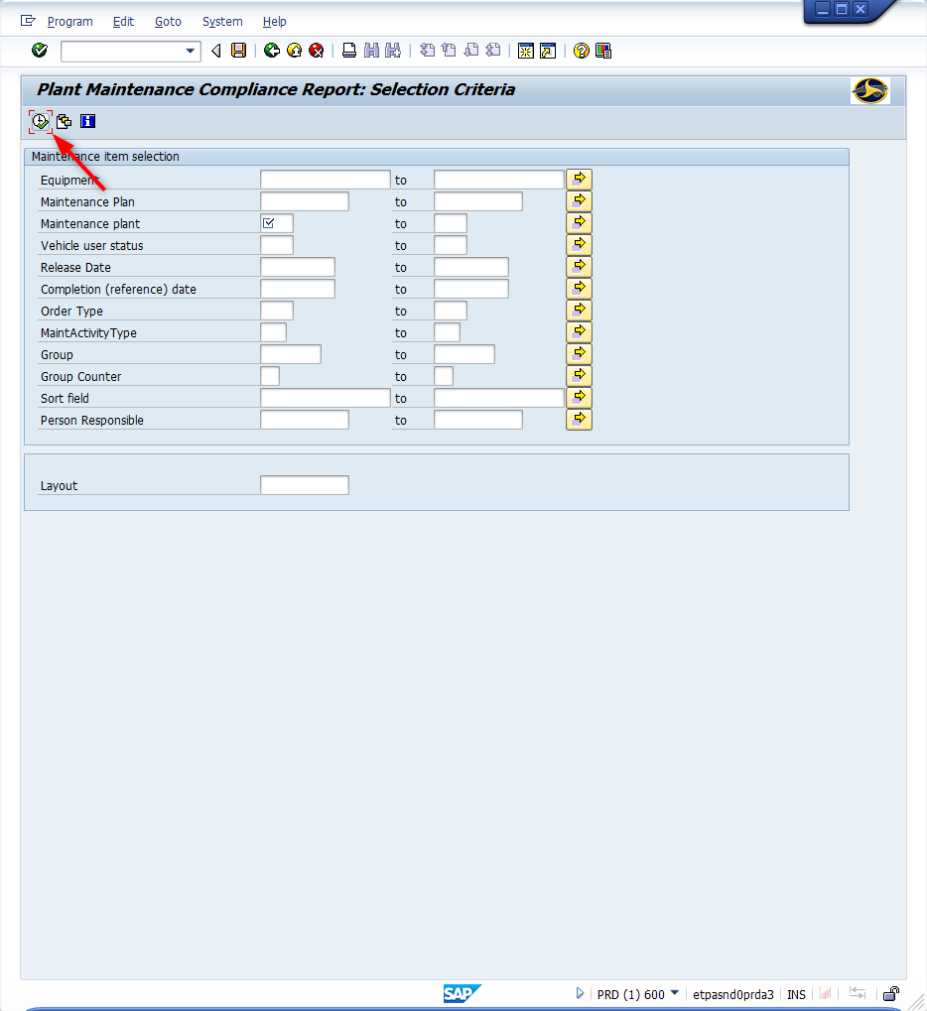
Window opens:
Plant Maintenance Compliance Report: Selection Criteria
<Click> Get Variant icon

Slide 7
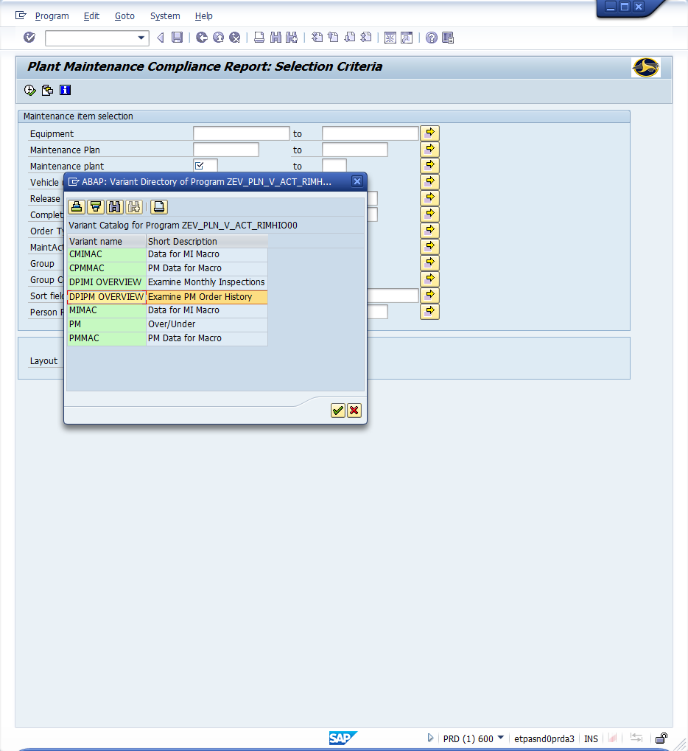
Window opens:
ABAP: Variant Directory of Program ZEV_PLN_V_ACT_RIMHIO00
<Double-Click> Variant Name Field – DPIPM_OVERVIEW

Slide 8
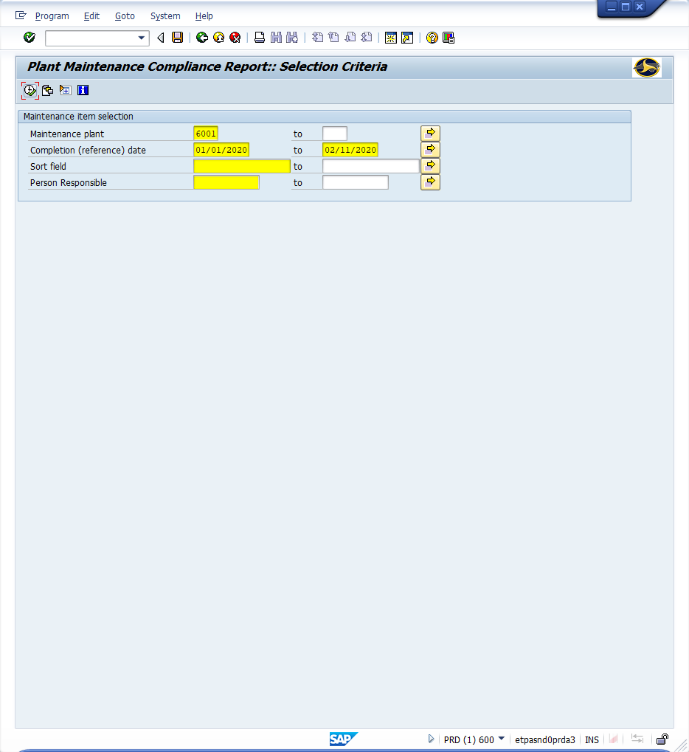
Window opens:
Plant Maintenance Compliance Report: Selection Criteria
Maintenance plant Field – Input four-digit code. (i.e., Alamance = 6001)
Completion (reference) Field – Input range to narrow search.
Sort Field – (Optional) Input text to match against to narrow search.
Person Responsible – (Optional) Input an employee’s SAP assigned number to narrow search (i.e., 7804625).
<Click> Execute icon

Slide 9
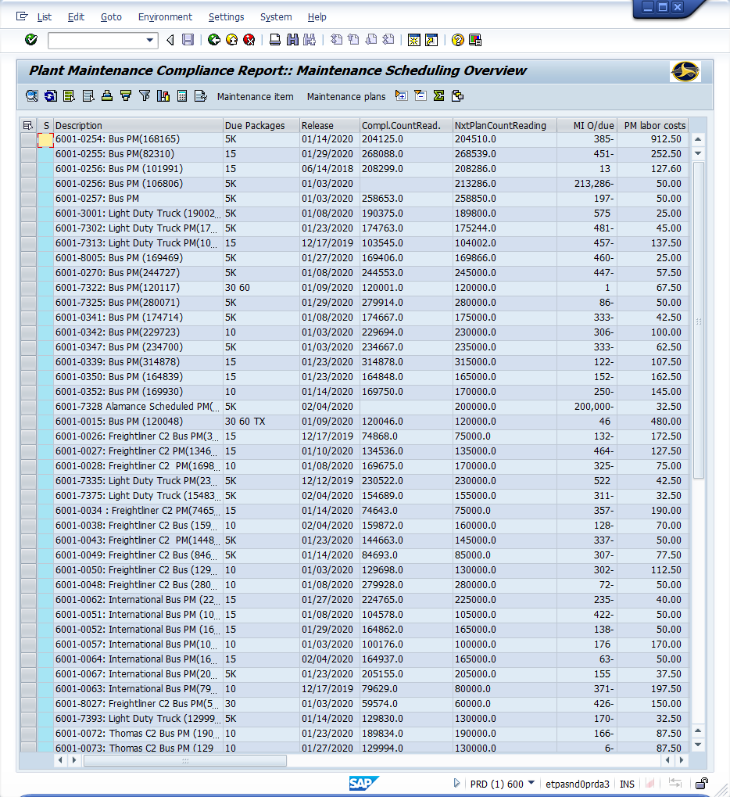
Window opens:
Plant Maintenance Compliance Report: Maintenance Scheduling Overview
Tip: A list displays of all vehicles that meet the selection criteria. If no vehicles are displayed; the message will appear in the bottom status bar. To know the details of a vehicle <Double-Click> upon the work order number of the vehicle.
Column descriptions next slide.

Slide 10
Window opens:
Plant Maintenance Compliance Report: Maintenance Scheduling Overview
Column Overview
Description Contains the vehicles inventory number & work order type.
Due Packages PM Package Due
Release Date The date the order was released (and most likely printed)
Compliance Counter (CCR) – Mileage at the time the order was technically completed.
Next Plan Counter (NPCR) – Mileage the PM was suppose to be completed by.
Miles Overdue Miles the PM was overdue when it was technically completed (If negative the order was completed early)
PM Labor Costs Total cost of labor for the PM
Actual Work Number of hours charged to the PM
Total Material Costs Dollar value of the parts charged to the order
Maintenance Plan Plan number (Double click on the plan number to see all maintenance plan data)
Order Work order number (Double click on the order number to see all order data)
Sort Field Contains the information from the sort field of the order (Copied from the equipment Sort Field at the time the order is created)
Person Responsible Person listed as responsible for assuring completion of the order. This is set using the change order transaction and can be set at any point in the order process.

Slide 11
Questions
Email: Stephen.Wright@dpi.nc.gov

Slide 12
Thank You!
Stephen Wright
DPI Technical Consultant

