Slide 1
Two methods to observe tutorial
Standard Method
This method allows presentation to be resized to user preference.
Slide Show Method (Example below)
Presentation fills entire screen
Click on Slide Show tab at top of screen
Click icon <From Beginning>
Note: Either method; to advance click the progression arrow in the bottom right corner of each slide or press the down-arrow key.

Slide 2
Welcome to
BSIP 101
Transaction Procedures
Report
Non-Stock Purchases
Instructor: Stephen Wright DPI Technical Consultant

Slide 3
Purpose: Identify all non-stock materials charged to a LEA.

Slide 4
One transaction is required to complete this procedure:
ZMB36B
Let’s get started -

Slide 5
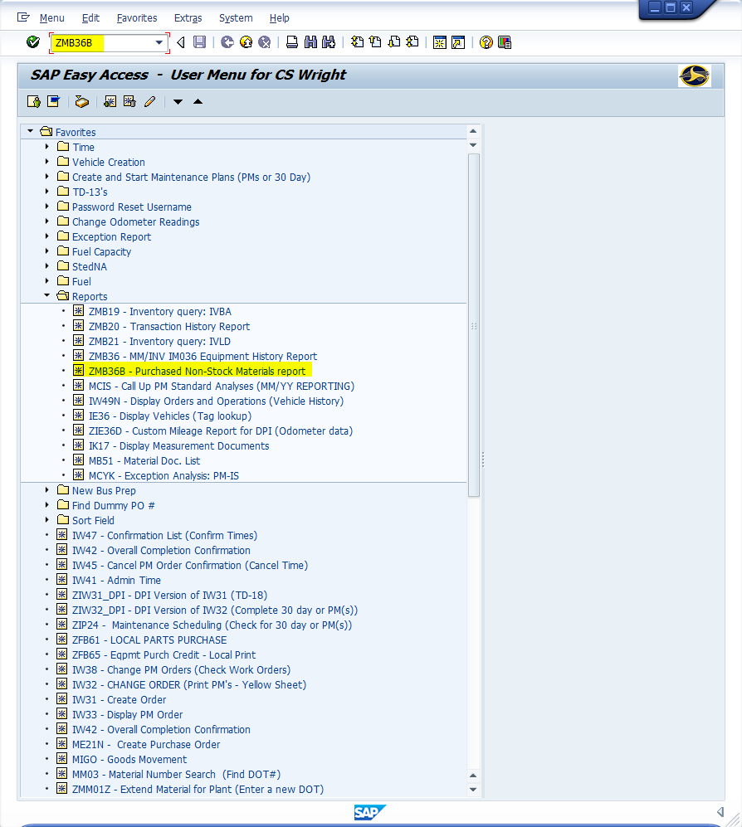
Window:
SAP R/3 Easy Access
Input ZMB36B; or
Favorites menu, <Select> transaction ZMB36B – Purchased Non-Stock Materials Report

Slide 6
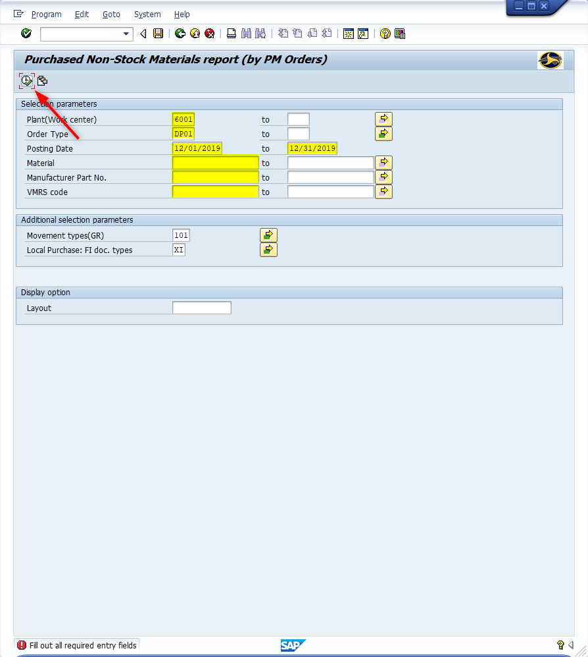
Window opens:
Purchased Non-Stock Materials Report (by PM Orders)
Plant Field – Input four-digit code (i.e., Alamance = 6001)
Order Type Field – Input four-digit code; leave blank to see all order types.
Common Order Types
DP00 = Standing Order
DP01 = Corrective Maintenance
DP02 = Preventive Maintenance
Date/Range Field – Input a single date or date range (i.e., 01/01/2019, 12/31/2019)

Slide 7
Window opens:
Purchased Non-Stock Materials Report (by PM Orders)
Material Field - (Optional) Input
A single nine-digit material number (i.e., EEA000000); or
A range of material numbers (i.e., EEA000000 to EEA000999)
Manufacturer Part No. Field – (Optional) Input the MFG # if you are looking for a particular part from a vendor (i.e., 2589576C1)
VMRS Field – (Optional) Input the VMRS if searching for a particular transaction (i.e., 052-005-003)
Tip: Using the VMRS as a search is very sensitive search. The work order must contain an exact match.

Slide 8
Window opens:
Purchased Non-Stock Materials Report (by PM Orders)
Additional Selection Parameters – Use defaults.
<Click> Execute icon

Slide 9
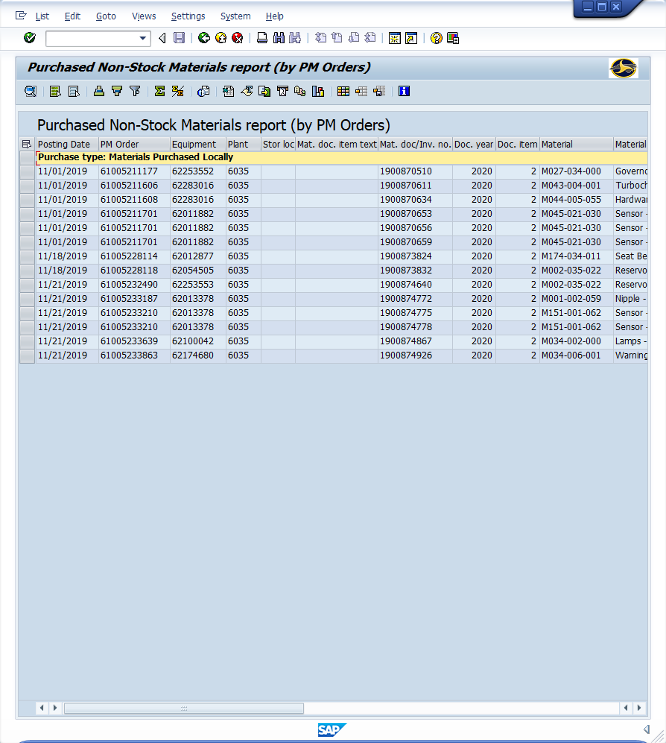
Window opens:
Purchased Non-Stock Materials Report
Items Displayed: (Scroll-right to see all)
Posting Date
PM Order
Material Document #
Material Description
VMRS Code
Qty
UOM
Amount
<Click> Exit icon

Slide 10
Questions
Email: Stephen.Wright@dpi.nc.gov

Slide 11
Thank You!
Stephen Wright
DPI Technical Consultant

