Slide 1
Two methods to observe tutorial
Standard Method
This method allows presentation to be resized to user preference.
Slide Show Method (Example below)
Presentation fills entire screen
Click on Slide Show tab at top of screen
Click icon <From Beginning>
Note: Either method; to advance click the progression arrow in the bottom right corner of each slide or press the down-arrow key.

Slide 2
Welcome to
BSIP 101
Transaction Procedures
Display Equipment
Orders & Operations
Instructor: Stephen Wright DPI Technical Consultant

Slide 3
Purpose: Produce a report that displays equipment orders and operations

Slide 4
One transaction is required to complete this procedure:
IW49N
Let’s get started -

Slide 5
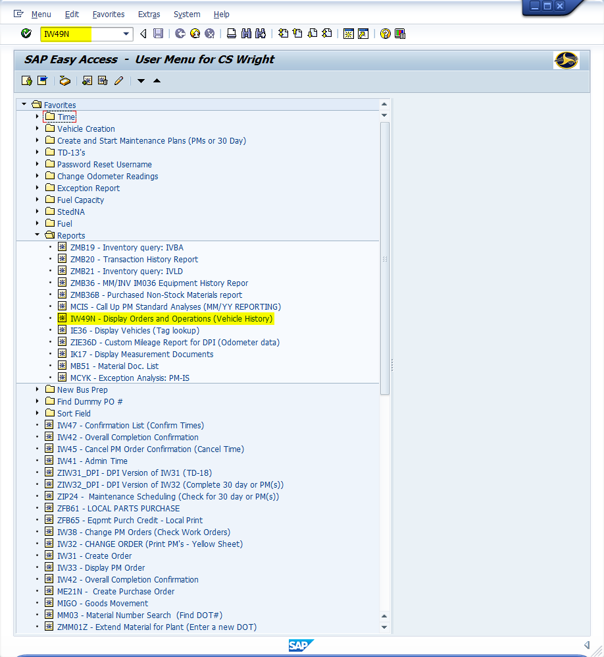
Window:
SAP R/3 Easy Access
Input IW49N; or
Favorites menu, <Select> transaction IW49N – Display Orders and Operations (Vehicle History)

Slide 6
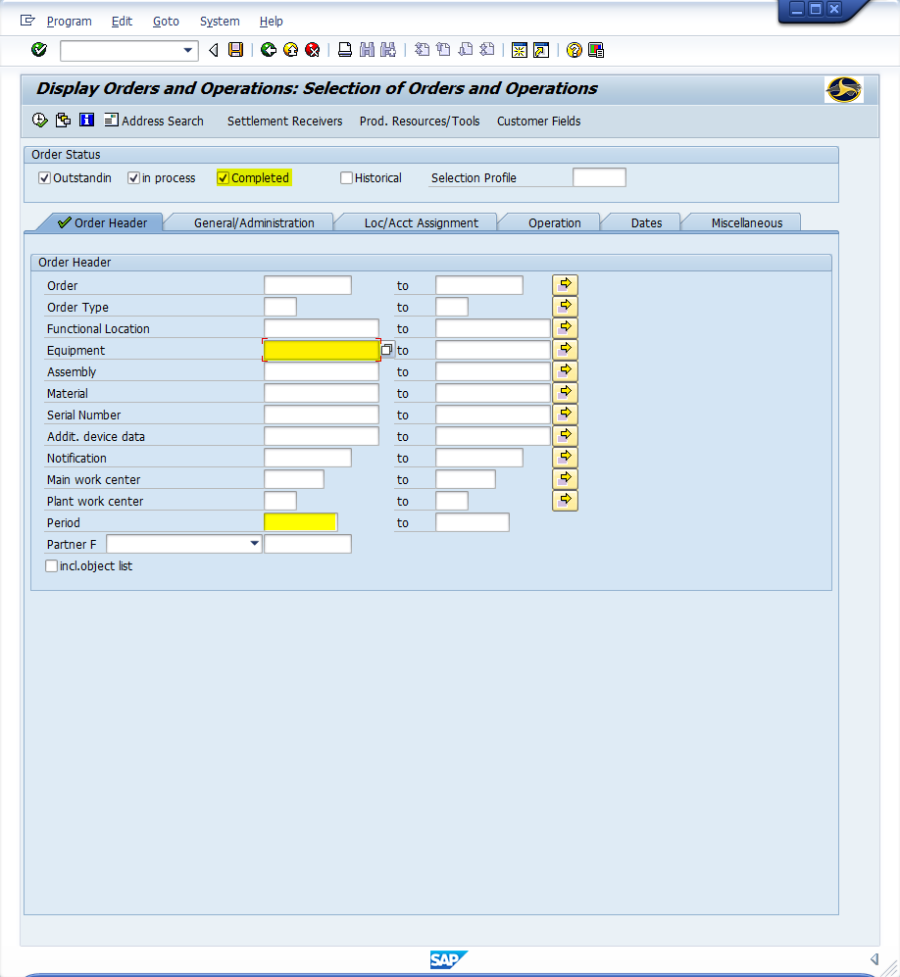
Window opens:
Display Orders and Operations: Selection of Orders and Operations
<Check> Completed Field
Input Equipment Field; (Go to Slide 8)
Or
<Click> within the Equipment field
<Click> Matchcode icon
Tip: Matchcode icon demonstrated on the next slide

Slide 7
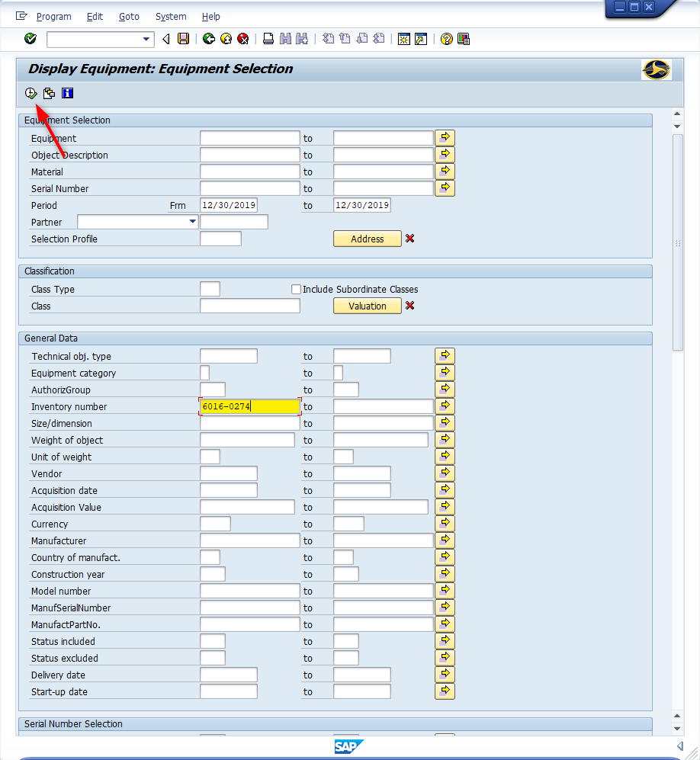
Window opens:
Display Equipment: Equipment Selection
Inventory number – Input SAP inventory number (General Data Section)
<Click> Execute icon

Slide 8
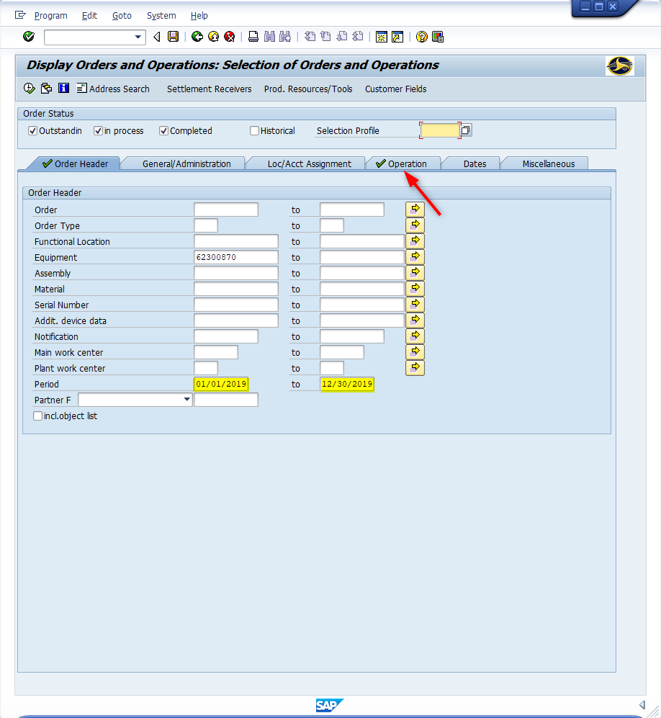
Window opens:
Display Orders and Operations: Selection of Orders and Operations -
Order Header Tab
Period Field – Input beginning and ending dates for span tracking. (i.e., 01/01/2019 to 12/30/2019)
<Click> Operation Tab

Slide 9
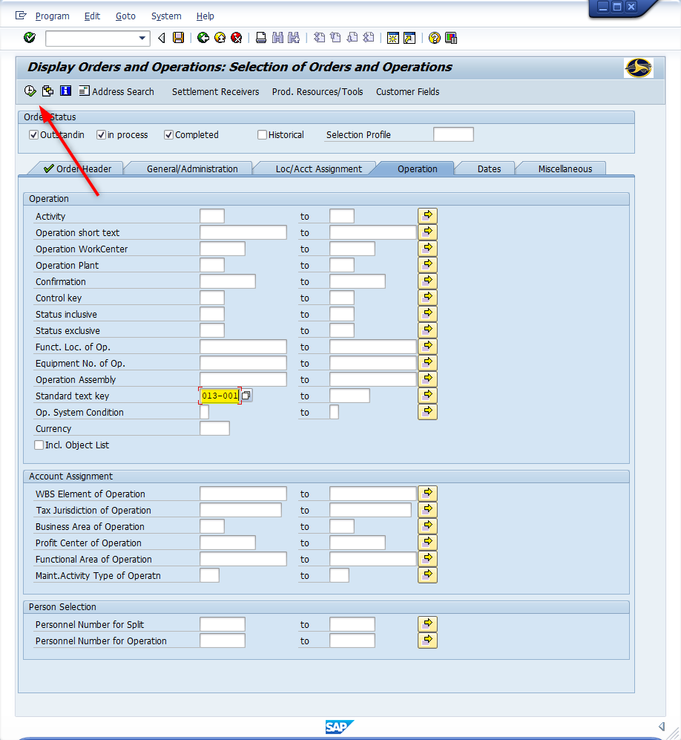
Window opens:
Display Orders and Operations: Selection of Orders and Operations -
Operation Tab
Standard test key Field - (Optional) Input first 7 digits of the VMRS code (i.e., Front Brakes and Drums = 013-001)
<Click> Execute Icon

Slide 10
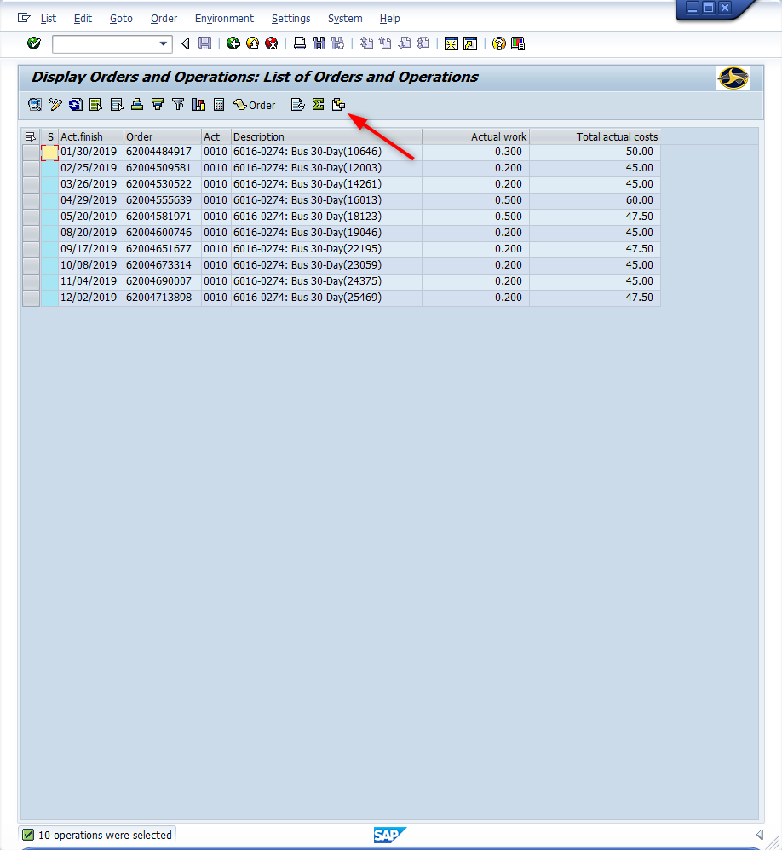
Window opens:
Display Orders and Operations: List of Orders and Operations
<Click> Current Layout icon

Slide 11
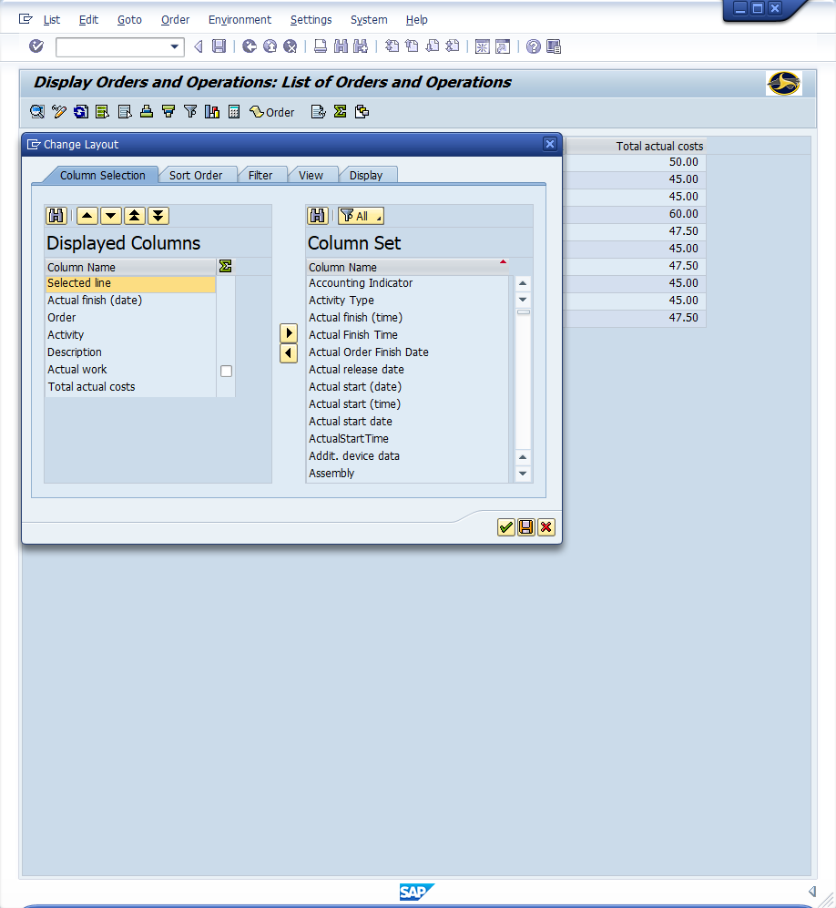
Window opens:
Change Layout
<Click> Column Name (Under Column Set) (Sorts Column Alphabetically)
<Double-Click> Columns
(Under Column Set)
Actual finish (date)
Order
Activity
Description
Actual work
Total actual costs
<Click> Save icon
Tip: Change Display column position
F8 – Shifts up (one increment)
F9 – Shifts down (one increment)
<Double-Click> - Return to column set

Slide 12
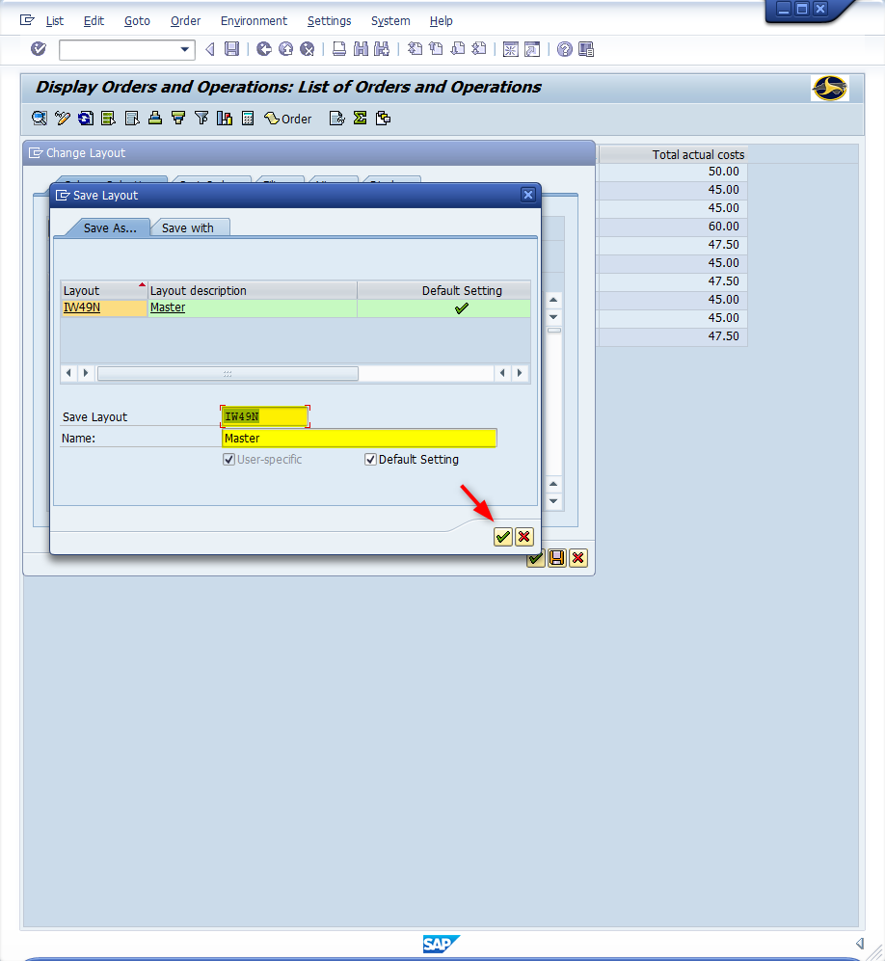
Window opens:
Save Layout
Save Layout Field – Input a descriptive name. (i.e., IW49N)
Name Field – Input a name that meets the criteria you are searching; if this is the default table use something like “Master”
<Click> Continue icon (Twice)

Slide 13
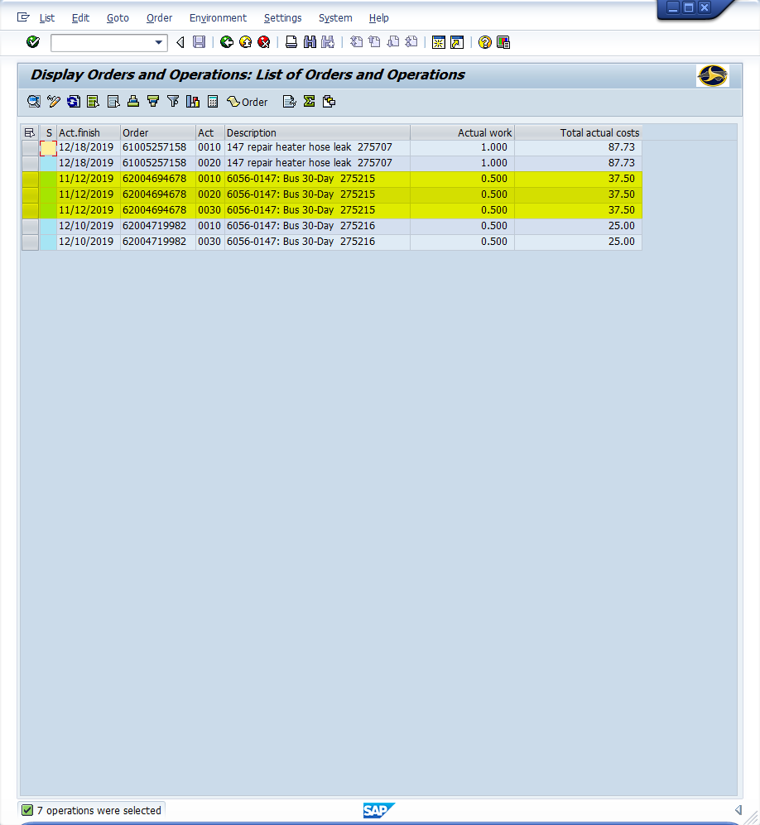
Window opens:
Display Orders and Operations: List of Orders and Operations
Items to Note:
The same work order may be reported multi-time(s) if multi activity numbers are used. (i.e., 62004694678 uses activity numbers 0010, 0020 and 0030)
Actual work is displayed per activity.
Caution!!! Be careful of grabbing a Total Actual Costs value. The value is the total per work order NOT per Activity. The cost to 62004694678 is $37.50 NOT $112.50

Slide 14
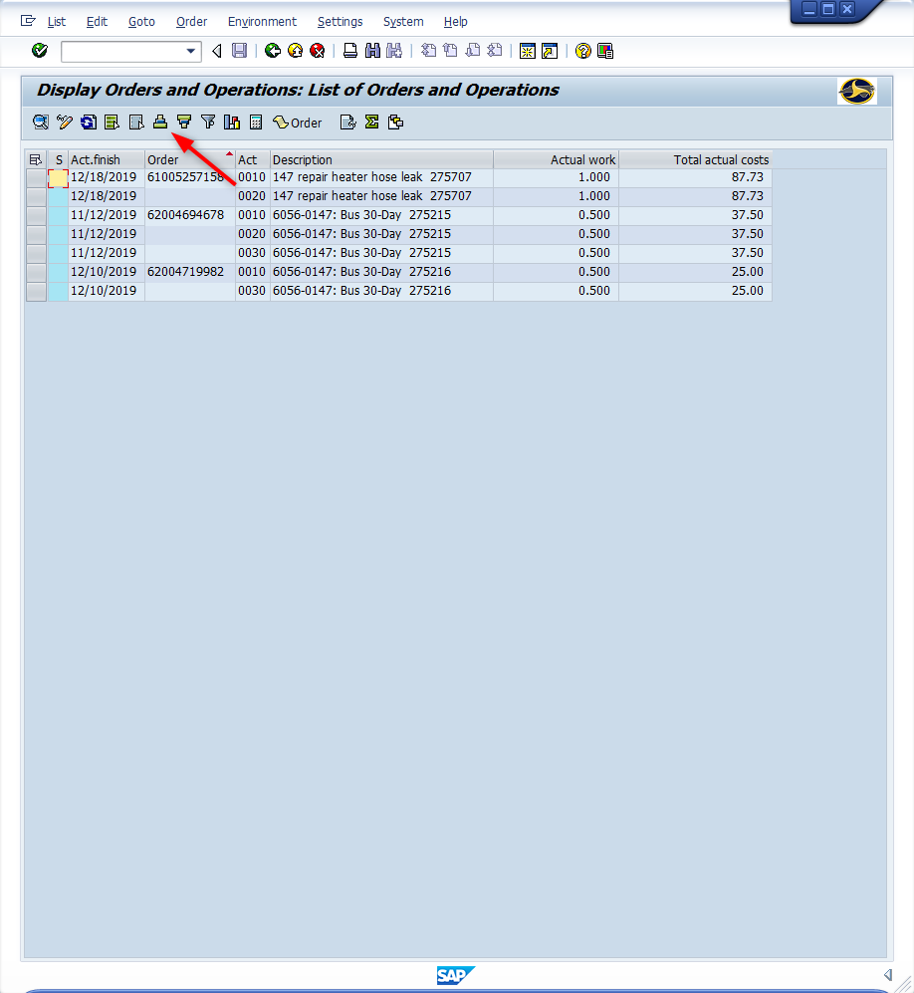
Window opens:
Display Orders and Operations: List of Orders and Operations
Items to Note: (Continued)
<Click> on the column header “Order” (highlights column)
<Click> Sort in Ascending Order icon The table will display the work orders only once with all the activities beside the work order cell

Slide 15
Questions
Email: Stephen.Wright@dpi.nc.gov

Slide 16
Thank You!
Stephen Wright
DPI Technical Consultant

