Slide 1
Two methods to observe tutorial
Standard Method
This method allows presentation to be resized to user preference.
Slide Show Method (Example below)
Presentation fills entire screen
Click on Slide Show tab at top of screen
Click icon <From Beginning>
Note: Either method; to advance click the progression arrow in the bottom right corner of each slide or press the down-arrow key.

Slide 2
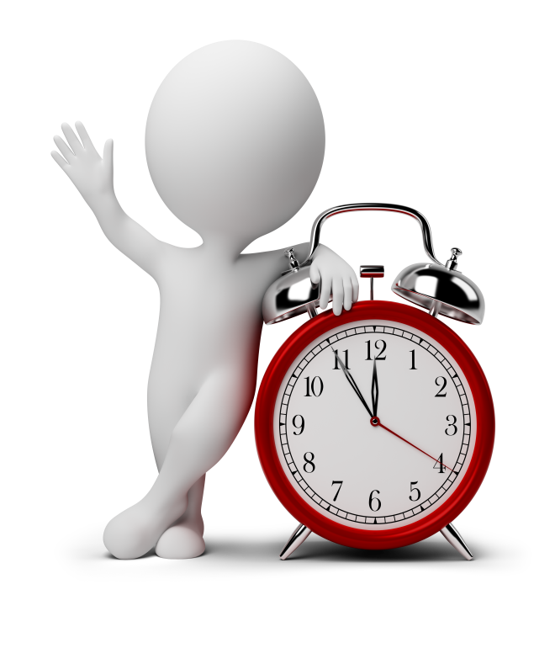
Welcome to
BSIP 101
Transaction Procedures
Odometer Adjustment
Increase
Instructor: Stephen Wright DPI Technical Consultant

Slide 3
Purpose: Use this procedure to adjust odometer readings upward.

Slide 4
One transaction is required to complete this procedure:
IK11
Let’s get started -

Slide 5
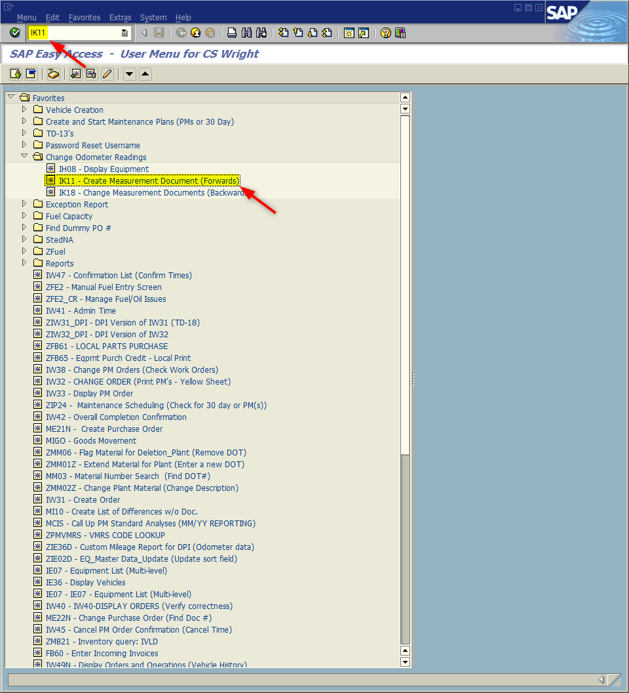
Window:
SAP R/3 Easy Access
Input IK11; or
Favorites menu, <Select> transaction IK11 – Create Measurement Document (Forwards)

Slide 6
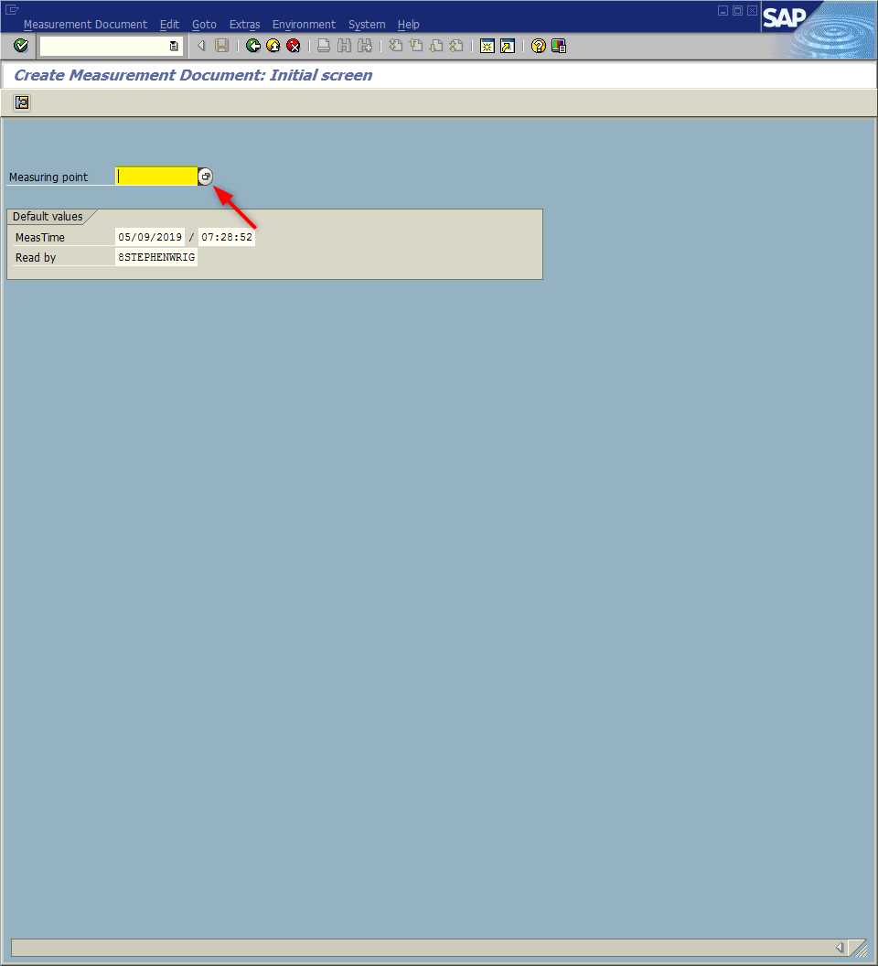
Window opens:
Create Measurement Document: Initial Screen
Input vehicle measuring point;
Or
<Click> within the Measure point field
<Click> Matchcode icon
Tip: Matchcode icon demonstrated on next slides

Slide 7
Window opens:
Restrict Value Range
Equipment Field – Input the SAP Equip # (Go to Slide 9)
OR
<Click> Matchcode icon

Slide 8
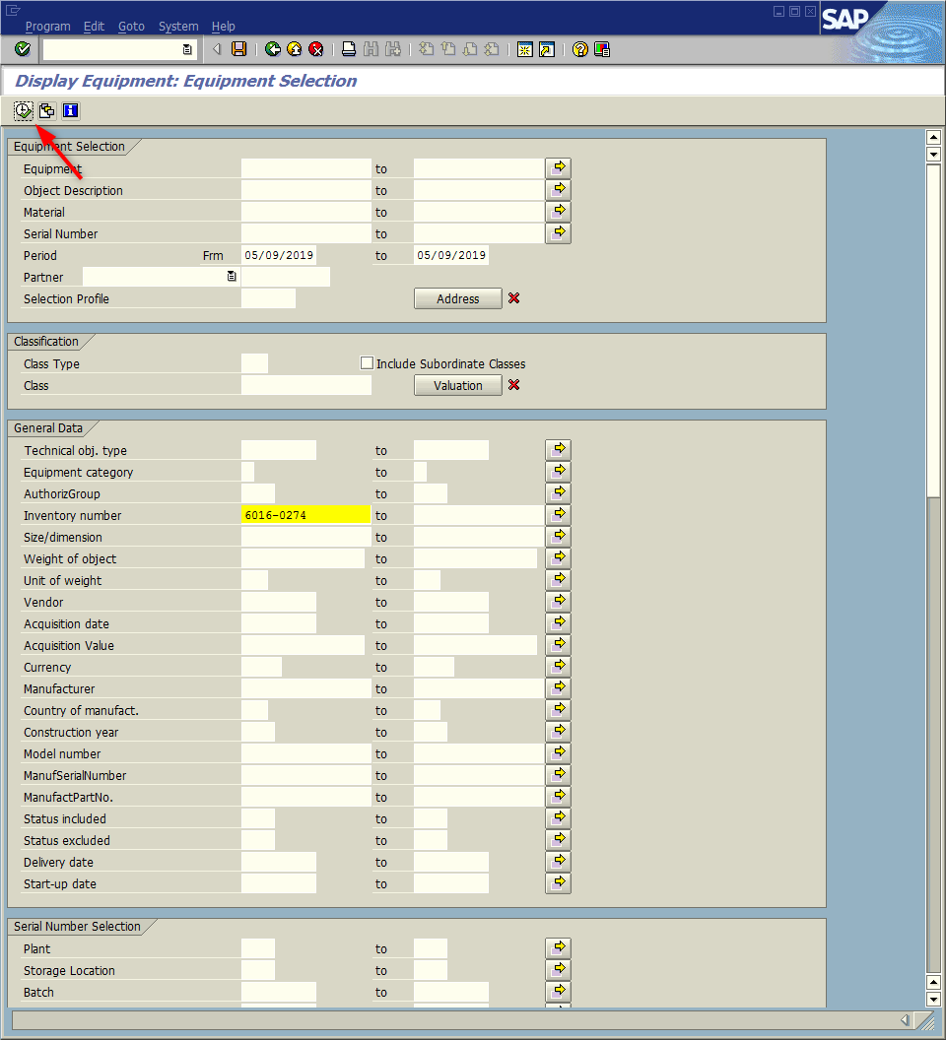
Window opens:
Display Equipment: Equipment Selection
Inventory number – Input SAP inventory number (General Data Section)
<Click> Execute icon

Slide 9
Window opens:
Restrict Value Range
<Click> Continue icon
Tip: When the Equipment Field is populated; the Description field will likewise populate providing an additional validity check.

Slide 10
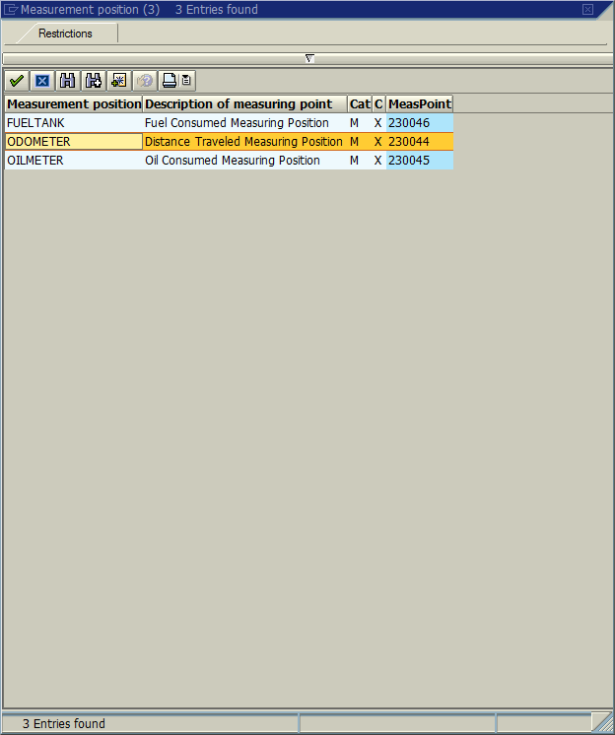
Window opens:
Measurement position
<Double-Click> Measurement position - Odometer

Slide 11
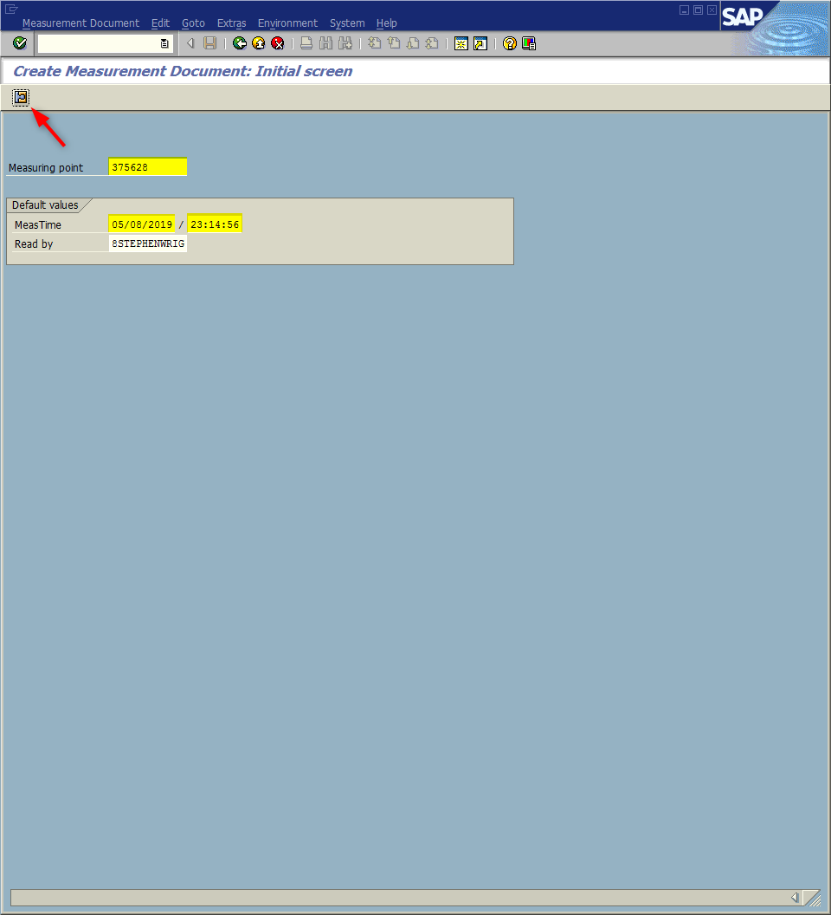
Window opens:
Create Measurement Document: Initial screen
Measure Time Field
Decrease date by one day (i.e., prior 11/18/2019, new 11/17/2019)
Change time field to 23 hundred hours (i.e., prior 09:08:50, new 23:08:50)
<Click> Measurement Document icon

Slide 12
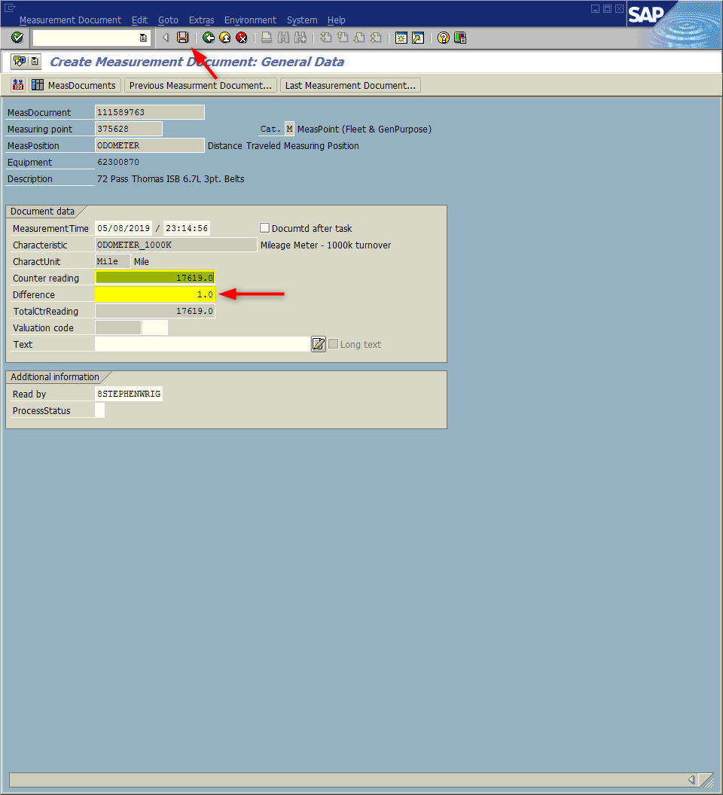
Window opens:
Create Measurement Document: General Data
Counter Reading field - Input the current odometer reading
<Enter>
<Click> Save icon
STOP and backout of transaction without saving if:
If the difference field numeric is unreasonable; or
If a yellow warning message displays at the bottom of the screen - stating, “The counter reading entered will lead to a counter overflow.”
If either occurs complete the website application.

Slide 13
If required to STOP. . .
What to do:
Verify the mileage; make necessary change if needed. If mileage is correct; back out without saving.
Go to BSIP support webpage http://www.ncbussafety.org/BSIP/SupportRequest.html
Click on the application Vehicle Odometer Change Request
Complete the application and click the submit button.

Slide 14
Questions
Email: Stephen.Wright@dpi.nc.gov

Slide 15
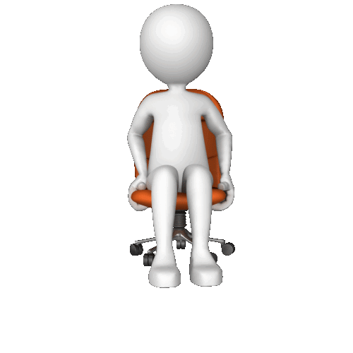
Thank You!
Stephen Wright
DPI Technical Consultant

