Slide 1
Two methods to observe tutorial
Standard Method
This method allows presentation to be resized to user preference.
Slide Show Method (Example below)
Presentation fills entire screen
Click on Slide Show tab at top of screen
Click icon <From Beginning>
Note: Either method; to advance click the progression arrow in the bottom right corner of each slide or press the down-arrow key.

Slide 2
Welcome to
BSIP 101
Transaction Procedures
Extend Inventory
Instructor: Stephen Wright DPI Technical Consultant

Slide 3
Initial setup MUST be completed
before material can be
entered into inventory for your plant.
Initial setup completed?
Yes
Continue with this tutorial.
No/Unsure
; go to
Tutorial Setup – Extending Material

Slide 4
Purpose: Extend materials into inventory.
Note: This allows items to be stocked and assigned to work orders.

Slide 5
One transaction is required to complete this procedure:
ZMM01Z
Let’s get started -

Slide 6
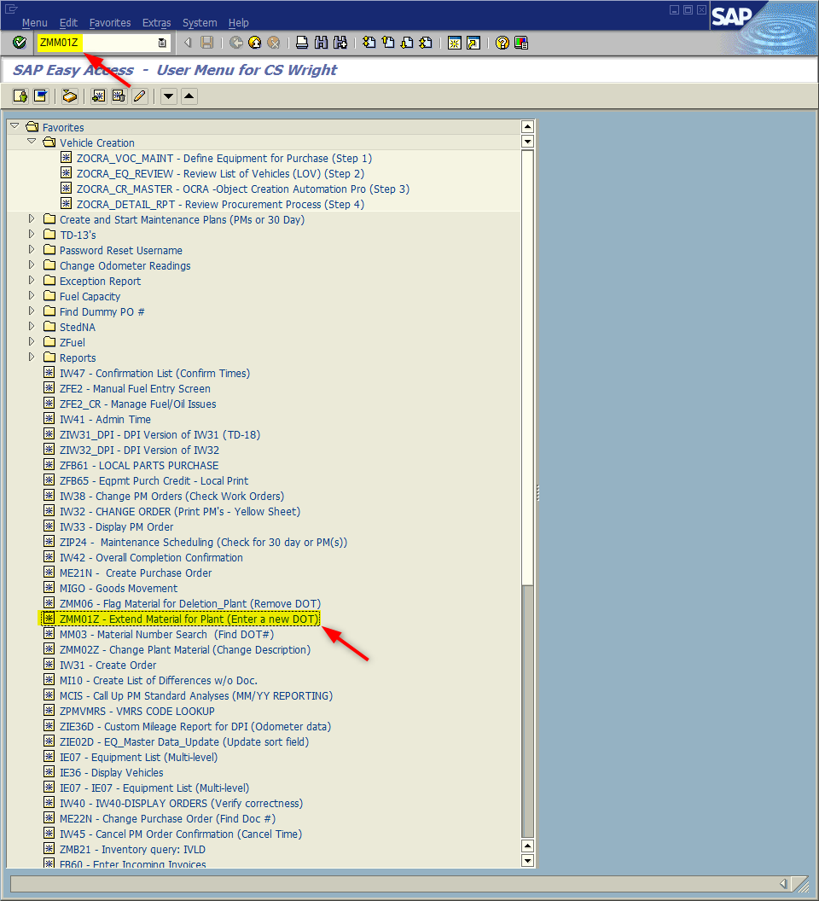
Window:
SAP R/3 Easy Access
Input ZMM01Z; or
Favorites menu, <Select> transaction ZMM01Z – Extend Material for Plant

Slide 7
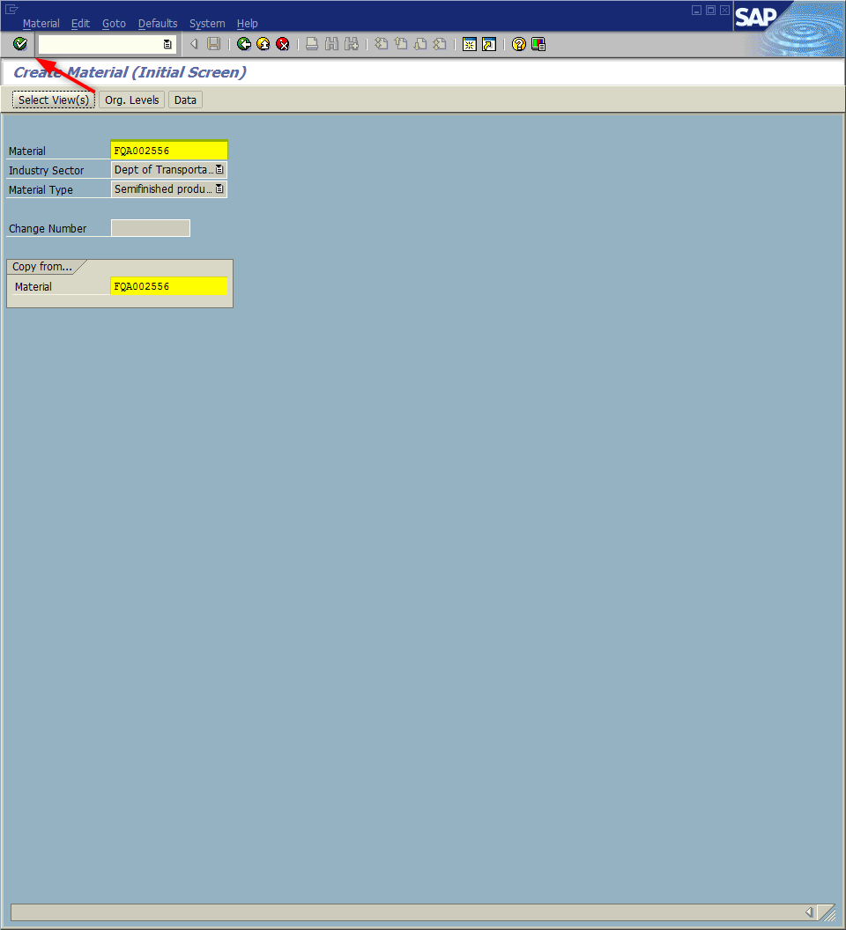
Window opens:
Create Material (Initial Screen)
Material Field – Input nine-digit number of item to stock. (i.e., FQA002556)
Copy from… Field - Repeat the nine-digit number keyed for material field. (i.e., FQA002556)
<Enter>

Slide 8
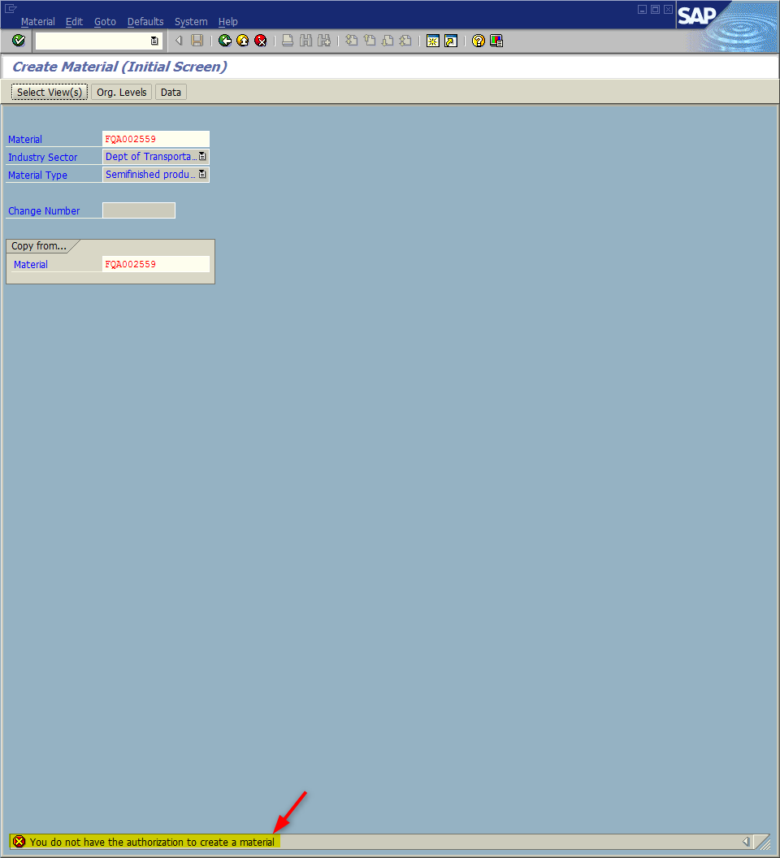
If you enter a invalid DOT # the DOT will turn red and the message;
will appear at the bottom of the Create Material (Initial Screen).
To correct
Re-check the DOT # input
Make corrections
<Enter>

Slide 9
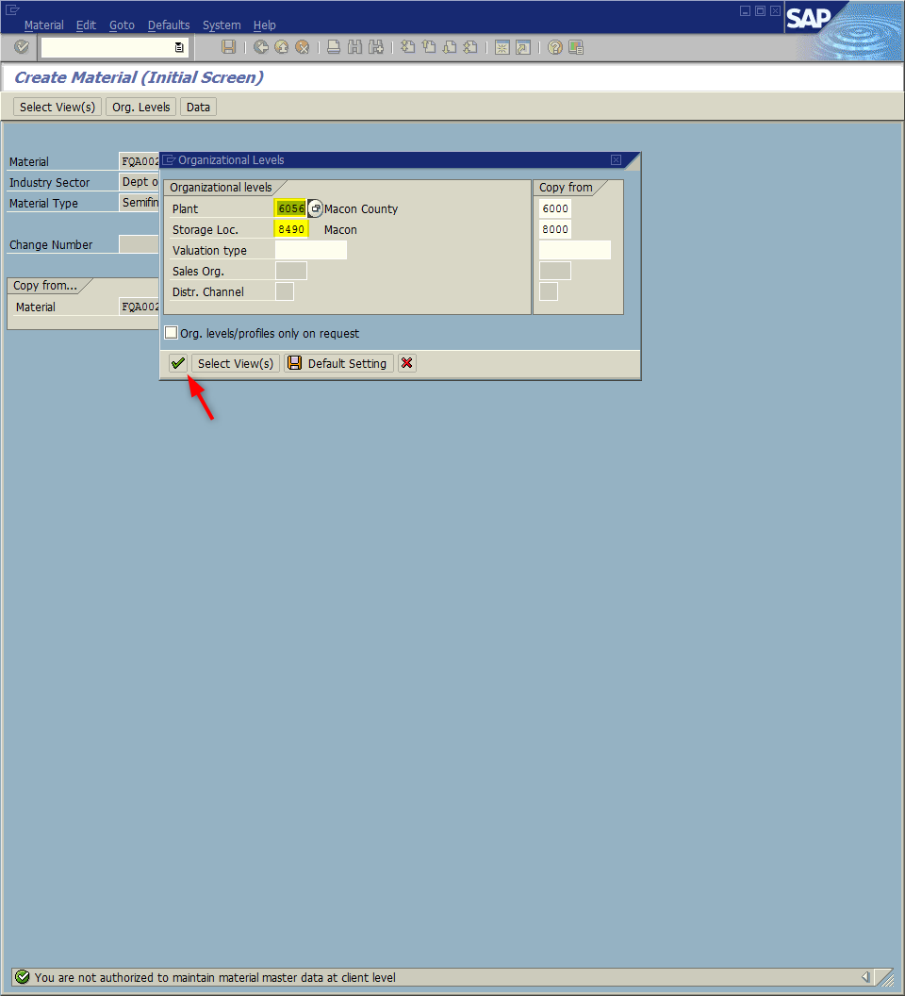
Window opens:
Create Material (Initial Screen)
Organizational Levels
Plant field – Input four-digit code (i.e., Alamance = 6001)
Storage location field – Input four-digit code (i.e., Alamance = 8001)
<Enter>
Tip: The Organizational Levels window should contain your plant data. If not return to the “Initial Setup” tutorial and complete initial setup for ZMM01Z.

Slide 10
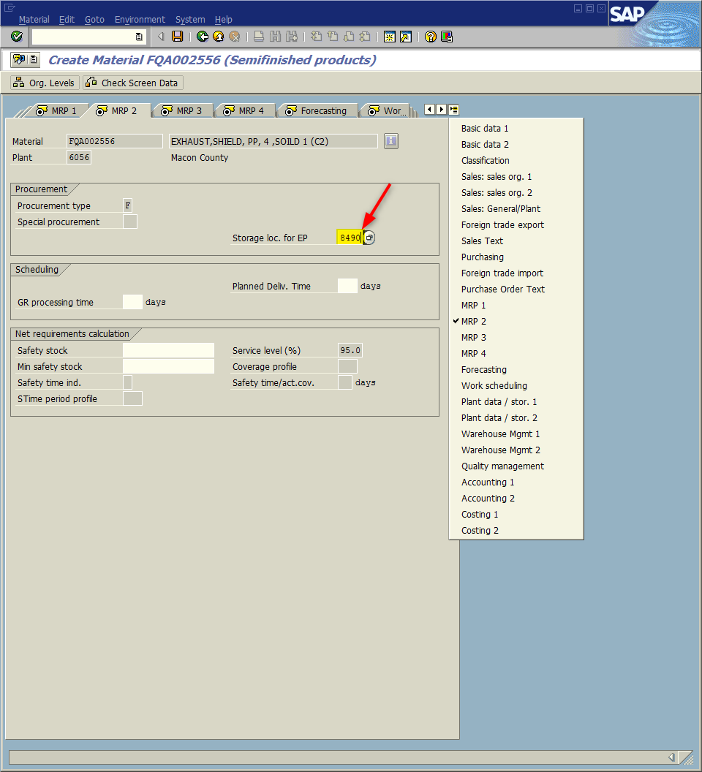
Window opens:
Create Material ######### (Semifinished products)
<Click> Drop-down menu icon
<Double Click> MRP 2
Storage Loc. For EP Field – Input storage location

Slide 11
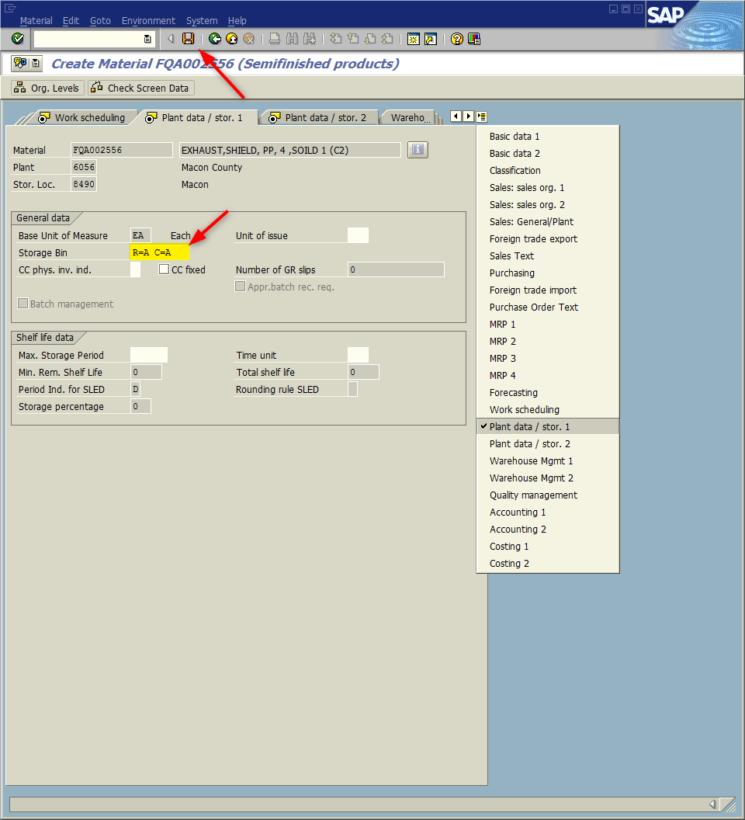
Window:
Change Material ######### (Semifinished products)
<Double Click> Plant data / stor. 1
Storage Bin Field – Input identifying location.
<Click> Save icon

Slide 12
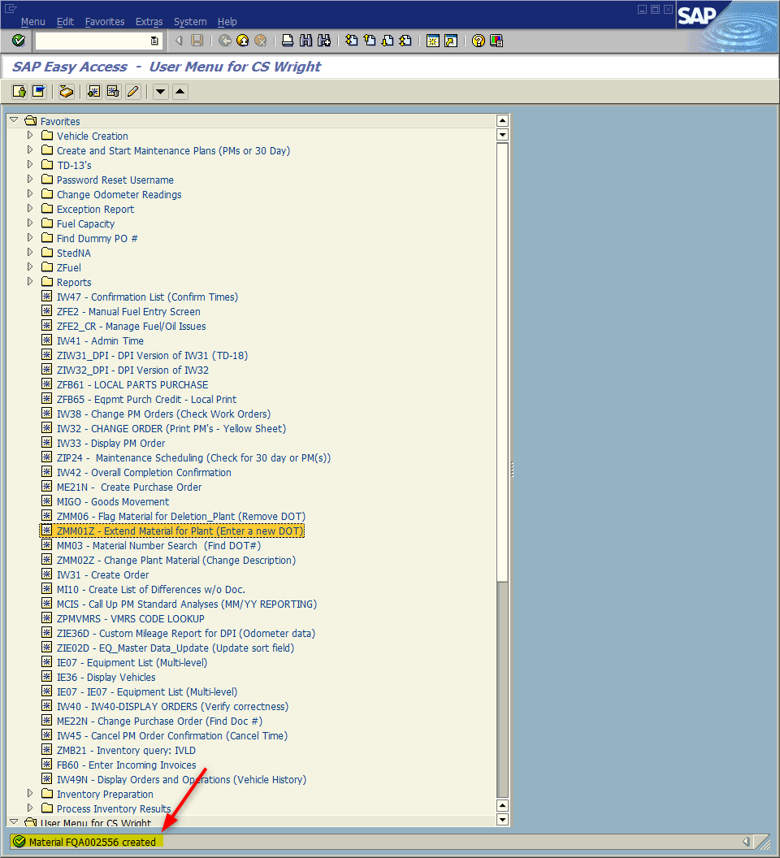
The system will return to the SAP Easy Access screen and a message in the status bar will state that the material has been created.
Tip: If inventory item was attempted to be included on a PO in BSIP, delete that line and add a new line for the item.

Slide 13
Questions
Email: Stephen.Wright@dpi.nc.gov

Slide 14
Thank You!
Stephen Wright
Technical Consultant

