Slide 1
Two methods to observe tutorial
Standard Method
This method allows presentation to be resized to user preference.
Slide Show Method (Example below)
Presentation fills entire screen
Click on Slide Show tab at top of screen
Click icon <From Beginning>
Note: Either method; to advance click the progression arrow in the bottom right corner of each slide or press the down-arrow key.

Slide 2
Welcome to
BSIP 101
Transaction Procedures
Interface Settings
Instructor: Stephen Wright DPI Technical Consultant

Slide 3
Purpose: Setup primary screen to display more thorough information.

Slide 4
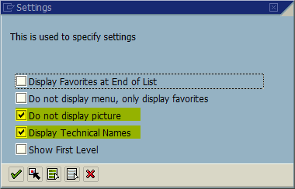
From the SAP R/3 Easy Access screen (Main menu screen); Press <Shift-F9>
Window opens:
Settings
<Check> Do not display picture
<Check> Display technical names
<Click> Continue icon
Tip: This process speeds up access to the primary menu screen and adds transaction codes to the items on the favorites list.

Slide 5
Questions
Email: Stephen.Wright@dpi.nc.gov

Slide 6
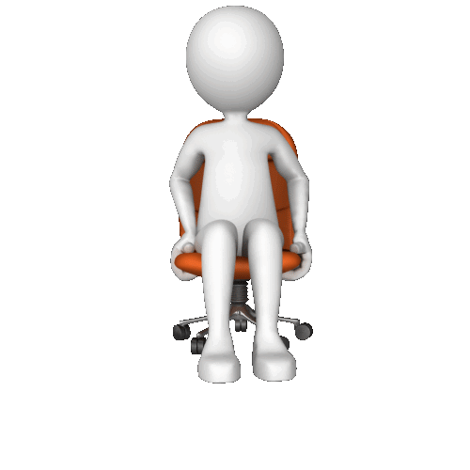
Thank You!
Stephen Wright
Technical Consultant

