Slide 1
Two methods to observe tutorial
Standard Method
This method allows presentation to be resized to user preference.
Slide Show Method (Example below)
Presentation fills entire screen
Click on Slide Show tab at top of screen
Click icon <From Beginning>
Note: Either method; to advance click the progression arrow in the bottom right corner of each slide or press the down-arrow key.

Slide 2
Welcome to
BSIP 101
Transaction Procedures
Transaction & Folder
Creation
Instructor: Stephen Wright DPI Technical Consultant

Slide 3
Purpose: Organize & Add Transactions to Menu Favorites List

Slide 4
No particular transaction is required to complete this procedure; it can be applied to all transactions.
Let’s get started -

Slide 5
For this tutorial we are going to create a folder that contains the transactions to complete three individual reports:
ZMB19 – Inventory Query
ZMB20 – Transaction History Report
ZMB36 – Equipment History Report

Slide 6
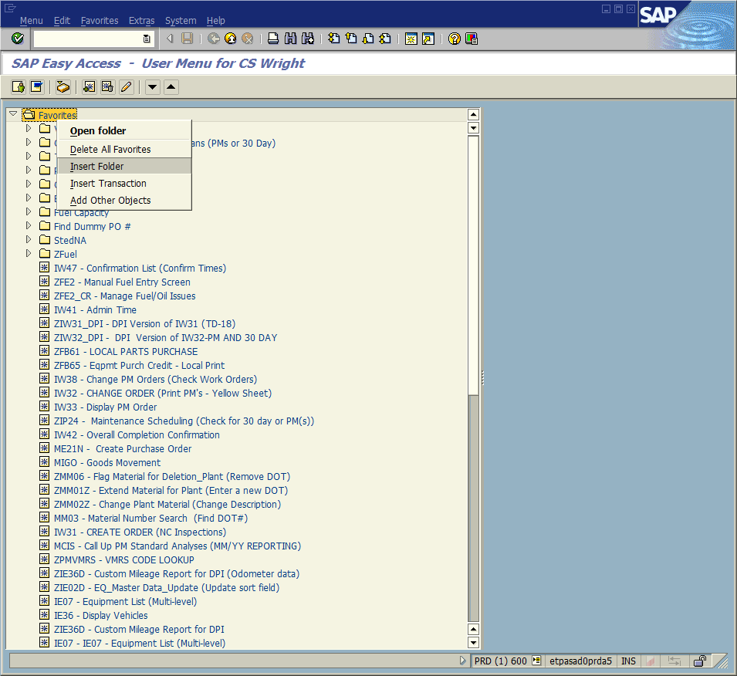
Right-click on the favorites folder; a small menu selection box will appear. From the menu choose Insert Folder.

Slide 7
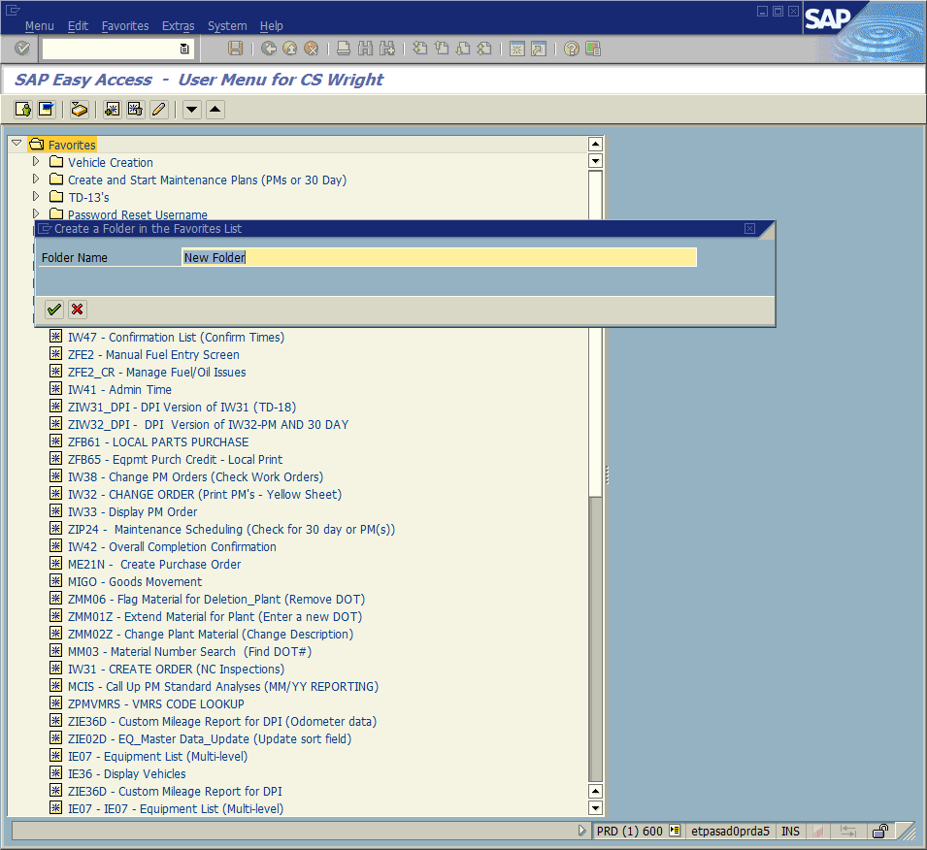
A new dialogue box will appear titled: “Create a Folder in the Favorites List.” In the folder name field it will have the words – “New Folder.” Replace them with the title which you desire to name the folder.
Click the Continue icon to record the change.
For our example we are going to use “Reports.”

Slide 8
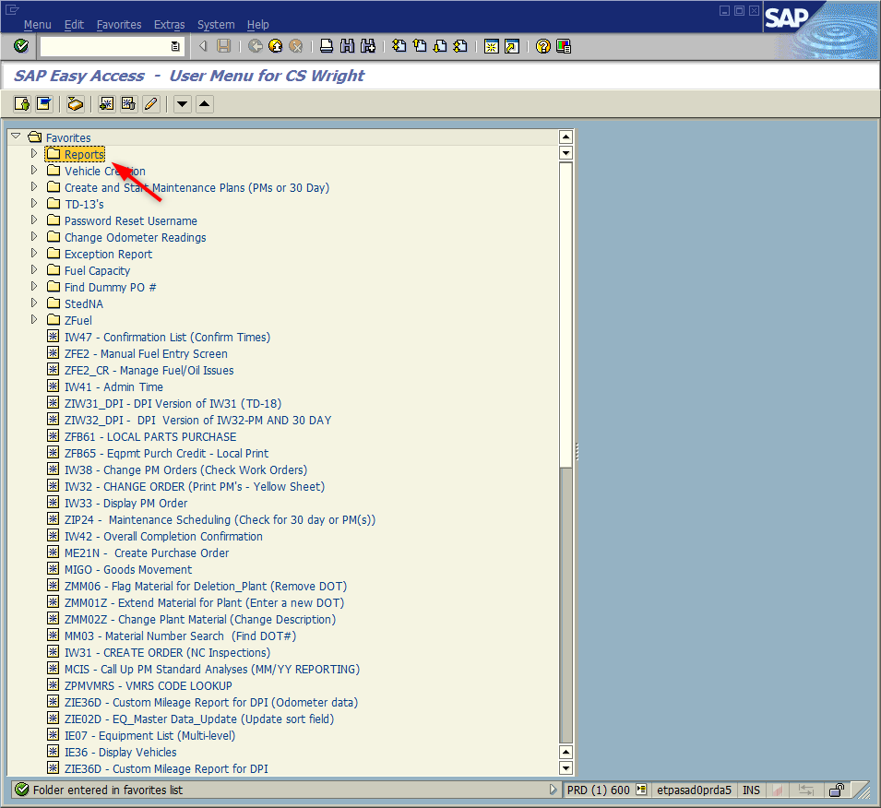
A new folder will be created immediately below the Favorites Folder. It will be titled the name given on the prior screen.

Slide 9
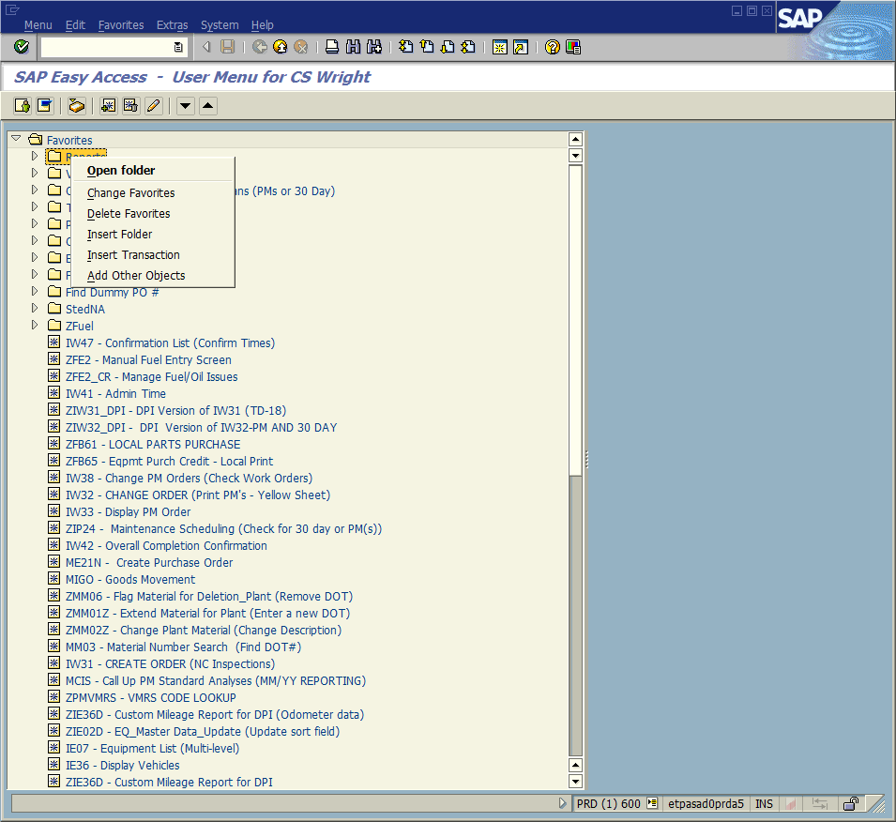
Right-click on the new folder; a new menu selection opens.
If you click on the following:
Open Folder – Opens the folder that you clicked; displaying its contents.
Change Favorites – Allows the user to change the title of the folder.
Delete Favorites – Removes the folder.
Insert Folder – Inserts a sub-folder into the selected folder.
Insert Transaction – Inserts transactions into the selected folder.

Slide 10
For this tutorial select “Insert Transaction.” A new dialogue window appears titled – “Manual entry of a transaction.”
Type ZMB19 into the open field. Click the Continue icon or press <Enter> to record the change.
Repeat the steps from the prior screen and this screen for Transactions ZMB20 and ZMB36.

Slide 11
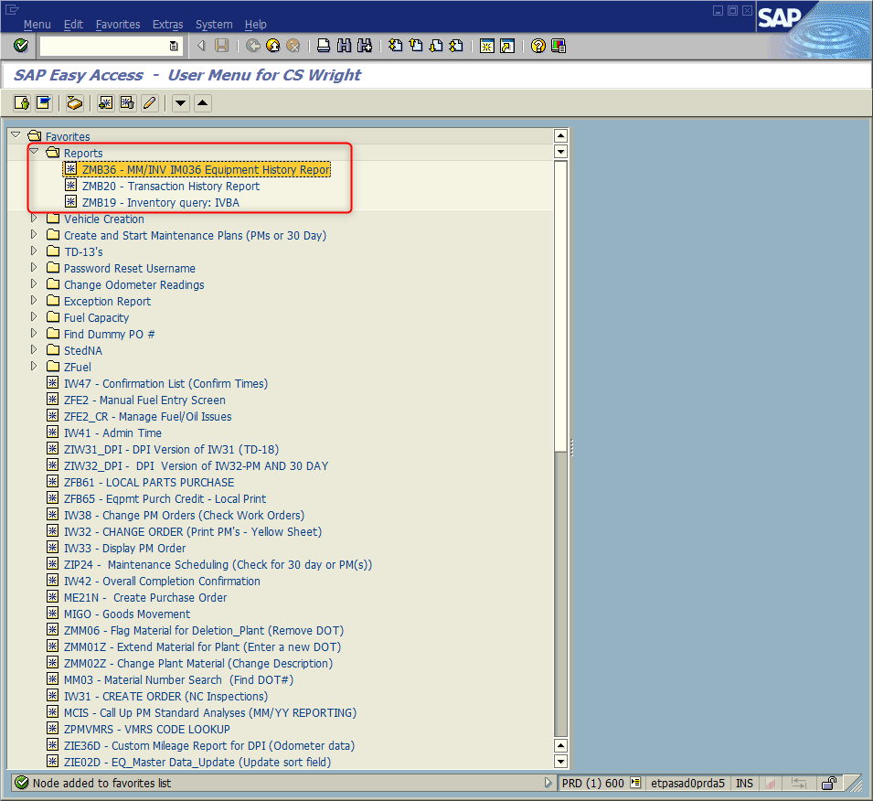
Your screen for the Favorites/ Reports should look very similar.
You can change the order the transactions appear. Left-click on the transaction, hold the mouse button down and drag and drop in the location you so desire.
The above step will also work with folders in the same fashion.

Slide 12
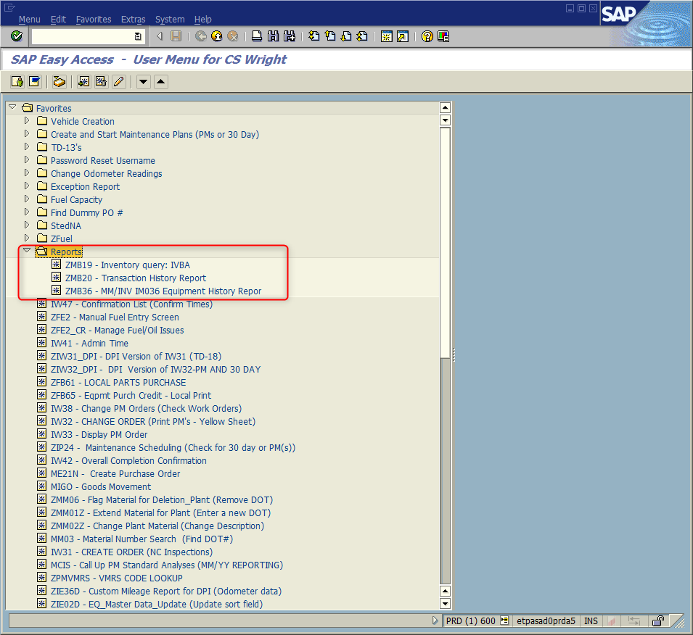
This is a view after the transactions have been rearranged and the folder has been shifted down.

Slide 13
Questions
Email: Stephen.Wright@dpi.nc.gov

Slide 14
Thank You!
Stephen Wright
DPI Technical Consultant

