Slide 1
Two methods to observe tutorial
Standard Method
This method allows presentation to be resized to user preference.
Slide Show Method (Example below)
Presentation fills entire screen
Click on Slide Show tab at top of screen
Click icon <From Beginning>
Note: Either method; to advance click the progression arrow in the bottom right corner of each slide or press the down-arrow key.

Slide 2
Welcome to
BSIP 101
Launch Software
Instructor: Stephen Wright DPI Technical Consultant

Slide 3
Before attempting to work in Citrix/SAP you must have a valid username and temporary password established.
Options: (Click the appropriate link if needed)
Password Requirements
New to Citrix/SAP
Forgot Password
(90+ days since last slog in)
Password Deactivated

Slide 4
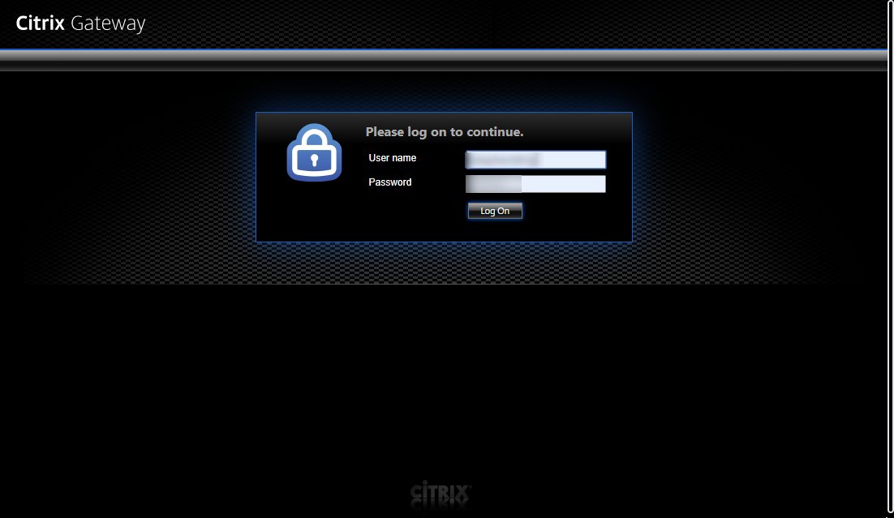
Launch Citrix/SAP
Click link it will navigate you to the Citrix Storefront (Actual web address shown below image on right). The webpage should look similar to the image shown.
Log in using your Citrix credentials.
Citrix Login
Actual web address:
https://remote.services.ncdot.gov/vpn/index.html

Slide 5
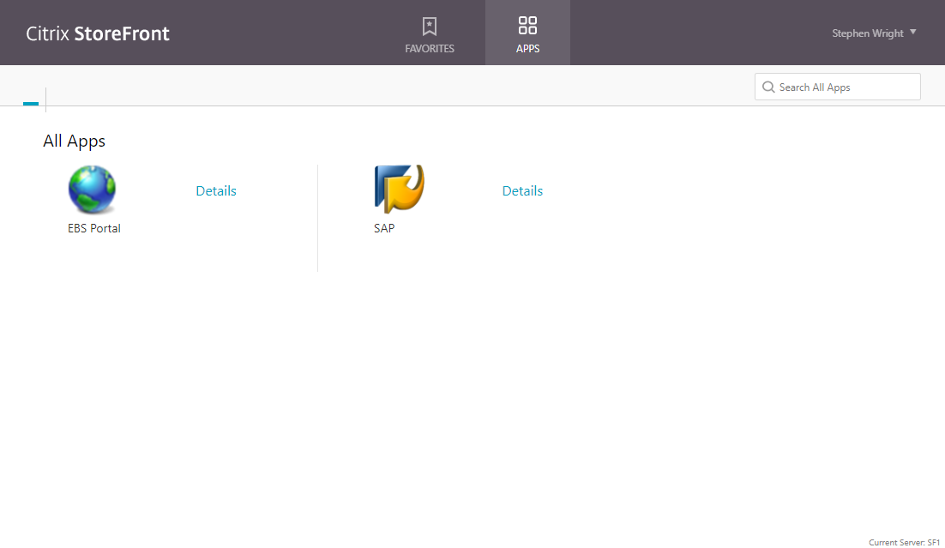
Citrix StoreFront
The StoreFront Webpage will appear; click the SAP icon to launch it’s login screen.

Slide 6
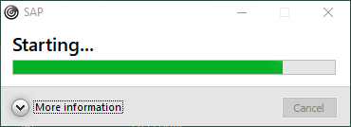
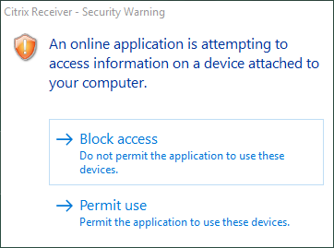
Launch Citrix/SAP
The application launch process will begin – generating a new SAP window – Starting SAP.
When step seven is complete; a new window appears – Citrix Receiver – Security Warning. Click the option labeled – Permit Use.

Slide 7
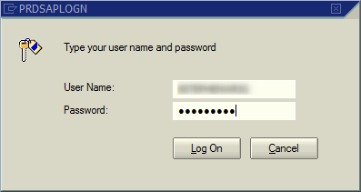
Launch Citrix/SAP
The SAP login screen will be displayed – enter your SAP password.
Tip: User Name will be automatically populated.
Citrix & SAP are two separate entities and thus require two separate passwords. You may use the same password, however, changing one does not change the other.
To return to the main tutorial click the Next icon

Slide 8
Installation Setup is complete

Slide 9
Questions
Email: Stephen.Wright@dpi.nc.gov

Slide 10
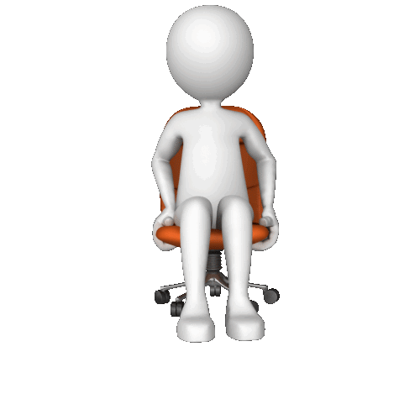
Thank You!
Stephen Wright
Technical Consultant

Slide 12
Password Requirements
Purpose: Development of a strong and secure password.

Slide 13
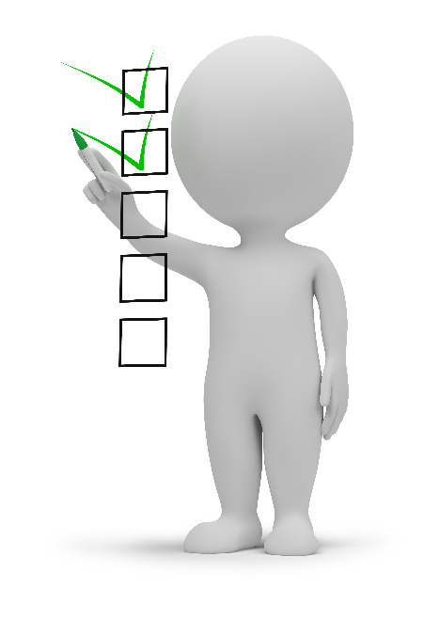
Password Creation
ABOUT YOUR PASSWORD
The first time you log on to the Production system, you will be required to change your password. You should create a password that will be easy for you to remember (Password is case sensitive). Keep your new password secure.
Your new password must meet the following requirements:
Must Not: Have been used previously, not be part of your name or username, not make a proper name, or be a word that occurs in the dictionary.
Must Have: Be a Length 8 to 12 characters, must have English uppercase & lowercase alpha characters (A – Z, a - z), numeric character (0 - 9), one special character: ! " @ $ % & / ( ) = ? etc.
Note: SAP (BSIP) will not allow you to use an exclamation point (!) or a question mark (?) as the first character in your password.

Slide 14
Password Creation (cont.)
GOOD TO KNOW
If you do not log into your account for 30 days, you will be locked out. If you cannot log on, or if you forgot your user ID or password, use the application Citrix/SAP Password Reset Request at http://www.ncbussafety.org/BSIP/SupportRequest.html.
If you leave a session of SAP open, it will time out after one hour of inactivity and you will need to log on again.
You must reset the Windows/Citrix account password every 3 months at a DOT Workstation or from the Citrix login link or the account will get disabled.
To return to the main tutorial click the Next icon

