Slide 1
Two methods to observe tutorial
Standard Method
This method allows presentation to be resized to user preference.
Slide Show Method (Example below)
Presentation fills entire screen
Click on Slide Show tab at top of screen
Click icon <From Beginning>
Note: Either method; to advance click the progression arrow in the bottom right corner of each slide or press the down-arrow key.

Slide 2
Welcome to
BSIP 101
Transaction Procedures
Zfuel
Review & Corrections
Instructor: Stephen Wright DPI Technical Consultant

Slide 3
Zfuel – Review Data
An equipment master record exists in SAP for each piece of equipment. Based on the profile, the system validates:
Type of fuel dispensed,
The quantity of fuel dispensed, and
Meter readings recorded against the equipment master record.
All conflicts are required to be resolved before the line item may be posted. Selected data for the fuel record can be edited from within the SAP Fuel Application, including the equipment number, product code (fuel type), and meter readings. Complete the steps below to review data uploaded from Fuel Master and make any corrections necessary.

Slide 4
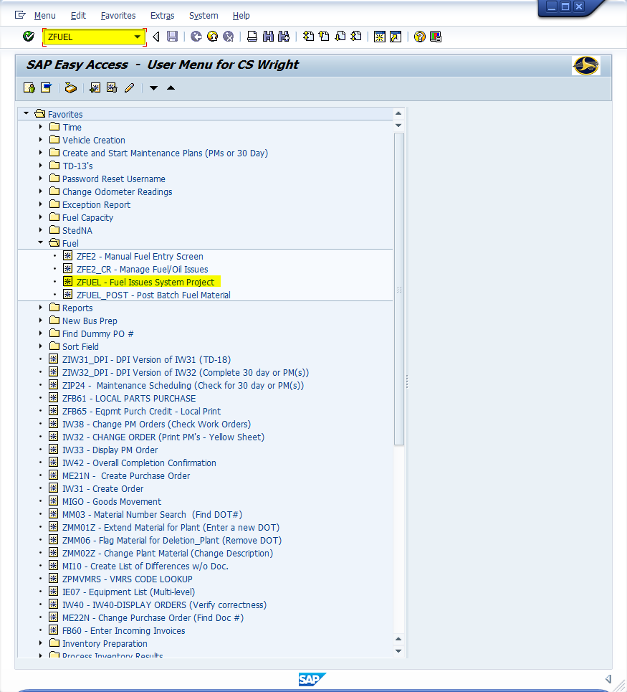
Window:
SAP R/3 Easy Access
Input ZFUEL; or
Favorites menu, <Select> transaction ZFUEL – Fuel Issues System Project

Slide 5
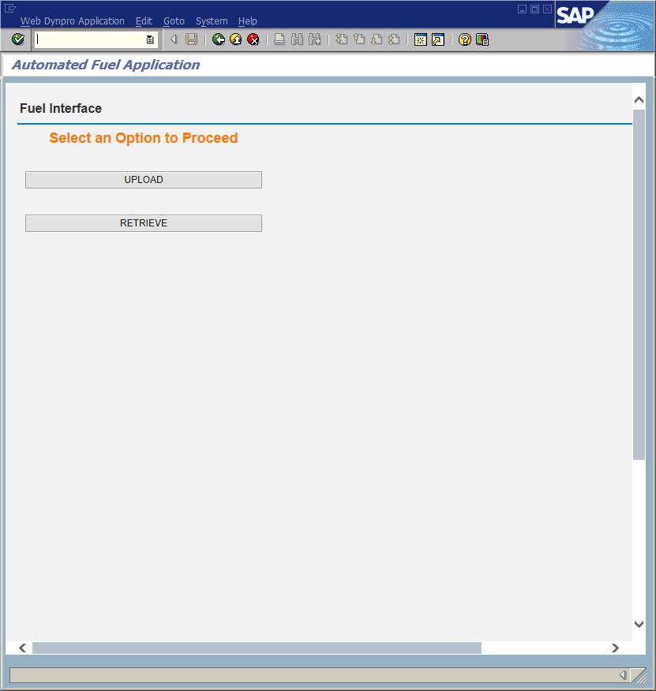
Window opens:
Automated Fuel Application
<Click> Retrieve button

Slide 6
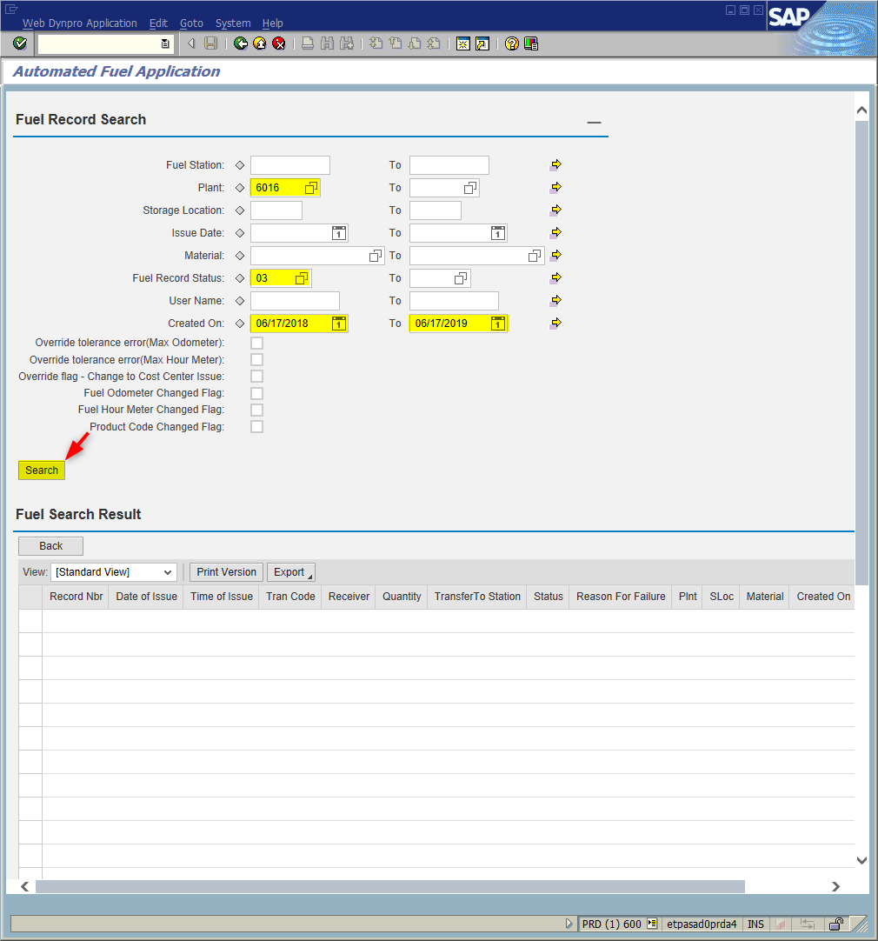
Window opens:
Automated Fuel Application
Fuel Record Search
Plant Field – Input four-digit plant code (i.e., Alamance = 6001)
Fuel Record Status Filed – Input “03”
Created On Field(s)
Left Col. - Current date minus one year
Right Col. – Current date
<Click> Search button

Slide 7
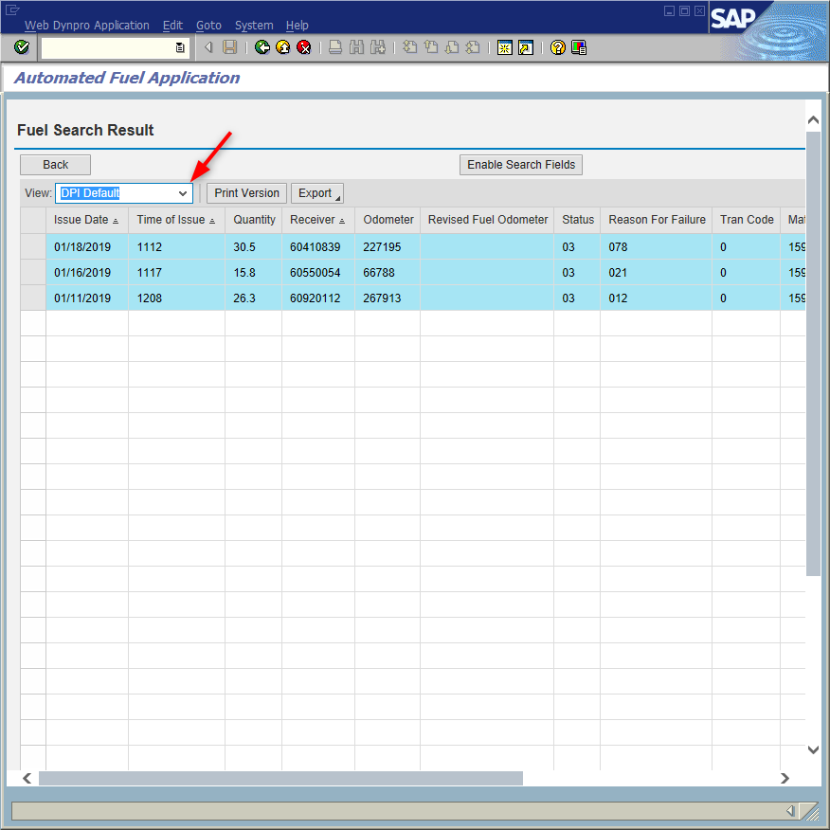
Window opens:
Automated Fuel Application
Fuel Search Result
View Field - <Click> on the field’s down arrow; choose from the list “DPI Default”

Slide 8
Important Columns in the DPI Default View
Issue Date Date fuel was dispensed
Time of Issue Time (in 24hr format) fuel was dispensed
Quantity Number of gallons of fuel dispensed
(Last digit tenths of a gallon)
Fuel Receiver Inventory number (Without the hyphen)
Odometer Uploaded odometer reading
Revised Fuel Odometer Manually changed odometer reading
Fuel Record Status Status of fuel record
Common codes:
02 Passed (the record was validated, and can be posted)
03 Failed (record failed validation and cannot be posted)
05 Posted (inventory issue posted and measuring document created)
06 Reversed (inventory issue canceled via ZFE2_CR)
10 Posted w/ errors (Usually a timestamp error prevents odometer update)

Slide 9
Important Columns in the DPI Default View
Reason for Failure Details on the source of the error.
Transaction Code Indicator of the data source or type of transaction.
Material DOT Number for the transaction.
Storage Location Storage Location parts are pulled from.
Created on Upload date for entry.
User Name User who last viewed/validated/modified the transaction
Material Document Material document where the parts were posted
Record Number Unique SAP assigned number
Tip: You can sort by Fuel Record Status (or any other column) by clicking on the column heading.

Slide 10
ZFUEL
Making Corrections

Slide 11
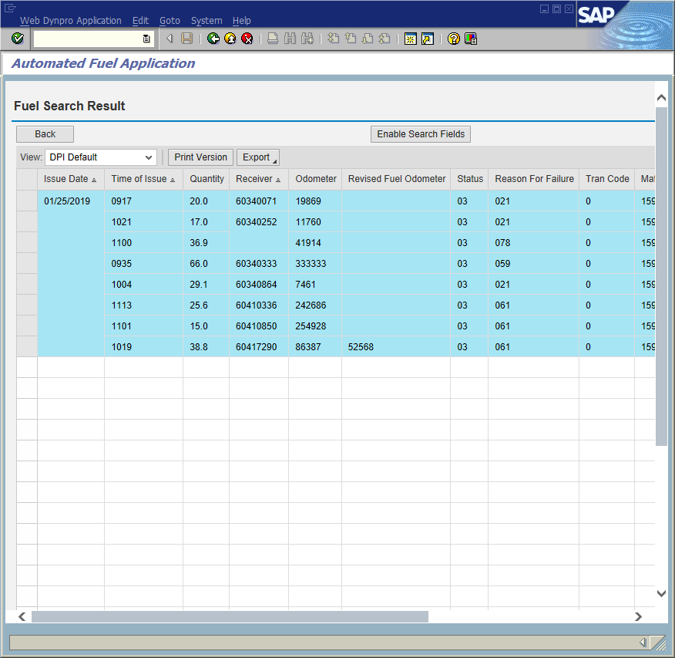
<Click> anywhere on the line of a failed record.

Slide 12
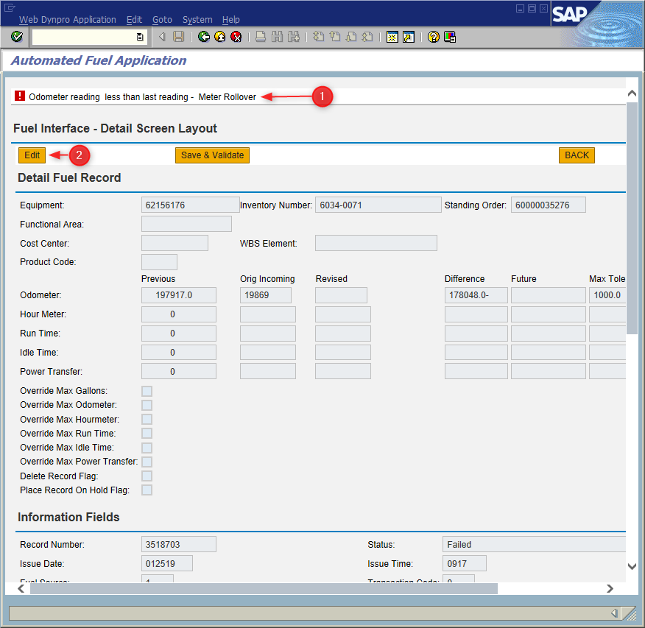
Window opens:
Automated Fuel Application
Fuel Interface – Detail Screen Layout
Review the error message at the top of the screen.
Tip: If the error cannot be corrected from within the Fuel Application, click the back button to return to the list of records.
<Click> Edit button
Tip: The editable fields will highlight.

Slide 13
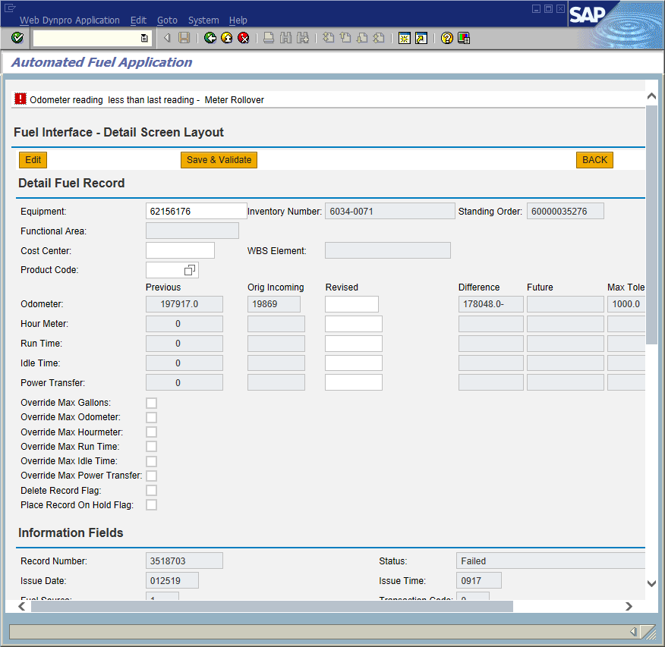
Window:
Automated Fuel Application
Fuel Interface – Detail Screen Layout
Input corrected data in the appropriate field(s) to correct the error.
<Click> Save & Validate button
<Click> Back button . The status value updates to “02.”
Repeat steps above as necessary
<Click> Exit icon
Tip: If the issue is corrected the message “Record Updated Successfully” will be displayed.

Slide 14
Important!
All unposted transactions for a vehicle must make sense before any of them validates, this may mean that you view all the transactions for that vehicle for a period, revise one or more odometer entries for the problem vehicle, and then click back through all admissions with errors to validate them. This is especially true if you have lots of outstanding entries for the same vehicle. They must ALL make sense.

Slide 15
Questions
Email: Stephen.Wright@dpi.nc.gov

Slide 16
Thank You!
Stephen Wright
DPI Technical Consultant

