Slide 1
Two methods to observe tutorial
Standard Method
This method allows presentation to be resized to user preference.
Slide Show Method (Example below)
Presentation fills entire screen
Click on Slide Show tab at top of screen
Click icon <From Beginning>
Note: Either method; to advance click the progression arrow in the bottom right corner of each slide or press the down-arrow key.

Slide 2
Welcome to
BSIP 101
Transaction Procedures
Annual Inventory
Step 1
Create Phys Inv Docs
Instructor: Stephen Wright DPI Technical Consultant

Slide 3
Purpose: Create Phys Inv Doc(s) for multiple materials in LEA’s plant & storage locations

Slide 4
Inventory documents may be created and printed prior to the count date; however, the posting block should not be set until the day of the actual physical inventory count.

Slide 5
One transaction is required to complete this procedure:
MI31
Let’s get started -

Slide 6
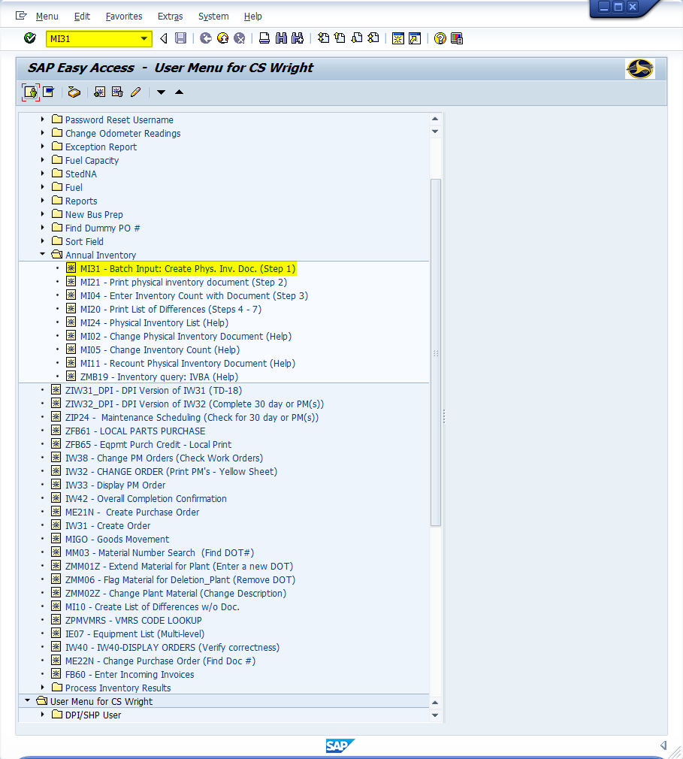
Window:
SAP R/3 Easy Access
Input MI31; or
Favorites menu, <Select> transaction MI31 – Batch Input: Create Phys. Inv. Doc.

Slide 7
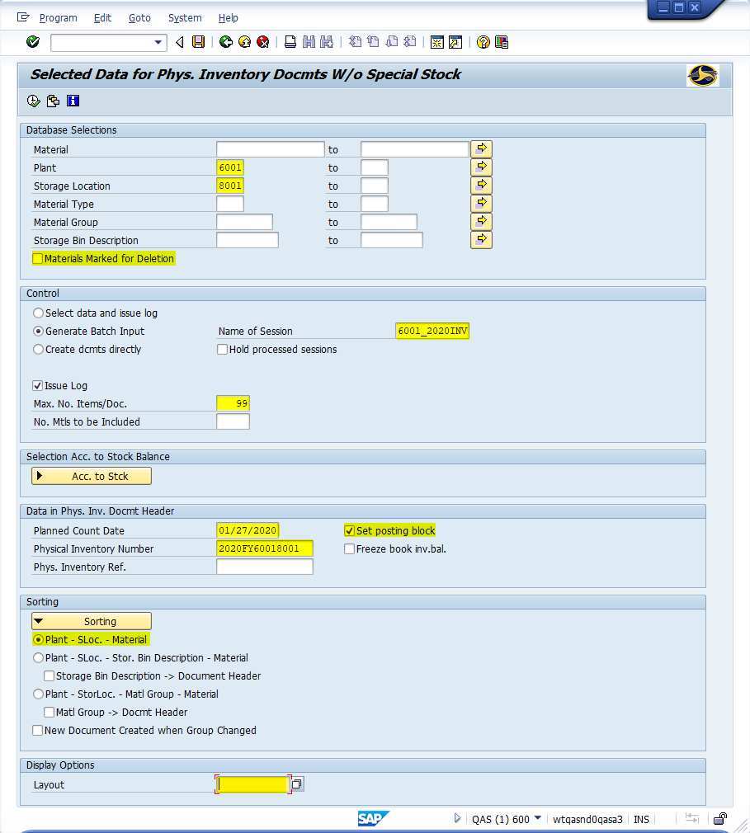
Window opens:
Selected Data for Phys. Inventory Documts W/o Special Stock
Database Selections Section
Plant Field = Input four-digit code (i.e., Alamance = 6001)
Storage Location Field = Input four-digit code (i.e., Alamance = 8001)
Materials Marked for Deletion Field – <Uncheck> (Default is checked)
Control Section
Name of Session Field – Remove default name “MB_101” and rename to a unique name. (i.e., 6001_2020INV)
Max. No. Items/Doc. Field –
99 - Main Storage Location
300 - Truck Storage Location

Slide 8
Window:
Selected Data for Phys. Inventory Documts W/o Special Stock
Data in Phys. Inv. Docmt Header Section
Planned Count Date Field – Input the actual date of inventory count.
Physical Inventory number Field – Input the fiscal year followed by plant number and storage location. (i.e., 2020FY60018001)
Set Posting Block Field –
Check if count is immediate
Leave blank if creating docs beforehand

Slide 9
Window:
Selected Data for Phys. Inventory Documts W/o Special Stock
Sorting Section
<Click> Sorting Button
<Select>
Plant – SLoc. – Material (List sorted by material number)
OR
Plant – SLoc. – Stor. Bin Description – Material (List sorted by storage location)
Display Options Section
Layout Field – Blank field (Erase any variants)
<Click> Execute Icon

Slide 10
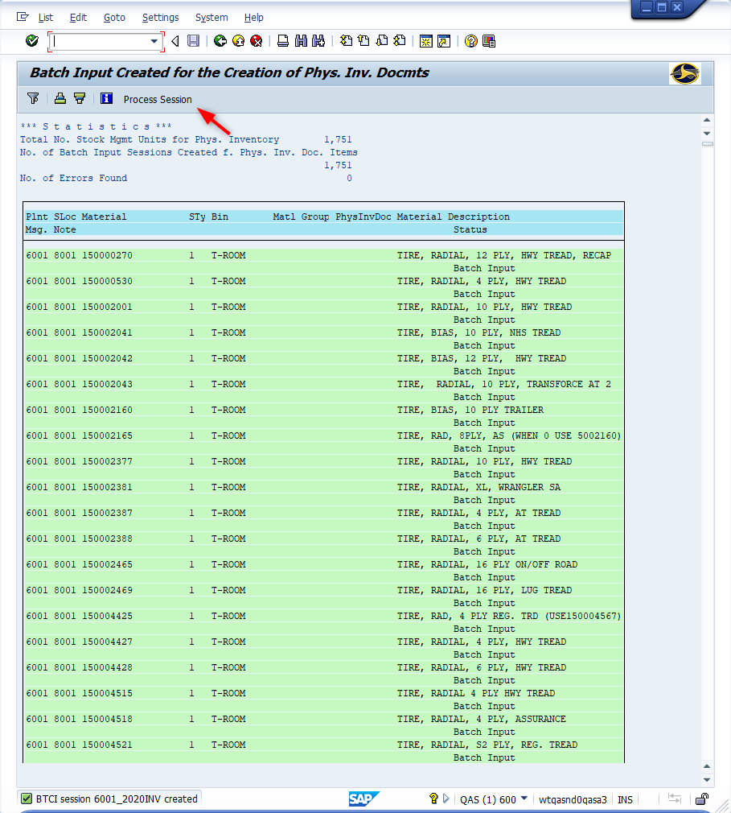
Window Opens:
Batch Input Created for the Creation of Phys. Inv. Docmts
<Click> Process Session Button

Slide 11
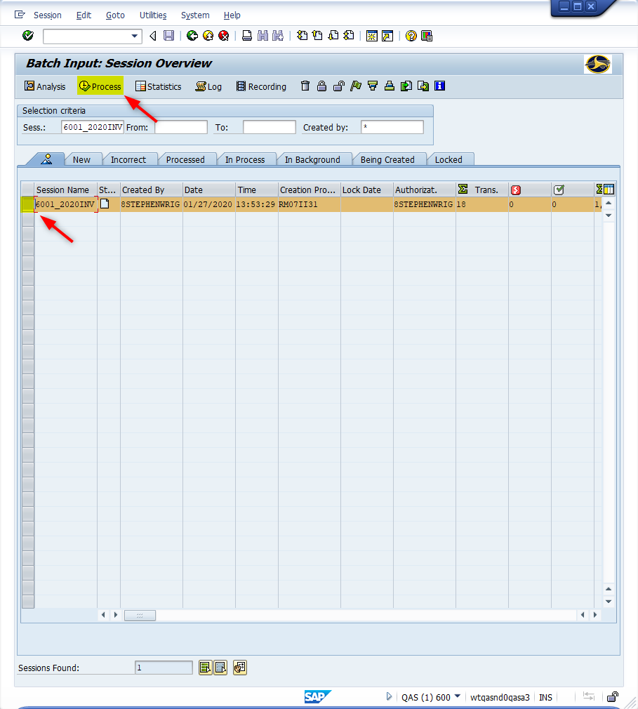
Window Opens:
Batch Input: Session Overview
<Click> Select icon to the left of the {session name} (This will highlight the row)
<Click> Process Button

Slide 12
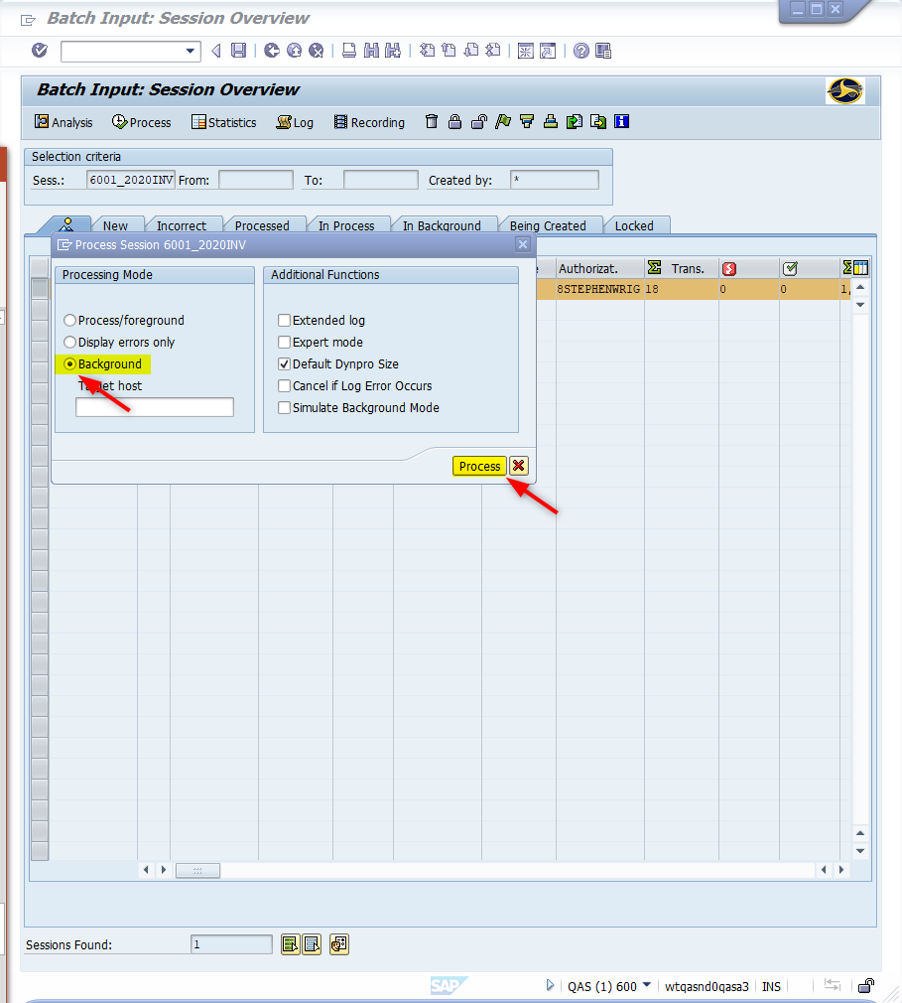
Window Opens:
Batch Input: Session Overview
Process Session {Session Name}
<Click> Background Radio Button
<Click> Process Button
Tip: The system requires approximately 5+ plus minutes to process a batch session. Please allow this time before continuing to the next step (Better to err on to much time versus to little).

Slide 13
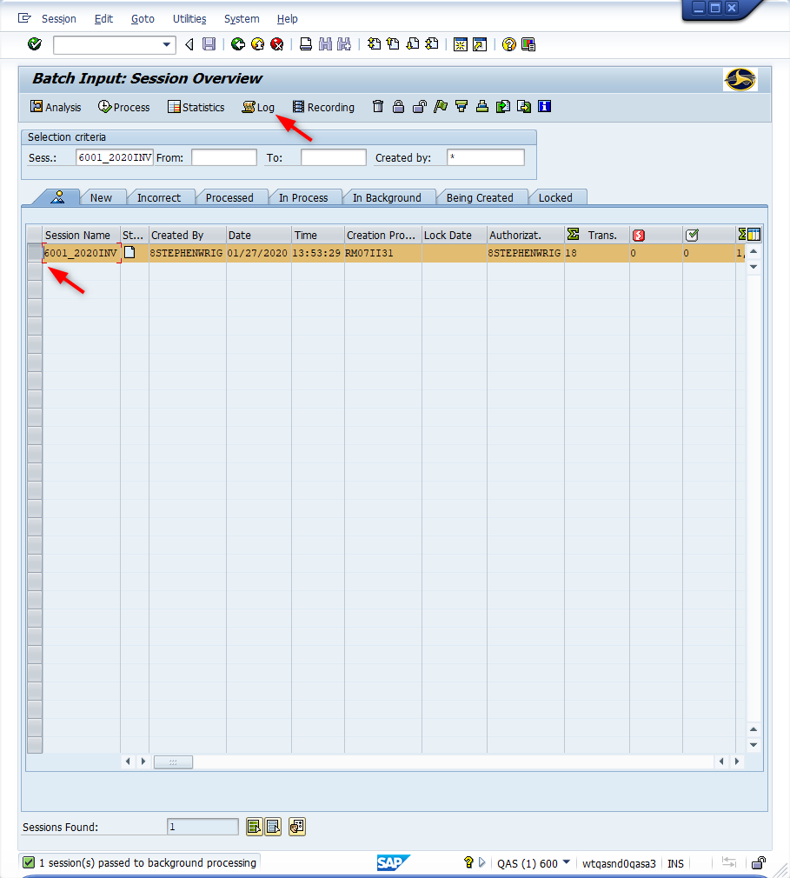
Window Opens:
Batch Input: Session Overview
<Click> Select icon to the left of the session name. (This will highlight the row)
<Click> Log Button

Slide 14
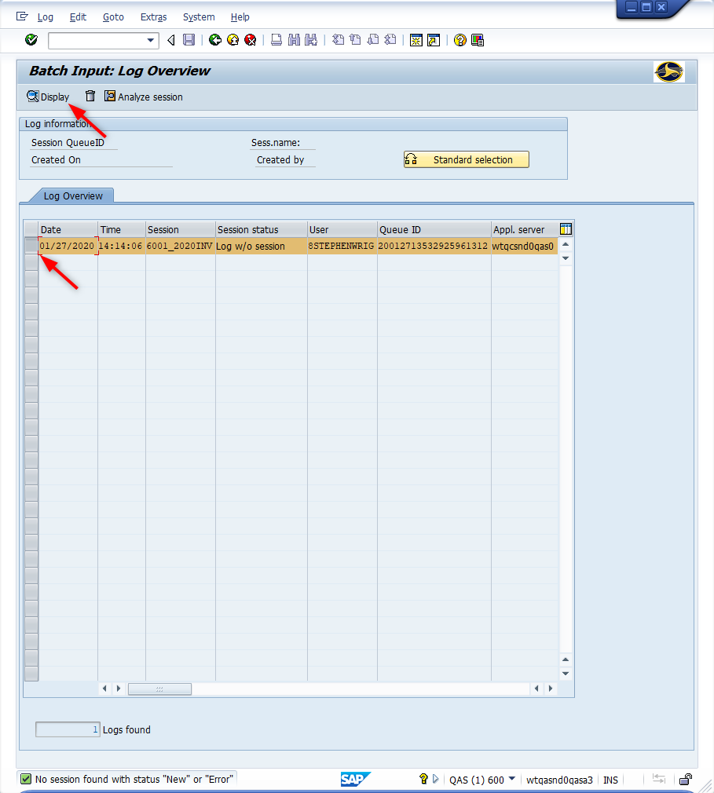
Window Opens:
Batch Input: Log Overview
<Click> Select icon to the left of the session name. (This will highlight the row)
<Click> Display button

Slide 15
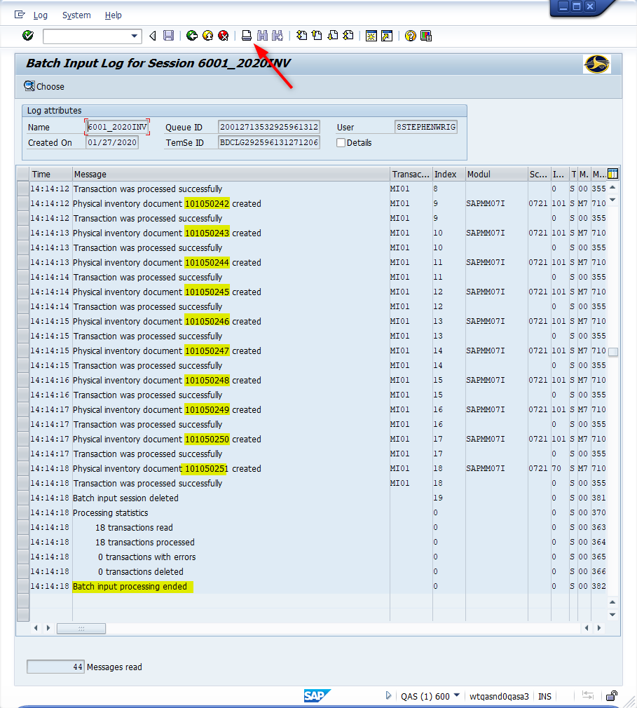
Window Opens:
Batch Input Log for Session {Session Name}
Tip: If the batch processing is completed the last line in the Message column should read “Batch input processing ended”. If this message does not appear on the last line adequate time was not provided for the batch process to be viewed. SAP continues the batch processing in the background. Use Transaction MI24 to retrieve a complete list of Physical Inventory Documents created.

Slide 16
Window:
Batch Input Log for Session {Session Name}
<Record> Physical Inventory Document Numbers (They are needed to print the inventory documents)
<Click> Print icon
<Review> Log for errors
A material master record being blocked for updates at the time of processing may cause errors. Note any material errors and add the materials to one of the existing physical inventory documents using Transaction MI02.
<Click> Exit icon

Slide 17
Questions
Email: Stephen.Wright@dpi.nc.gov

Slide 18
Thank You!
Stephen Wright
Technical Consultant

