Slide 1
Two methods to observe tutorial
Standard Method
This method allows presentation to be resized to user preference.
Slide Show Method (Example below)
Presentation fills entire screen
Click on Slide Show tab at top of screen
Click icon <From Beginning>
Note: Either method; to advance click the progression arrow in the bottom right corner of each slide or press the down-arrow key.

Slide 2
Welcome to
BSIP 101
Transaction Procedures
Annual Inventory
Display Multiple
Phys Inv Docs
Instructor: Stephen Wright DPI Technical Consultant

Slide 3
Purpose: Use this transaction if you forget to record your inv doc numbers or if your SAP session times out or you get logged off the system while MI31 is processing.

Slide 4
Note: Physical Inventory Item must not have been posted

Slide 5
Note: This will NOT allow you to enter the initial count of an item. It will only change an existing count.
To enter the initial item count of a material use Transaction MI04 (Step 3).

Slide 6
One transaction is required to complete this procedure:
MI05
Let’s get started -

Slide 7
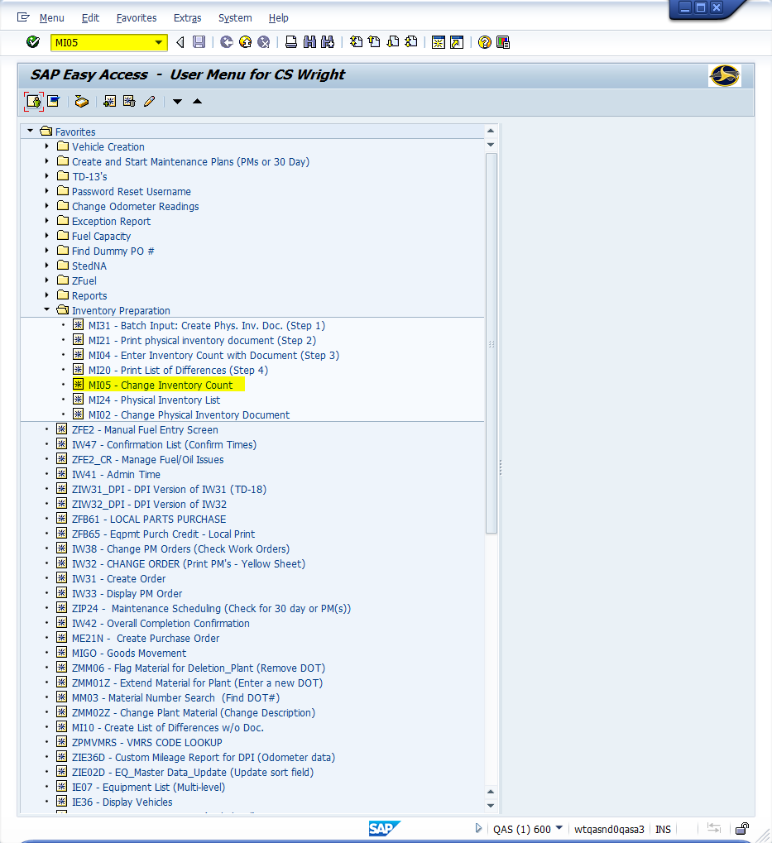
Window:
SAP R/3 Easy Access
Input MI05; or
Favorites menu, <Select> transaction MI05 – Change Inventory Count

Slide 8
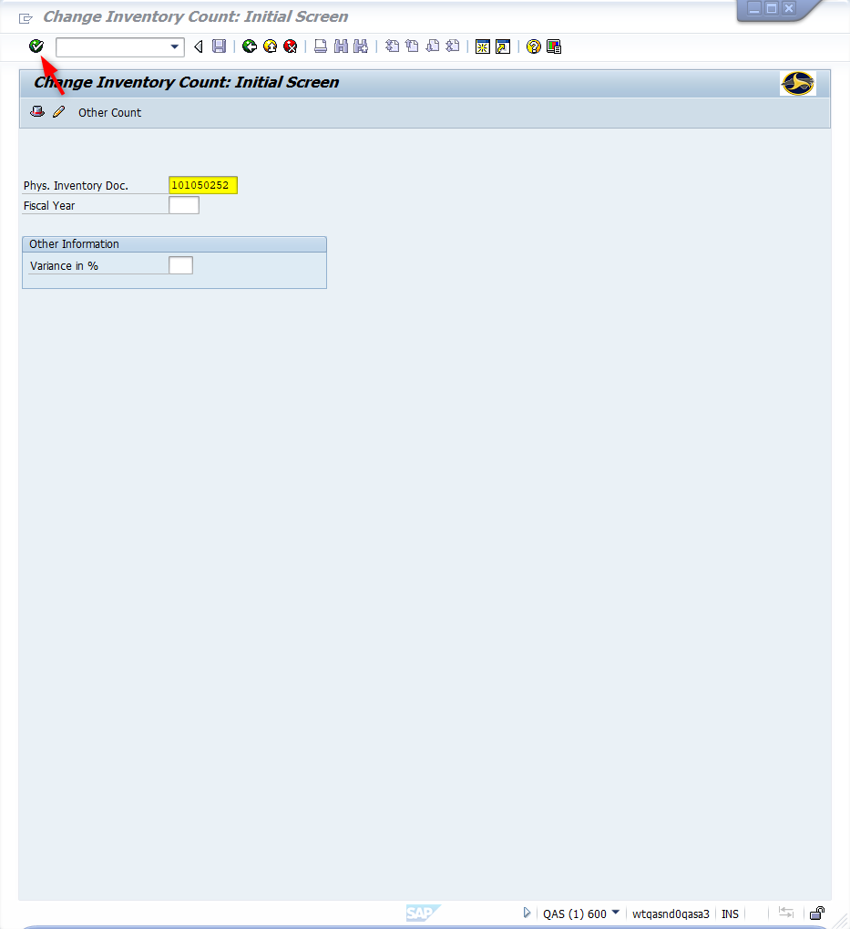
Window opens:
Change Inventory Count: Initial Screen
Physical Inventory Document Field - Input the physical inventory document number of the document to be changed
<Click> Continue icon

Slide 9
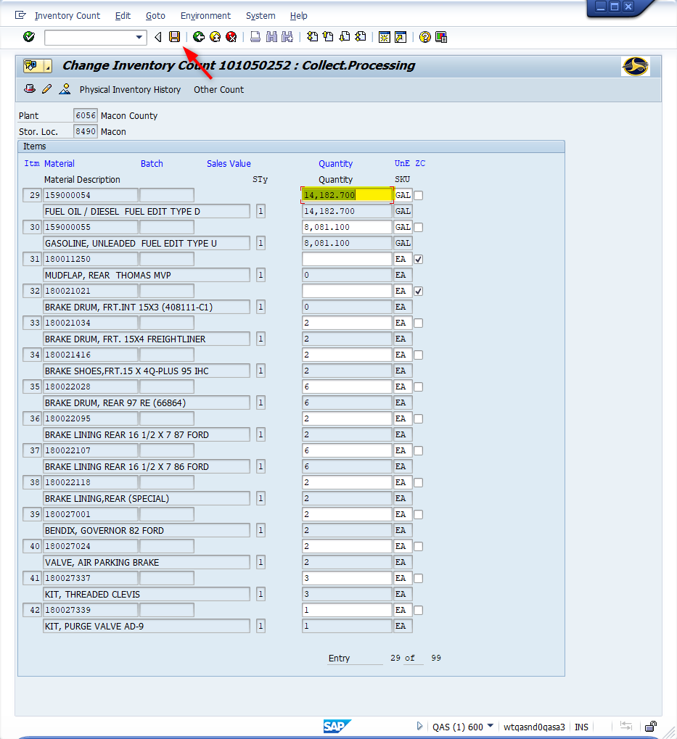
Window opens:
Change Inventory Count {Phys Inv Doc ID}: Collect. Processing
Quantity Column Fields – Input correct inventory count of items to change. Do NOT enter a zero in these fields.
ZC (Zero Count) Column Fields - <Check> the box if the item count is Zero. SAP recognizes a “0” count as blank and it is not counted unless the checkbox indicator is active.
Tip: Repeat steps above as necessary. <Page-down> to advance. <Page-up> move backwards.

Slide 10
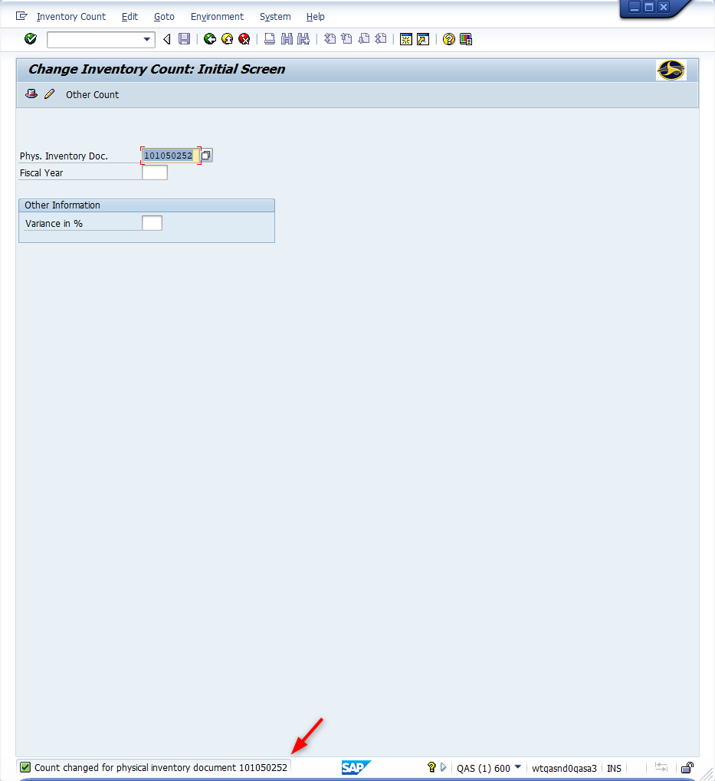
Window opens:
Change Inventory Count: Initial Screen
<Click> Save icon
Tip: The message displays in the bottom status bar: “Count changed for Physical Inventory Document {Phys Inv Doc ID}”
Tip: Repeat for all Physical Inventory Documents as needed
<Click> Exit icon
Tip: Repeat Step 4 (MI20) to verify all changes are complete and nothing remains incorrect.

Slide 11
Questions
Email: Stephen.Wright@dpi.nc.gov

Slide 12
Thank You!
Stephen Wright
Technical Consultant

