Slide 1
An Equity-driven Approach for School Zone Safety to Inform Safe Routes to School (SRTS) Programs
Major Updates: Crash Analysis and Education Program
Mouyid Islam, PhD
Shuchi Deb, PhD
Monday, January 10, 2022
School Transportation, Convention center

Slide 2
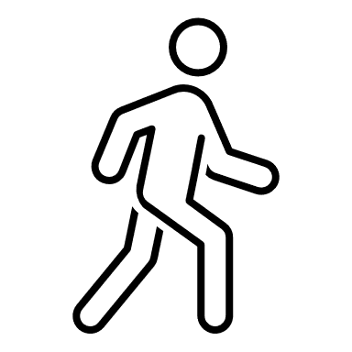




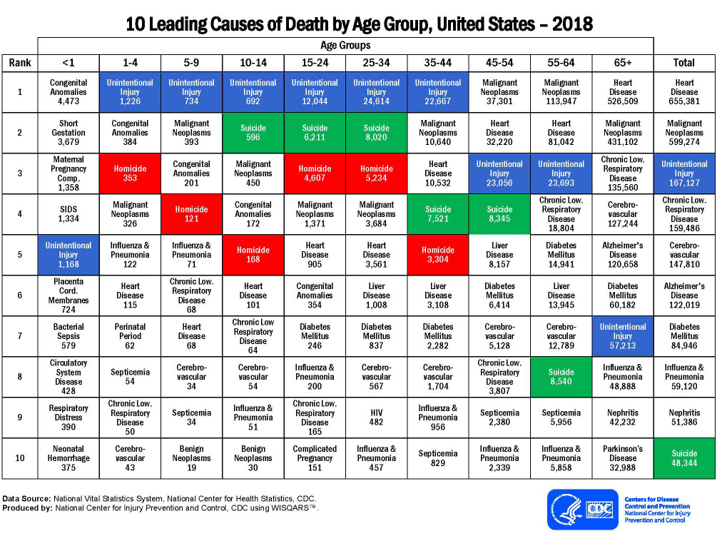

Rational – Research Motivation
School-age children account for nearly one-fifth of the total pedestrian fatalities. (Dangerous by Design, 2019)
5-11
Over 52% school-age pedestrians, killed in school transportation-related crashes, belong to the age group of 5-10 years. (NHTSA, 2020)
12-14
15-19
Demo-
graphics
Actions and Locations
Vehicle Type and Maneuvers
Roadway Attributes
Education Program
Equity

Slide 3




Study Approach
Safety Analysis
(DFW & TB)
Engineering
Enforcement
Emergency Medical Services
Education

Slide 4
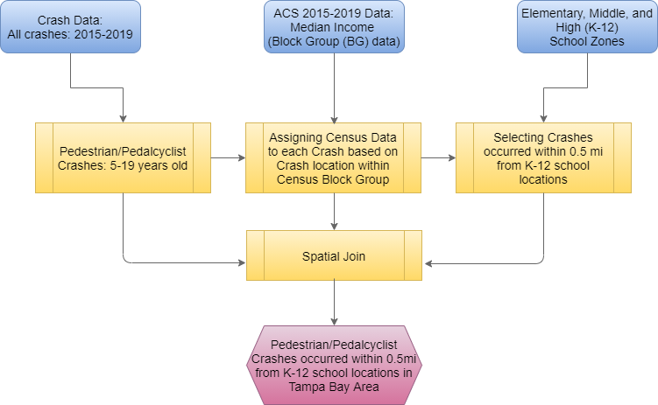
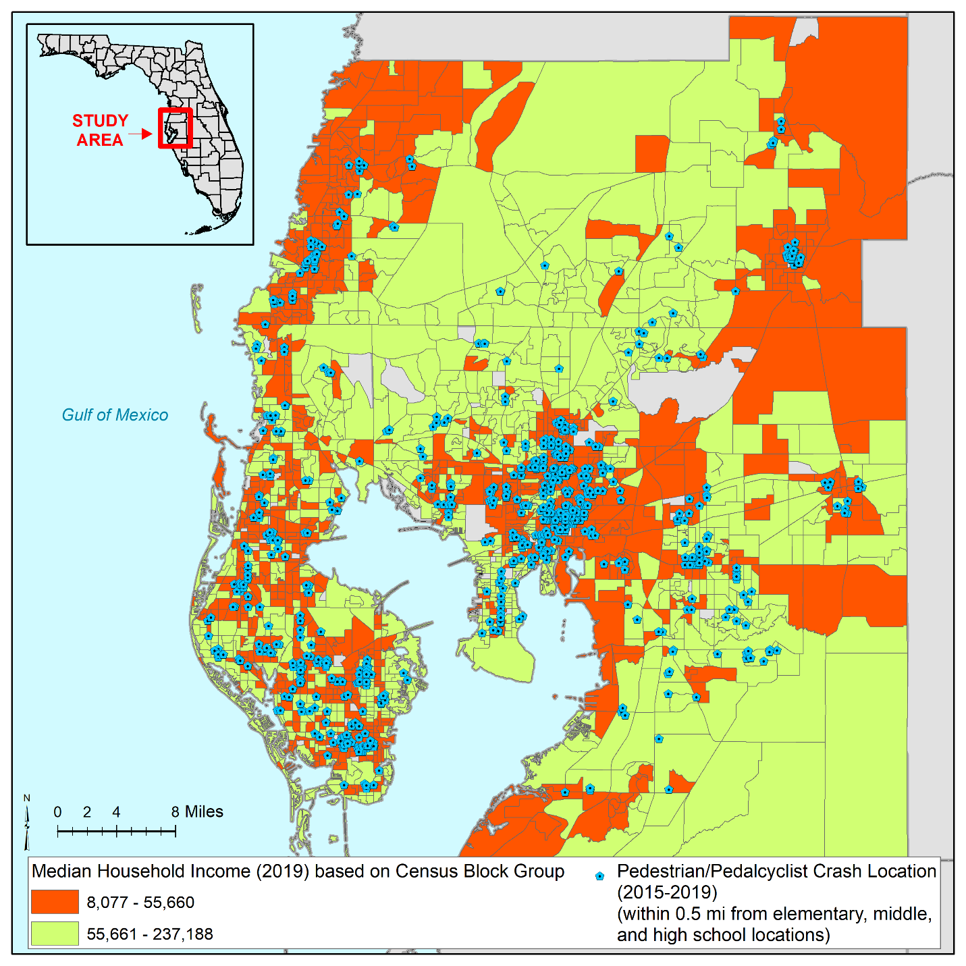
Study Approach
Spatial Distribution of Pedestrian and Pedalcyclist Crashes in Tampa Bay Area in Florida
nearby the Elementary, Middle, and High Schools (2015-19)
N = 778
Crash Data:
Data Source: CAR
Analysis Period: 2015-19
Study Area: Tampa Bay
(Hillsborough, Pasco, Pinellas)
Analysis Focus: Injury Severity (KABCO)
Severe = KA
Moderate = B
Minor = CO

Slide 5
Safety Analysis

Slide 6
Safety Analysis

Slide 7
Safety Analysis

Slide 8
Safety Analysis

Slide 9
Differences in Crashes analysis: Roadway attributes
Traffic Control: DFW vs TB
Factors | Crash by percentage
 | Most frequent | Most severe
Road-way type | Undivided Road DFW: 50.5% TB: 77.1% | Undivided Road DFW: 58.2% TB: 71.7%
Traffic control | No Control DFW: 41.8% TB: 56.7% | No Control DFW: 49.5% TB: 60.6%
Vehicle type | Passenger Vehicle DFW: 56.6% TB: 64.8% | Passenger Vehicle DFW: 55.8% TB: 64.5%
Speed limit | 30-45 mph DFW: 84.2% TB: 58.5% | 30-45 mph DFW: 83.0% TB: 71.4%
Weather | Clear DFW: 77.7% TB: 85.4% | Clear DFW: 73.2% TB: 87.1%
Speed Limit: DFW vs TB
Number of Lane: DFW vs TB

Slide 10
Education Program Development: Scenarios (VR)
Scenarios for the Dallas-based Training Module
1. Road-way type Undivided 2. Number of lanes 2 and 4 3. Traffic control No control Traffic signal 4. Speed limit (mph) 20 and 45 5. Traffic volume 25,000 to 50,000 vehicles/day | 6. Weather Clear 7. Pedestrian location Marked crosswalk Unmarked crosswalk Midblock 8. Pedestrian action Crossing Waiting to cross 9. Obstacles Parked car Bushes/trees School bus

Slide 11
Education Program Development: Scenarios (VR)
Scene | Vehicle Speed (mph) | Crosswalk Position | Crosswalk Type | Traffic Control
“Start Game” | --- | --- | --- | ---
Level 1 | 20 | Intersection | Marked | Present
Level 2 | 20 | Midblock | Unmarked | Absent
Level 3 | 20 | Intersection | Unmarked | Present
Level 4 | 20 | Intersection | Unmarked | Absent
Level 5 | 45 | Intersection | Marked | Present
Level 6 | 45 | Midblock | Unmarked | Absent
Level 7 | 45 | Intersection | Unmarked | Present
Level 8 | 45 | Intersection | Unmarked | Absent
“Complete” | --- | --- | --- | ---

Slide 12
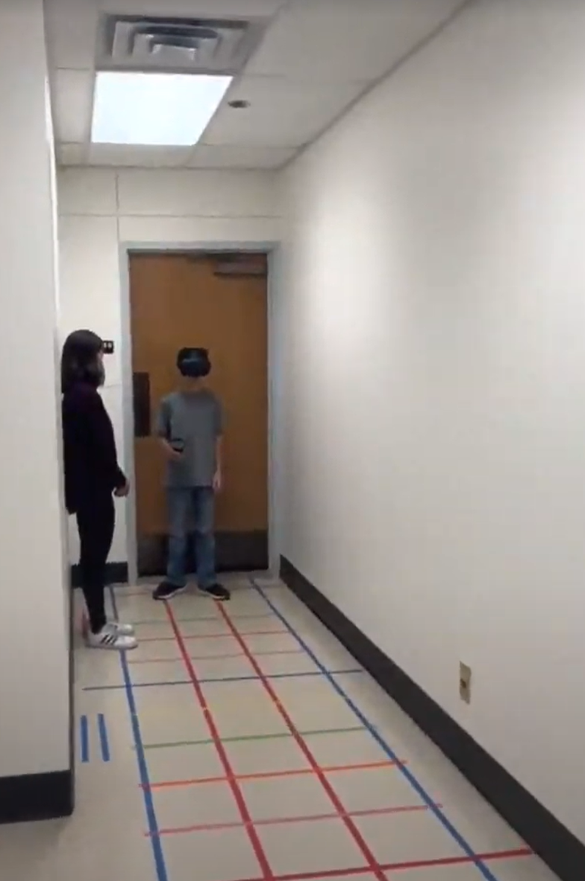
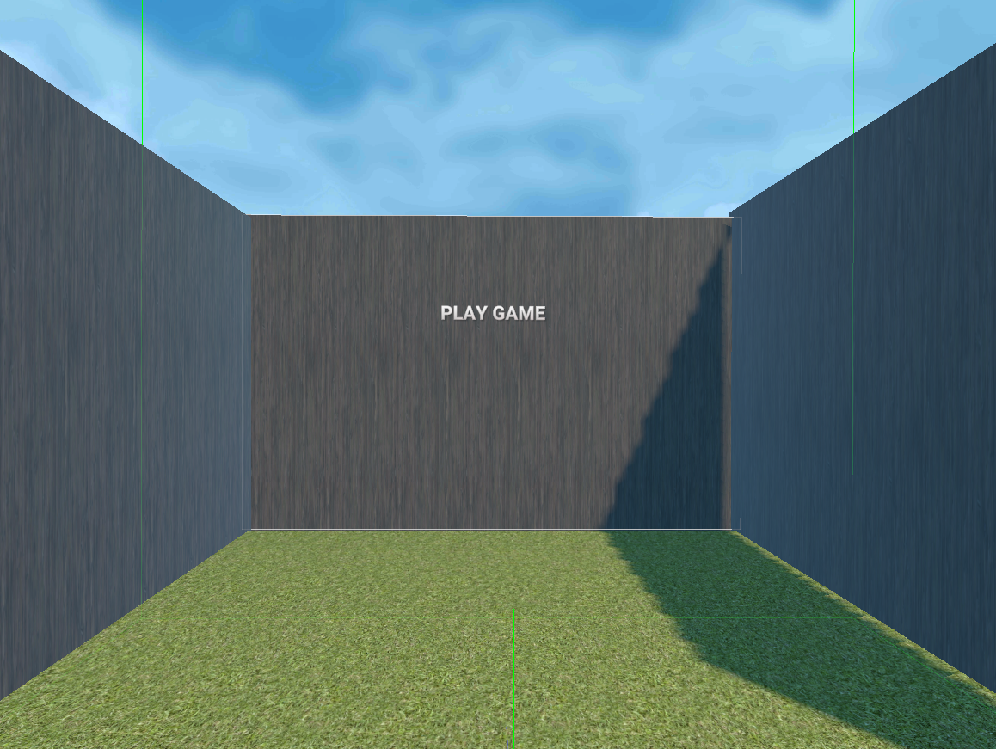
Education Program Development: Training Procedure
Step 1
  The player will enter the "Playground," a 30 ft. long free floor space in the lab.
  They will stand on a designated area to stand and start the game.
  They will wear the HMD and take the Right-Hand Controller.
  Step 2
    The player will discover them in a virtual room with a "Play Game" button in front.
    Pressing the "Play Game" button, they will be on the edge of a street facing a crosswalk.

Slide 13
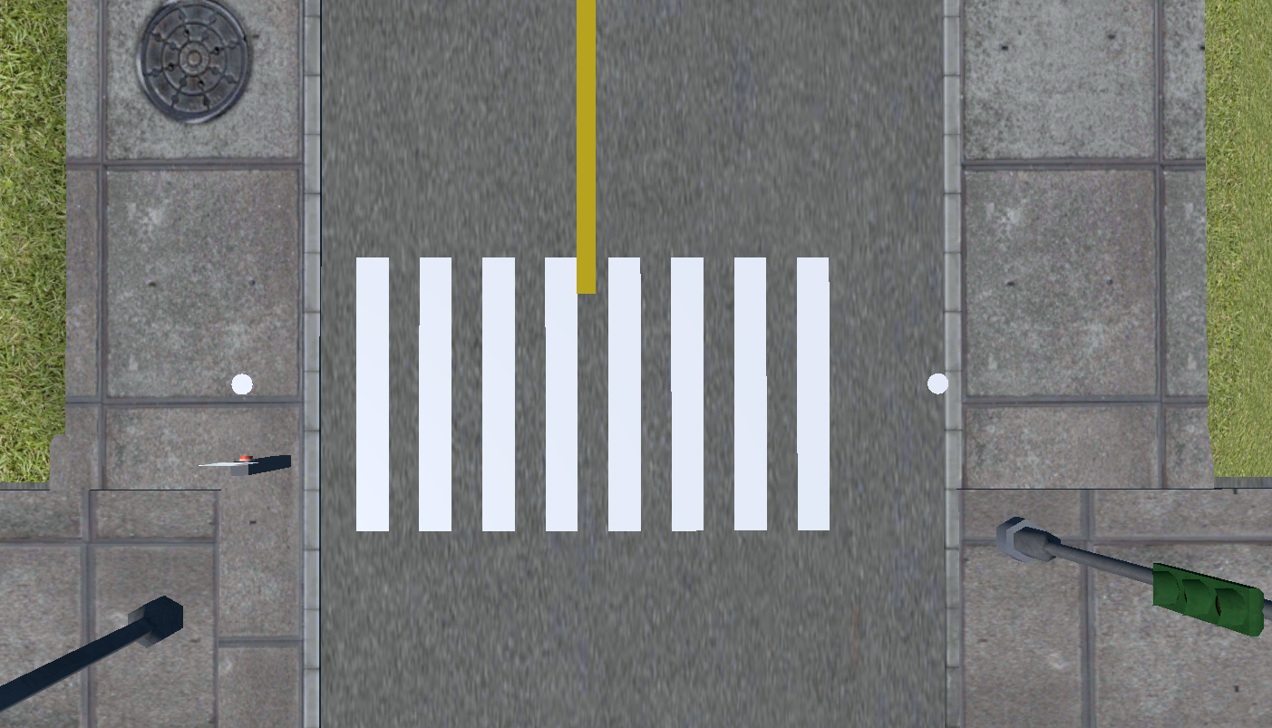
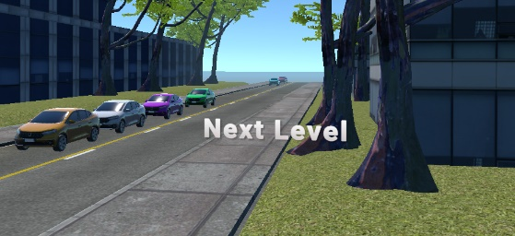
Education Program Development: Training Procedure
Step 3
  There are two white dots on the street: "Start Point," and "End Point". Player starts the game from the "Start Point.
  Player will observe the surrounding and attempt to cross the street to reach the “End Point”.
  Step 4
  At End Point, the player will turn around (180 degrees) and see a button called "Next Level" across the street.
Step 5
  The player will repeat Step 3 and Step 4 until they complete all levels.
  When the player completes all eight levels, they will see a virtual room with a "Complete" button in front.
  If the player presses the "Complete" button, the study will end for this player and will be ready for the next player to play.

Slide 14
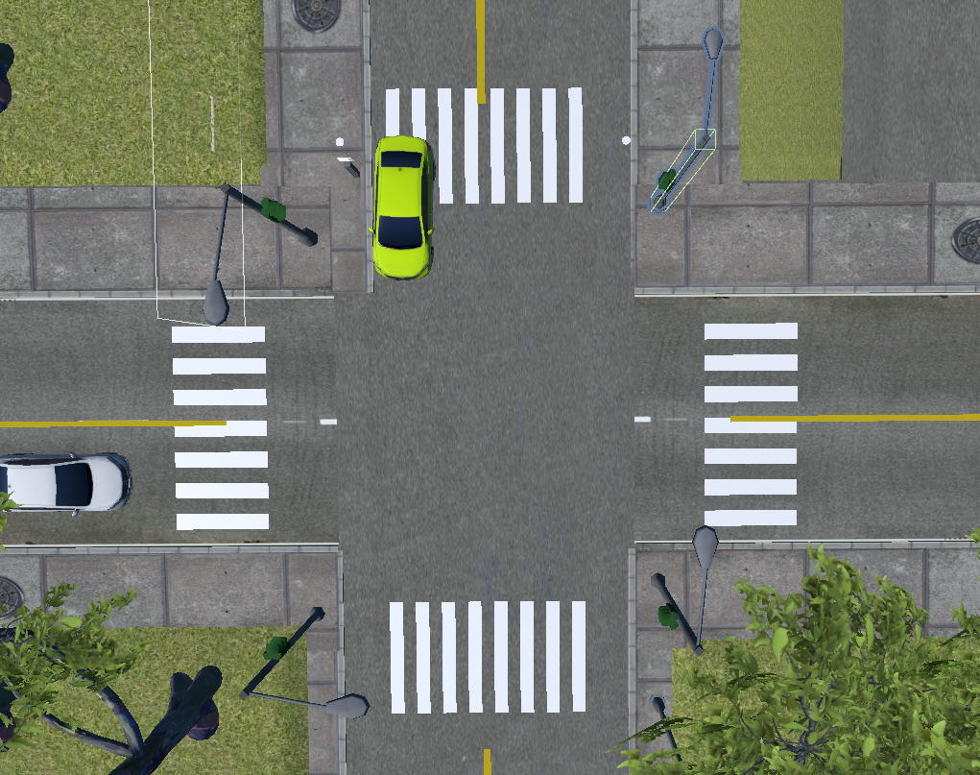
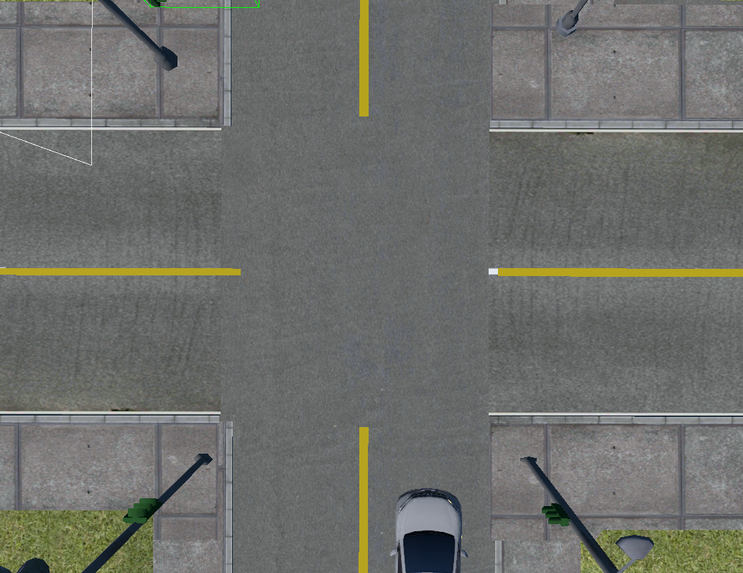
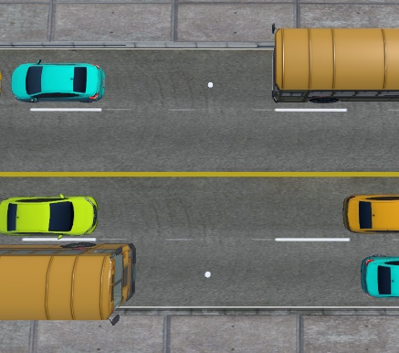
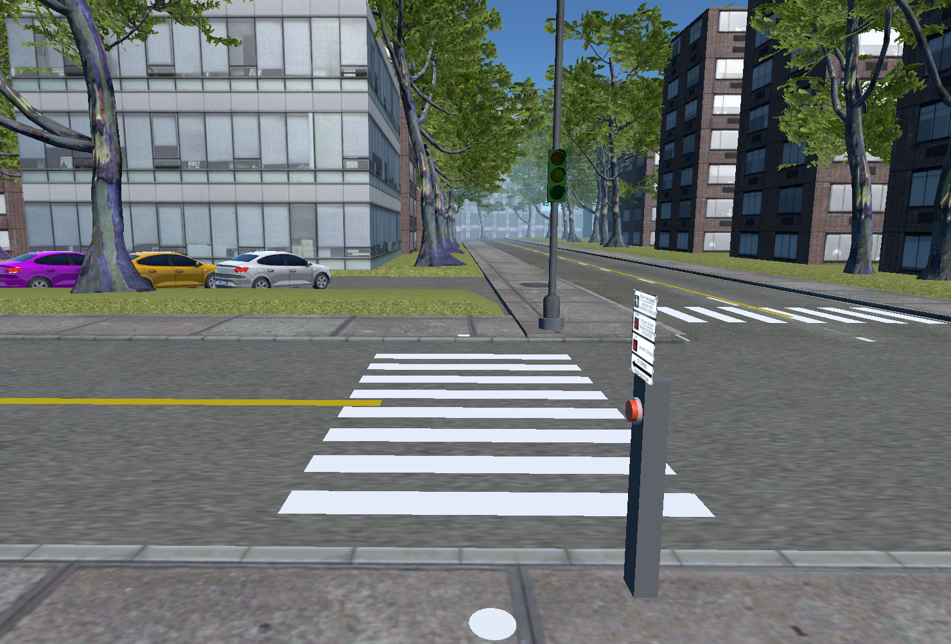
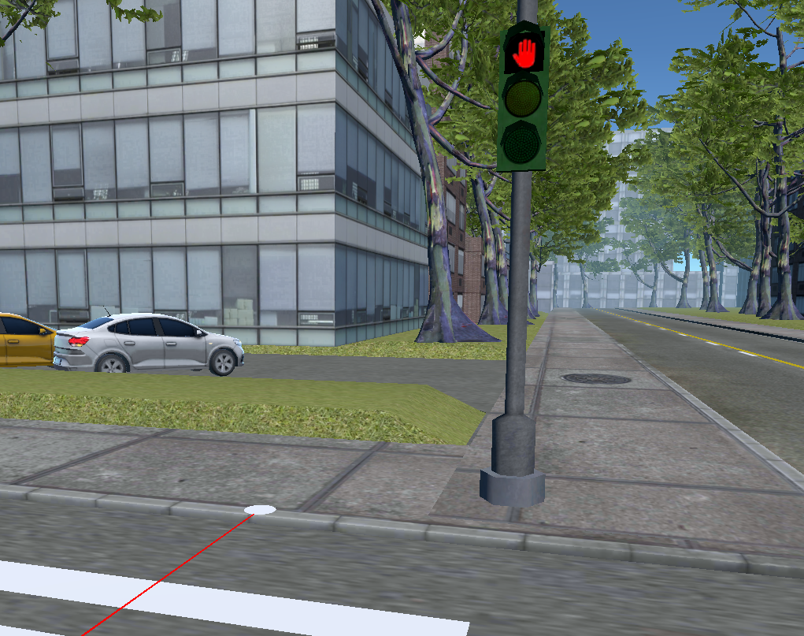
Education Program Development: VR(HMD) - Plan VIEW
(a) Marked Crosswalk (b) Unmarked Crosswalk (c) Midblock Crossing
(d) Pedestrian push-button (e) Pedestrian lights

Slide 15
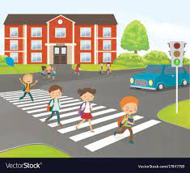






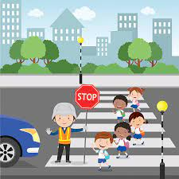


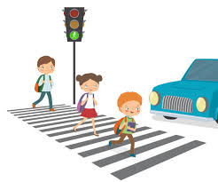
Conclusions (Recommendations: education)
Education Video

Slide 16
Questions?
mislam@vtti.vt.edu
540-231-5022

