Slide 1
TRB ACS10 Research Updates

Slide 2
ACS10: Research Problem Statements Update
Recent/Current Successes:
NCHRP 17-96: Traffic Safety Culture Research Roadmap (In progress – UNC Chapel Hill)
NCHRP 17-101: Applying the Safe System Approach to Transportation Planning, Design, and Operations in the United States (Pending)
NCHRP 17-109: Crash Modification Factors (CMFs) for Automated Traffic Signal Performance Measures (ATSPMs) (Anticipated – supported by ACS10)
Recently Submitted/In-Progress Problem Statements
“Practical Approaches to Quantifying Safe System Concepts” – NCHRP (under review)
“Institutionalizing Safe Systems and Safety Culture in the Transportation Planning Process” – NCHRP (under review)
“Pedestrian Safety Measures Along Streets and Highways” – BTSCRP (under development – supported by ACS10)
Developing Research Needs Statements
Potential funding sources: NCHRP, NCHRP Synthesis, TCRP, BTSCRP, AAA Foundation for Traffic Safety, others..
Coordination with AASHTO Committee on Safety:
~April 1: Research ideas due to the AASHTO Safety research subcommittee (brief write-ups of research ideas)
August 27: Full research problem statements due to the AASHTO Safety research subcommittee
November 1: final deadline to submit to NCHRP

Slide 3
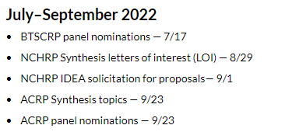
Transportation Research Board Cooperative Research Programs - Key Dates
https://www.nationalacademies.org/trb/programs/cooperative-research-programs

Slide 4
ACS10 Strategic Plan
Goals:
Goal 1: Advance and implement Safe Systems research
Goal 2: Identify and promote other emerging trends/innovations in transportation safety
Goal 3: Collaborate with transportation safety organizations
Goal 4: Foster organizational growth within the committee
Focus Areas
Focus Area 1: Communication & Collaboration
Focus Area 2: Research
Focus Area 3: Member Involvement & Process Documentation

Slide 5
Tactic 1: Develop research implementation plan
Include separate tracks for research paper review and RNS development/coordination
We’ve already moved in this direction
Include feedback loop on RNS success/failure
Track implementation
Provide good examples for what successful implementation looks like
Keep website updated with RNS/Project status/results

Slide 6
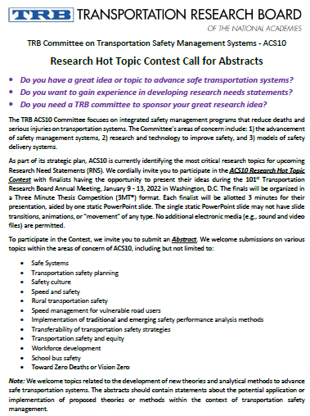
Tactic 2: Hold annual research hot topic contest
Implemented for the first time for 2022 Annual Meeting
Call for abstracts sent out in early October
16 submissions received
Based on initial reviews, 5 selected for presentation (3MT format) at ACS10 Committee Meeting
Develop into problem statements for submission

Slide 7
Tactic 3: Maintain a permanent research coordination team
The research coordination team will maintain the strategic research plan from year to year

Slide 8
Tactic 4: Develop annual research needs statements
Move from ad hoc process
Create formal requests/process for RNS submissions:
Discuss/schedule time at quarterly/midyear/annual meeting
Coordinate with timing of AASHTO committee
Potentially use hot topic contest as source for RNS

Slide 9
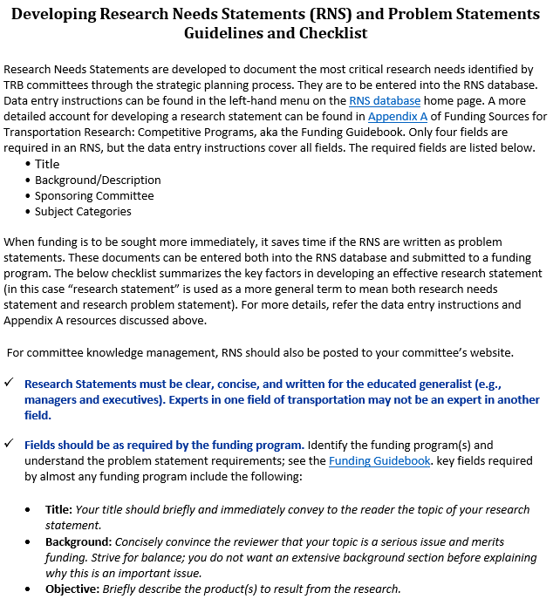
Tactic 5: Develop research needs statements ‘how-to’ guide
Primarily for committee members and friends outside of the research coordination team
TRB CRC Website has resources: https://sites.google.com/view/trbcrc/home
https://rppm.org/research-funding-guidebook/appendix-a-how-to-write-an-effective-research-statement/

Slide 10
Tactic 6: Conduct gap assessment of Safe System research transfer to practice
Which factors to address? – who’s involved, think about “5 Rs” framework, look to other countries, etc..
Working ACS10 Safe System definition:
“Safe System represents a coordinated, systems thinking- and science-informed approach to traffic safety. This approach treats safety as the foundational goal across all user contexts of the transportation system; recognizes humans possess known vulnerabilities and unique abilities to recognize patterns and navigate environments; and integrates equity and justice into a collaborative governance model of realizing a future without fatal or serious road injury.”
Survey regarding work and partnerships in road safety:
https://unc.az1.qualtrics.com/jfe/preview/SV_9o7JJqOejDLDjls?Q_CHL=preview&Q_SurveyVersionID=current

Slide 11
Questions/Discussion?
Feel free to reach out with any questions/comments: Brendan.russo@nau.edu

